Slide 1
Week00
Hans the Announcement Parrot
🦜
introduce class
introduce self
take roll
syllabus
type
whitespace
scope
success tips
fix Eclipse installs
NOTE: lecture is recorded and posted ~noon same day
NOTE: Homework00 is due on Monday
NOTE: Help Hours start on Monday

Slide 2
record lecture!

Slide 3
introduce class

Slide 4
what is CS 136?
a computer science major requirement 🎉
a bridge between coding and theory
about how you store data (HINT: in an array)
harder problems
bigger problems
good prep for coding interviews 💸
going beyond "it works" to different measures of "good"
speed 🦔
space 🐘
elegance? ✨

Slide 5
introduce self

Slide 6
[other slide deck]

Slide 7
take roll

Slide 8
take roll
this is the only time i will ever take roll
this is also the only time i will wear a coat 😢
please correct me if i mispronounce your name
if you are not yet enrolled, please fill out the other sheet now

Slide 9
syllabus

Slide 10
syllabus

Slide 11
syllabus
🚌

Slide 12
syllabus
🚌
🪟

Slide 13
the syllabus is online https://github.com/james-bern/CS136/wiki

Slide 14
grading

Slide 15
final grade
final grade is 1/3 homework, 1/3 midterm exam, 1/3 final exam
homework is on an A- (90), A (95), A+ (100) scale
A- is meant to be doable
A is meant to be challenging
A+ is meant to be a growth opportunity 🪴
i will go over some of your homework with you during lab and ask you questions about it 🙂👍
exams are in-person, on-paper, no-notes
questions are either similar to homework, or similar to PracticeExam
"if you understand the (A- and A) homework, the exam should be unsurprising and approachable"

Slide 16
😈 ChatGPT

Slide 17
ChatGPT can do every homework in this class up to an A level 😈 it is impossible for me to prove whether or not you used ChatGPT (people who say otherwise are wronggg)

Slide 18
so, ChatGPT, etc. are "allowed," but...
you are not allowed copy and paste code from anywhere
bad bad very bad don't do it
(unless i gave you the code then it's fine 🙂👍)
you can't use ChatGPT, etc. on exams
😈 "if your coding job can be done by an AI, then it will be done by an AI"

Slide 19
collaboration

Slide 20
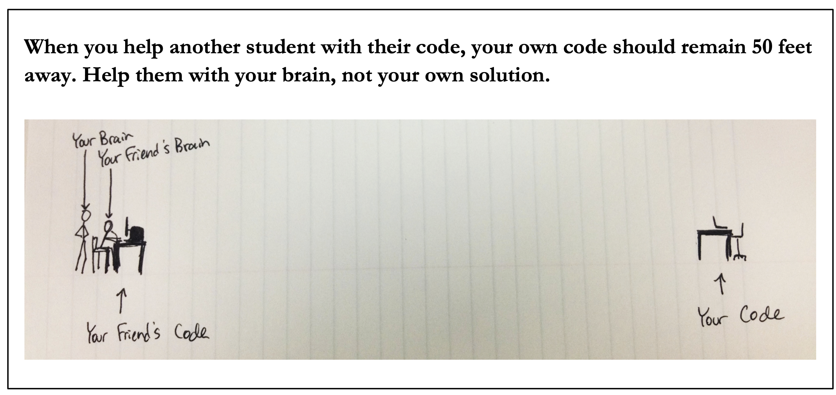
😈

Slide 22
Java

Slide 23
Java

Slide 24
☕️

Slide 25
this class is in Java

Slide 26
this class is in Cow.Java

Slide 27
which is basically C

Slide 28
by which I mean Java

Slide 29
type

Slide 30
type

Slide 31
a variable in Java has a type
# okay in Python
foo = 7 # foo is an int
foo = False # now, foo is a boolean
// NOT okay in Java
int foo = 7; // foo is an int
foo = false; // Error: incompatible types:
// boolean cannot be converted to int

Slide 32
declaring and initializing are separate things
// Option A: one line int foo = 7; // declare int foo and initialize it to 7
// Option B: two lines int foo; // declare a variable foo of type int foo = 7; // initialize foo to 7

Slide 33
primitive types

Slide 34
primitive types
in this class, "a variable being a primitive" means that the variable is a boolean, char, double, or int
primitive types are simple
primitive types are small
primitive types are NOT Objects
we will talk about Objects later
examples of Objects: String, MyCoolClass, int[] (array of ints)

Slide 35
boolean, char, double, int
a boolean stores a truth value
true, false
a char stores a character
'\0', 'a', 'Z', '!', '\n'
a double stores a real number
0.0, -0.5, 3.1415926, Double.NEGATIVE_INFINITY
an int stores an integer
0, -1, 4

Slide 36
primitive type Venn diagram
integers
numbers
char
double
boolean
int

Slide 37
char is an integer type
a char is an integer type
each char has a corresponding integer, for example ('a' == 97)
the letters are in order ('a' == 97), ('b' == 98), ('c' == 99)...
the numbers are also in order ('0' == 48), ('1' == 49)...
you can do math with char's
char foo = 'a' + 2; // foo is 'c'
char bar = '0' + 7; // bar is '7'
int baz = '6' - '0'; // baz is 6

Slide 38
zero
each primitive data type has its own notion of what it means to "be zero"
int zero = 0;
double zero = 0.0;
boolean zero = false;
char zero = '\0'; // the "null character"

Slide 39
whitespace

Slide 40
whitespace

Slide 41
whitespace
whitespace includes spaces, tabs, and newlines
🐍 Python does care about whitespace (indentation changes what code does)
☕️ Java does NOT care about whitespace (it cares about curly braces)
🗣️ do you care about whitespace?
some guidelines:
be consistent
make sure your curly braces line up
✨ use Eclipse's auto-indentation feature (see Tut00)! no excuses!
sparks joy | NOT equivalent -- doesn’t spark joy
for (int i = 0; i < 10; ++i) { if (i % 3 == 0) { System.out.println("fizz"); } } | for (int i = 0; i < 10; ++i) { if (i % 3 == 0) { } System.out.println("fizz"); }

Slide 42
scope

Slide 43
scope

Slide 44
scope
a scope is a region of code in which variables live
in Java, a scope is (usually) defined by a pair of curly braces
OUTER_SCOPE { INNER_SCOPE } OUTER_SCOPE
{
int i;
{
int j;
// you CAN use i here 🙆‍♂️
// you CAN use j here 🙆‍♂️
}
// you CAN use i here 🙆‍♂️
// you CANNOT use j here 🙅
}

Slide 45
common scope-related errors

Slide 46
cannot be resolved to a variable
Compile Error: foo cannot be resolved to a variable
class Main extends Cow {
public static void main(String[] arguments) {
if (...) {
int foo = 0;
} else {
int foo = 1;
}
PRINT(foo);
}
}

Slide 47
cannot be resolved to a variable
class Main extends Cow {
public static void main(String[] arguments) {
int foo;
if (...) {
foo = 0;
} else {
foo = 1;
}
PRINT(foo);
}
}

Slide 48
duplicate local variable
Compile Error: duplicate local variable foo
class Main extends Cow {
public static void main(String[] arguments) {
int foo;
if (...) {
int foo = 0;
} else {
foo = 1;
}
PRINT(foo);
}
}

Slide 49
duplicate local variable
class Main extends Cow {
public static void main(String[] arguments) {
int foo;
if (...) {
foo = 0;
} else {
foo = 1;
}
PRINT(foo);
}
}

Slide 51
success tips

Slide 52
success tips (1/3)
establish basic study habits (this might not have been necessary in highschool; it most likely is now)
start homework early! (very hard to code well while stressed)
don't work in a vaccuum
collaborate with your friends / acquaintences / enemies
come to help hours (they are there for you!)
code a lot (ideally, 5+ days per week)
if the homeworks are feeling too hard, talk to me; we have resources!
if the homeworks are too easy, do the A+ / A++; do side projects; just keep coding; code code code code code; COOOOOOOOODE

Slide 53
success tips (2/3)
try to find your own bugs
this is a huge skill; it takes time (and pain) to build
try to answer your own questions (using Google!) ("what does IDE stand for?"; "what does this error message mean?")
this is also a huge skill; it also takes time (and pain) to build
however, if you are stuck (>= 10+ minutes of pain), ASK FOR HELP
there is literally no judgement here; we all have different starting points; my only goal is for all students to get stronger and have fun 🙂👍
and, for what it's worth, i was a mechanical engineering undergrad and my first comp sci course was *terrifying* (though, eventually, fun)

Slide 54
most importantly though

Slide 55

you gotta push the button

Slide 58
come see me if you had trouble with Tut00 otherwise, see you in class on Monday 🌞

Slide 59
let's learn someting upsetting 🙂👍

Slide 60
7 % 3
2
R1
3
7
-
6
1

Slide 61
🐍 -7 % 3
☕️ MODULO(-7, 3)
☕️ -7 % 3
-2
R-1
3
-7
-7 - (-6)
= -7 + 6
= -1
+ 3 = 2
-
-6
-1
-1

Slide 62
%
x % y returns the remainder of (x / y) and is read "x modulo y"
int foo = 17 % 5; // 2 ("17 divided by 5 is 3 remainder 2")
☠ % probably doesn't do what you expect for negative numbers; if x can be negative, use Math.floorMod(x, y) instead
5 % 3 // 2
4 % 3 // 1
3 % 3 // 0
2 % 3 // 2
1 % 3 // 1
0 % 3 // 0
-1 % 3 // -1 WAIT WHAT 🤔
MODULO(-1, 3) // 2 🙂👍

Slide 63
MODULO(x, y)
MODULO( 5, 3) // 2
MODULO( 4, 3) // 1
MODULO( 3, 3) // 0
MODULO( 2, 3) // 2
MODULO( 1, 3) // 1
MODULO( 0, 3) // 0
MODULO(-1, 3) // 2
MODULO(-2, 3) // 1
MODULO(-3, 3) // 0
MODULO(-4, 3) // 2
MODULO(-5, 3) // 1
MODULO(-6, 3) // 0
MODULO(-7, 3) // 2

Slide 64
Week01
🦜
tips and tricks
operators
control flow
Cow.Java
WARMUP
foo = (2 * 5.0) - 1.0;
what type is foo?
what value is foo?
bar = (3 > foo);
what type is bar?
what value is bar?
char baz = 'A' + ('7' - '5');
what value is baz?

Slide 65
tips and tricks

Slide 66
"hot code replace failed" Eclipse message

Slide 67
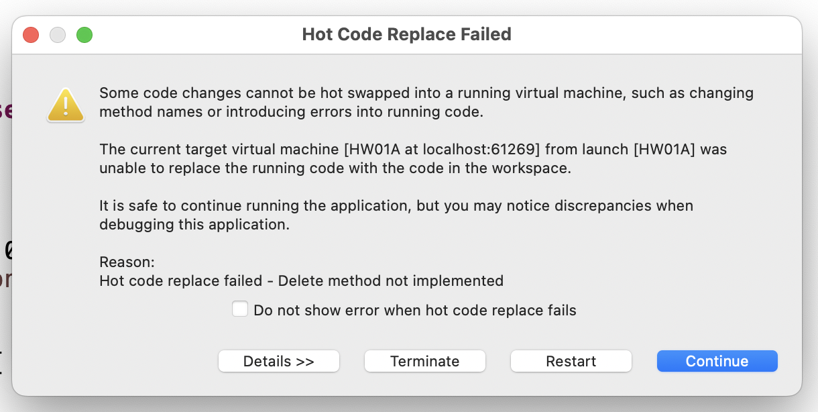
if you've been getting this error a bunch...

Slide 68
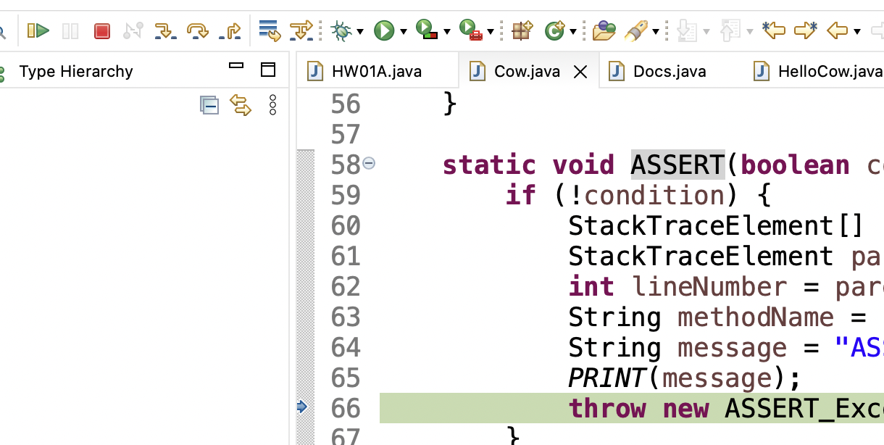
make sure you are pressing this button after every crash / failed assert (otherwise Eclipse keeps your program running, and will try to "hot swap" your changes into it)

Slide 69
you can also press this button (which, for us, does basically the same thing)

Slide 70
you can also just close Eclipse and reopen it if anything really weird happens 🤷

Slide 71
how to email jim

Slide 72
first, how to email not-jim
Subject Line: Question Regarding The Reading
Email Body:
Dear Prof. Dr. Professorson Ph.D Exquire,
I hope you are having a wonderful afternoon; that the morning sun is shining upon you this fine evening, and that you do not feel the quiet whisper of the all-consuming Void chilling you to your very core.
I am writing because I am unclear on the assigned reading for tomorrow. Your very, very helpful syllabus says to read pages 300 – 500 of Beowulf, however the book is, it seems, much fewer than 500 pages long.
Thank you so much for your help with this matter. I appreciate the time you take in supporting me in my studies—I could not do this without you.
Sincerely,
James Bern
Caltech '15

Slide 73
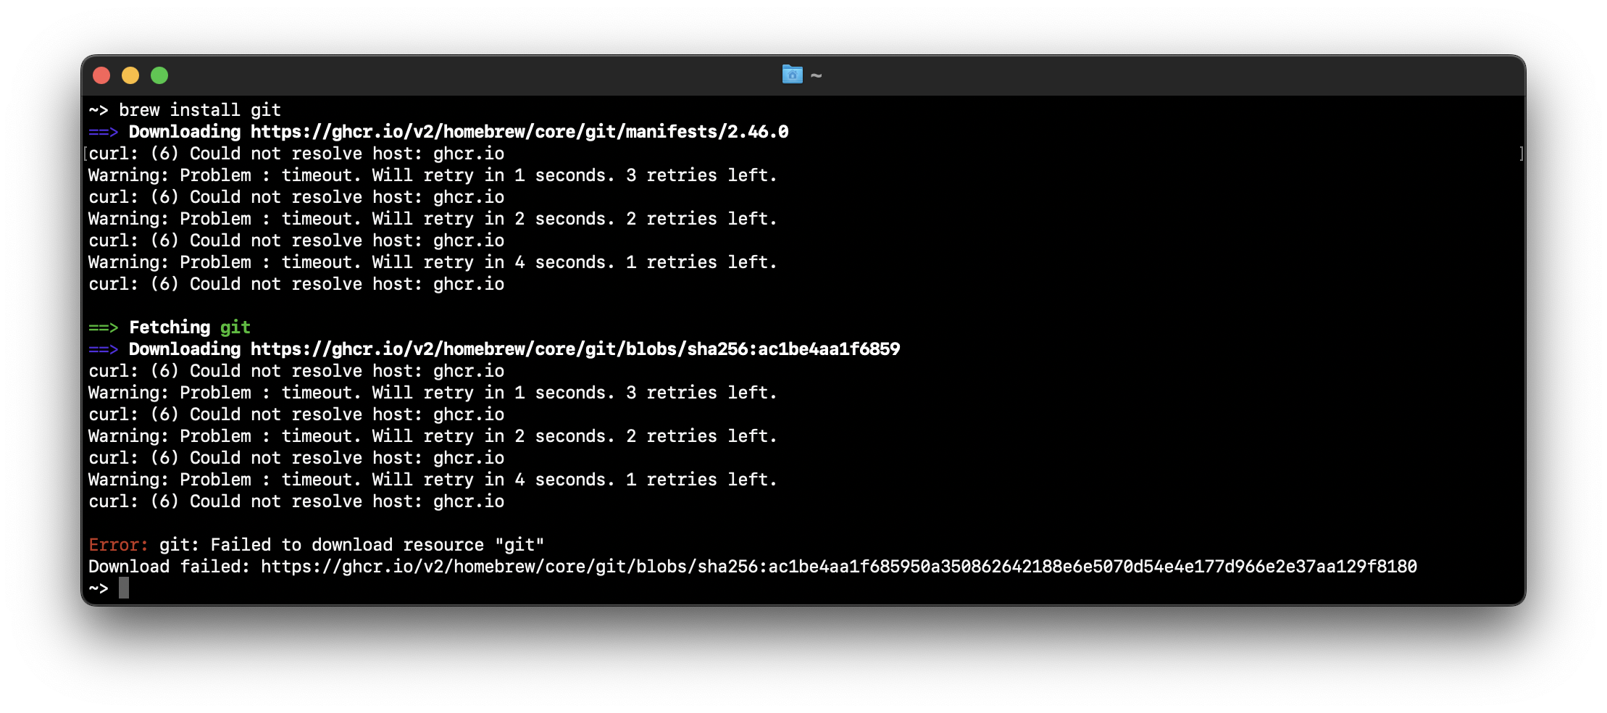
how to email jim
Reply to Q + A Thread
Email Body: brew won't install 😡

Slide 74
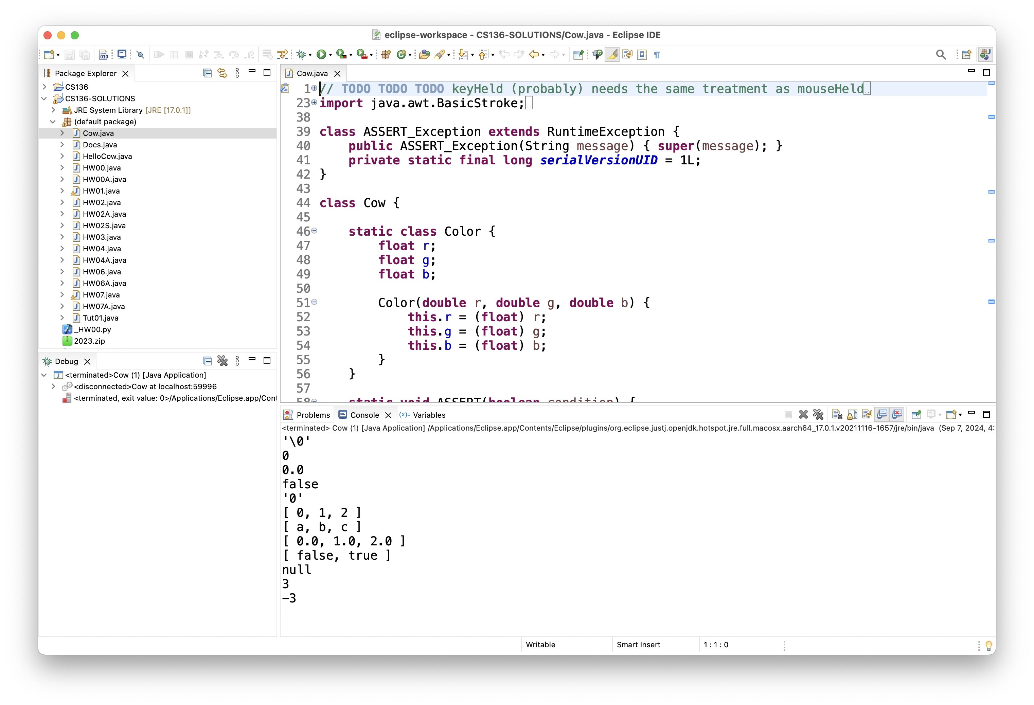
how to email jim
Reply to Q + A Thread
Email Body: can't run tic tac toe 😢

Slide 75
this is the fastest way to get your question answered i will not be offended i promise

Slide 76
how to do HW

Slide 77
implement one thing at a time get it working perfectly then, try the next thing

Slide 78
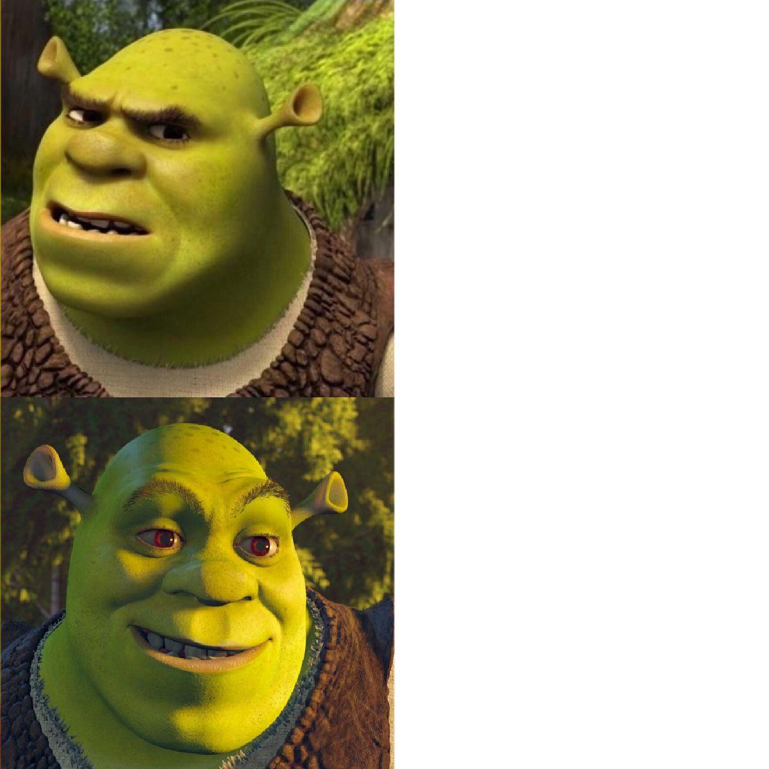
code up the entire homework without ever trying to run it
compile early; compile often

Slide 79

compilers

Slide 80
operators (except for bitwise operators, which we'll do later maybe)

Slide 81
assignment operator

Slide 82
assignment operator
= assigns the value on the right-hand side to the variable on the left-hand side
int i = 0; // 0 ("int i now has the value 0")
double foo = coolFunction();
☠ the assignment operator returns the value it assigned this is usually pretty confusing
boolean b = false;
boolean c = (b = foo());

Slide 83
arithmetic operators

Slide 84
basic arithmetic (number) operators
+ adds two numbers
- subtracts two numbers
* multiplies two numbers
/ divides two numbers
☠ an int divided by an int is an int
int foo = 8 / 2; // 4
int bar = 7 / 2; // 3
Java "throws away the remainder"
- returns the negative of a number
int bar = -7; // -7 ("negative 7" or "minus 7")
int baz = -bar; // 7

Slide 85
modulo
x % y returns the remainder of (x / y) and is read "x modulo y"
int foo = 17 % 5; // 2 ("17 divided by 5 is 3 remainder 2")
☠ % probably doesn't do what you expect for negative numbers; if x can be negative, use MODULO(x, y) instead
5 % 3 // 2
4 % 3 // 1
3 % 3 // 0
2 % 3 // 2
1 % 3 // 1
0 % 3 // 0
-1 % 3 // -1 🤔
MODULO(-1, 3) // 2 🙂👍

Slide 86
logical operators

Slide 87
logical operators (1/2)
|| returns whether the left-hand side or the right-hand side is true
(true || true) // true
(true || false) // true
(false || true) // true
(false || false) // false
&& returns whether the left-hand side and the right-hand side are true
(true && true) // true
(true && false) // false
(false && true) // false
(false && false) // false
! returns the opposite of a boolean, and is read as "not"
(!true) // false ("not true")
(!false) // true

Slide 88
logical operators (2/2)
// example, step by step
boolean a = (2 + 2 == 5); // false
boolean b = true; // true
boolean c = (a || b); // true
boolean d = !c; // false
// same thing all on one line
boolean d = !((2 + 2 == 5) || true); // false
// equivalent code
boolean d = false;

Slide 89
☠ logical operator short-circuiting
(false && foo()) "lazily" evaluates to false without evaluating foo()
(true || foo()) "lazily" evaluates to true without evaluating foo()

Slide 90
comparison operators

Slide 91
☠ equality (is equal to)
== returns whether the left-hand side is equal to the right-hand side
boolean b = (foo == bar);
if (foo == bar) { ... }
☠ this does NOT work for String's
instead, use (stringA.equals(stringB))
☠ this (usually) does NOT work for double's
instead, use ARE_EQUAL(double1, double2)

Slide 92
is greater than, is less than
> returns whether the left-hand side is greater than the right-hand side
< returns whether the left-hand side is less than the right-hand side

Slide 93
convenient operators (feel free to ignore these for now)

Slide 94
inequality
!= returns whether the left-hand side is not equal to the right-hand side
(left != right) is exactly the same as (!(left == right))

Slide 95
greater than or equal to, less than or equal to
>= returns whether the left-hand side is greater than or equal to the right-hand side
(left >= right) is basically the same as ((left > right) || (left == right)) greater-than or equal
<= returns whether the left-hand side is less than or equal to the right-hand side

Slide 96
arithmetic assignment operators
a += b; // a = a + b;
a -= b; // a = a - b;
a *= b; // a = a * b;
a /= b; // a = a / b;

Slide 97
String concatenation
+ concatenates two String's
// String foo = "Hello".concat("World"); String foo = "Hello" + "World"; // "HelloWorld"
it also does some conversions for you (very convenient, kind of confusing)
// String foo = "Hello".concat(Integer.toString(2)); String foo = "Hello" + 2; // "Hello2"

Slide 98
increment operator
to "increment" means to increase the value of a number by one
i = i + 1;
i += 1;
the pre-increment ++i increments i and returns the new value of i
j = ++i; // i = i + 1;
// j = i;
the post-increment i++ increments i and returns the old value of i
j = i++; // j = i;
// i = i + 1;

Slide 99
decrement operator
to "decrement" means to decrease the value of a number by one
i = i - 1;
i -= 1;
the pre-decrement --i decrements i and returns the new value of i
j = --i; // i = i - 1;
// j = i;
the post-decrement i-- decrements i and returns the old value of i
j = i--; // j = i;
// i = i - 1;

Slide 100
Week01b
🦜
🐝
record lecture
tips and tricks
operators
control flow
Cow.Java
REVIEW
foo = true;
bar = false;
baz = (!(!foo || !bar) && !!foo);
what value is baz?
WARMUP
A) imagine if code didn't have for, while, or functions...
B) imagine if it didn't have if...
could it get the job done?
could it ✨spark joy✨?

Slide 101
control flow

Slide 102
the execution of a Java program starts at the top of main(...) and flows down down down

Slide 103
let's step through this program in our minds, and then in a debugger
class Main extends Cow {
public static void main(String[] arguments) {
double a = 3.0;
double b = 4.0;
double result = SQRT(a * a + b * b);
PRINT(result);
}
}

Slide 104
[visualizing the flow of HW00A in a debugger] 💻👥

Slide 105
functions (preview)

Slide 106
functions (preview)
when a function is called, control flow jumps to the top of the function, flows down through it, and then jumps back to right after the function call
class Main {
static double pythagoreanTheorem(double a, double b) {
return Math.sqrt(a * a + b * b);
}
public static void main(String[] arguments) {
double hypotenuse = pythagoreanTheorem(3.0, 4.0);
System.out.println(hypotenuse);
}
}

Slide 107
ASSERT

Slide 108
ASSERT(condition);
an assert statement crashes the program if its condition is false
ASSERT(false); crashes the program no matter what
class Main {
static double pythagoreanTheorem(double a, double b) {
ASSERT(a > 0.0);
ASSERT(b > 0.0);
return Math.sqrt(a * a + b * b);
}
public static void main(String[] arguments) {
double hypotenuse = pythagoreanTheorem(3.0, 4.0);
PRINT(hypotenuse);
}
}

Slide 109
assert condition; (Java Java)
☠ Java's asserts are actually disabled by default (wat)
you can enable them in Eclipse, but it's easy to forget to do

Slide 110
if and else

Slide 111
if (condition) { body }
an if statement lets a program make a decision (instead of just stepping down down down forever down)
int choice = getIntFromUser();
if (choice == 0) {
System.out.println("The user chose 0. What a fine choice");
}

Slide 112
if (...) { if-body } else { else-body }
the body of an else statement is executed if its corresponding if statement's condition is false
int choice = getIntFromUser();
if (choice == 0) {
System.out.println("The user chose 0. What a fine choice");
} else {
System.out.println("The user did not choose 0.");
System.out.println("How avant-garde!");
}

Slide 113
if (...) { ... } else if (...) { ... } ... else { ... }
if and else statements can be chained together
this is great for decisions with many options
int choice = getIntFromUser();
if (choice == 0) {
...
} else if (choice == 1) {
...
} else if (choice == 2) {
...
} else {
ASSERT(false);
}

Slide 114
while and do...while

Slide 115
while (condition) { body }
a while loop repeats a block of code as long as the condition holds (if the condition is false the first time we see it, we never execute the body)
while (true) { ... } is an infinite loop
while (!gameOver) {
...
if (player.health <= 0) {
gameOver = true;
}
}

Slide 116
do { ... } while (...);
a do...while loop is (sometimes) useful when you know you need to do something at least once (and then potentially a bunch more times)
int choice;
do {
choice = getIntFromUser();
} while (!(0 <= choice && choice <= 2));
int choice = getIntFromUser();
while (!(0 <= choice && choice <= 2)) {
choice = getIntFromUser();
}

Slide 117
for

Slide 118
for (...; condition; ...) { ... } (1/2)
a for loop can be a convenient alternative to a while loop
for (int i = 0; i < n; ++i) {
...
}
{
int i = 0;
while (i < n) {
...
++i;
}
}

Slide 119
for (...; condition; ...) { ... } (2/2)
for loops can be kind of wild (probably stick with simple ones for now)
for (double a = 10.0; (a > 1.01); a = SQRT(a)) {
...
}
for (int j = n - 1, i = 0; (i < n); j = i++) {
...
}
for (;;) {
...
}

Slide 120
break and continue

Slide 121
break
break breaks out of a loop
while (true) {
...
if (player.health <= 0) {
break;
}
}

Slide 122
continue
continue continues to the next iteration of a loop
for (int i = 0; i < chairs.length; ++i) {
if (chairs[i].hasStudentSittingInIt) {
continue;
}
...PRINT student's name...
}

Slide 123
exceptions to the rule that "scope is the same as curly braces"

Slide 124
for (...; ...; ...) { ... }
variables declared inside the parentheses of a for loop are not available outside of the for loop (this is probably the behavior you already expected)
Compile Error: cannot find symbol i
class Main {
public static void main(String[] arguments) {
for (int i = 0; i < 10; ++i) {
...
}
PRINT(i);
}
}

Slide 125
☠ if, else, for, while without braces (1/2)
☠ if you (intentionally or unintentionally) forget your curly braces, then Java will assume you wanted them go around the first statement after the if (...), else, for (...), or while (...)
in this class, i highly recommend always using curly braces
if (choice == 0)
System.out.println("The user chose 0. What a fine choice");
if (choice == 0) {
System.out.println("The user chose 0. What a fine choice");
}

Slide 126
☠ if, for, while without braces (2/2)
if (choice == 0)
PRINT("The user chose 0. What a fine choice");
else
PRINT("The user did not choose 0.");
PRINT("How avant-garde!");
if (choice == 0) {
PRINT("The user chose 0. What a fine choice");
} else {
PRINT("The user did not choose 0.");
} // whoops!
PRINT("How avant-garde!");

Slide 127
Week01c
🦜
🐝
record lecture
tips and tricks
operators
control flow
Cow.Java
story tiiiime ☕️
NOTE: if lab too loud can use other room
REVIEW / WARMUP
1) what is 1234 % 10?
2) what is 1234 / 10?
3) what is 1 / 10?
4) implement int digitSum(int n) { ... }
using a while loop
BONUS: what does this print?
double a = -42.0;
double b = 0 * a;
PRINT(b);
PRINT(b == 0.0);

Slide 128
Java doesn't have a goto
NOTE: gray sections are just for fun; not on the HW; not on the tests

Slide 129
goto

Slide 130
goto label;
a goto "goes to" some label
it turns out loops are just convenient alternatives to goto's
goto's are considered *spooky*👻
while (condition) {
...
}
label BEGINNING_OF_WHILE:
if (!condition) {
goto END_OF_WHILE;
}
...
goto BEGINNING_OF_WHILE;
label END_OF_WHILE:

Slide 131
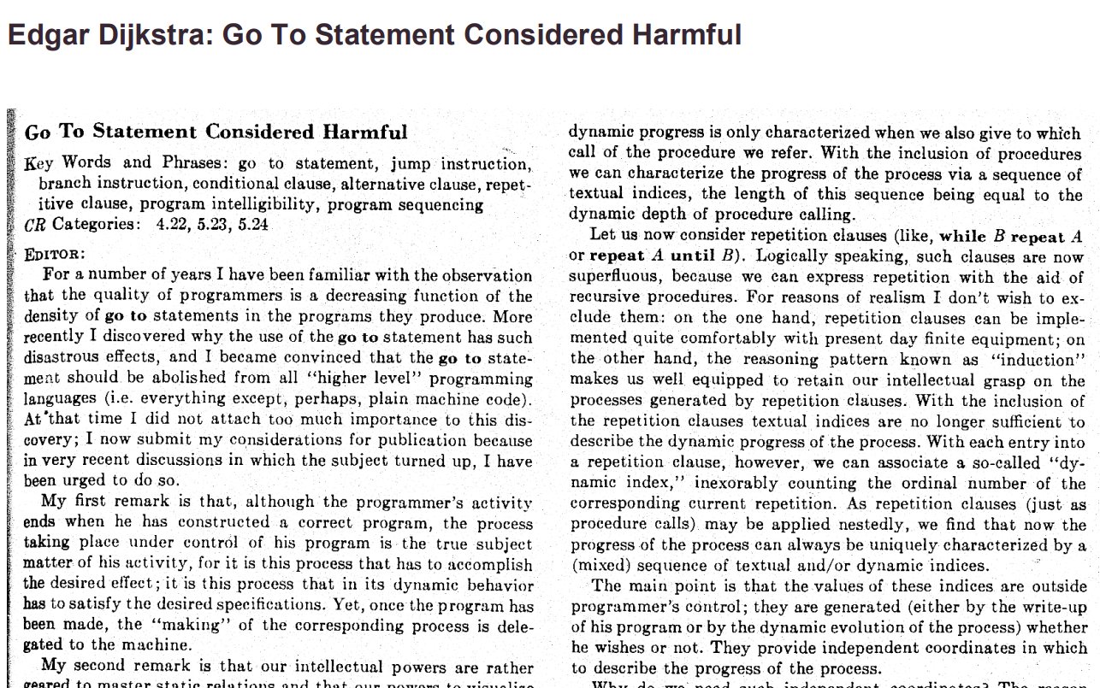

Slide 132
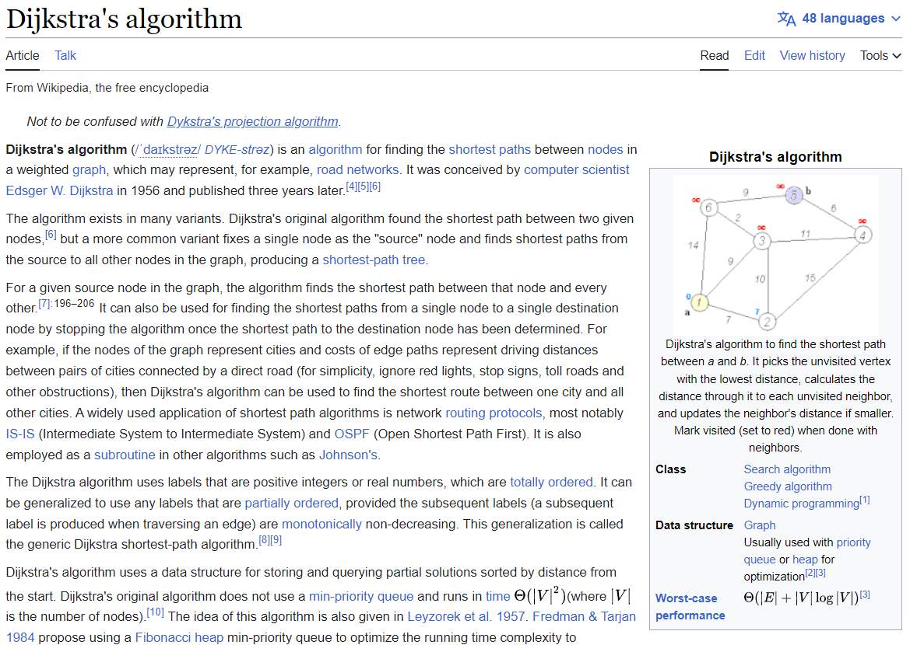

Slide 133
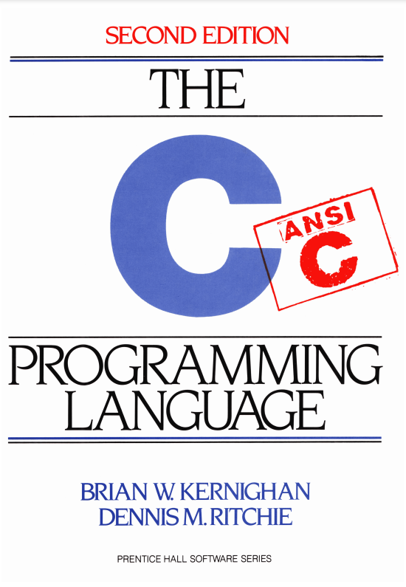

Slide 134
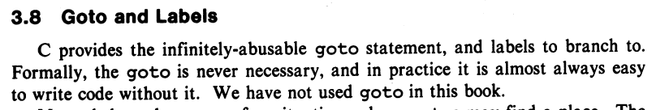
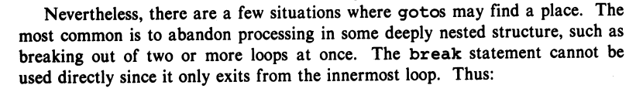
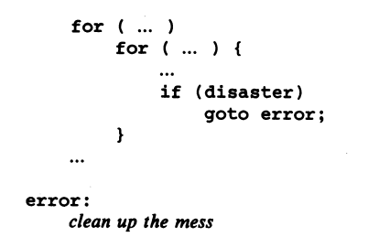

Slide 135
story time ☕️

Slide 136
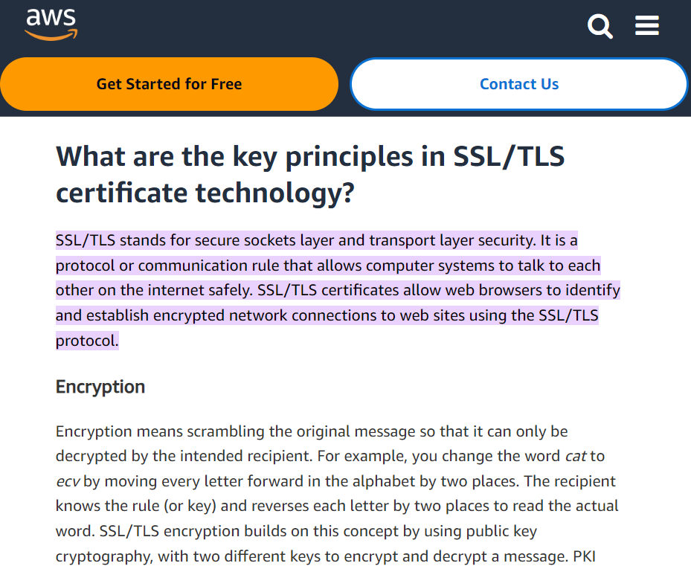

Slide 137
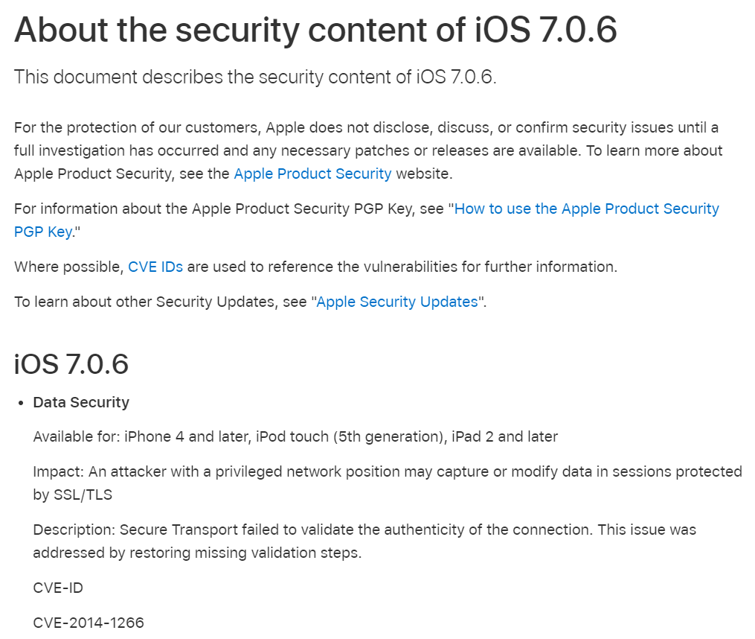

Slide 138
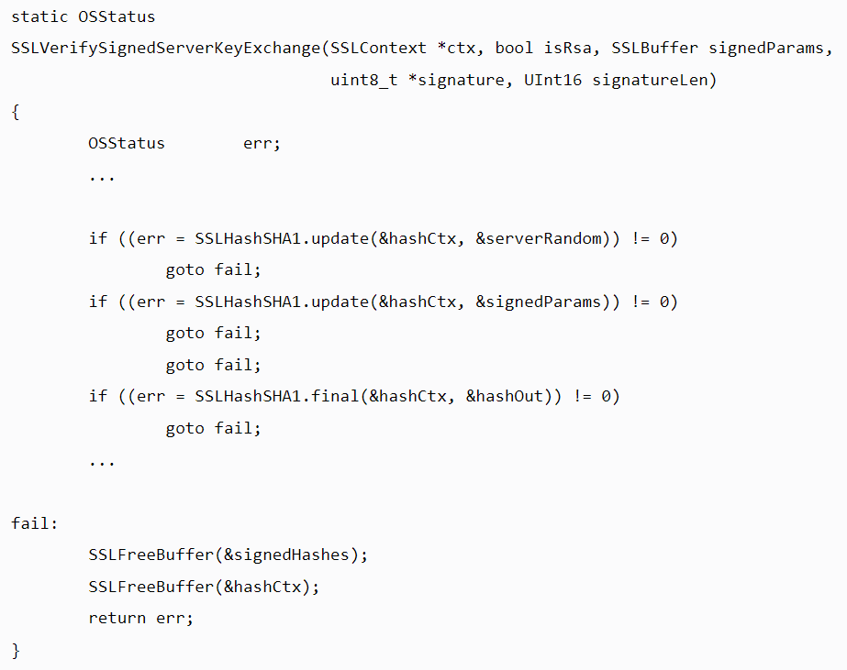

Slide 139
{
}
goto fail;

Slide 140
did the bug really happen because they left out the curly braces?

Slide 141
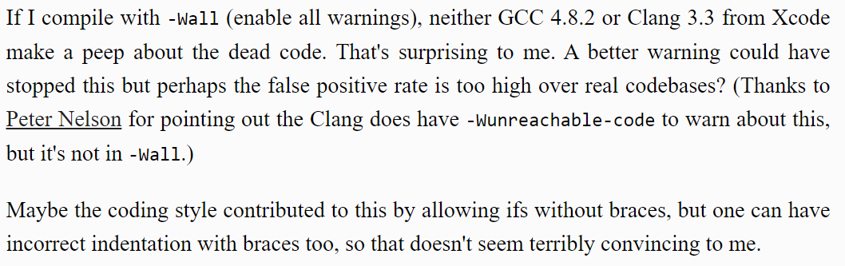

Slide 143
press CTRL+A and then press CTRL+I

Slide 144
🙂👍

Slide 145
Cow.Java

Slide 146
overview during a frame (like a frame of a movie) we update and draw the world

Slide 147

beginFrame()
beginFrame()
beginFrame()
beginFrame()
beginFrame()
beginFrame()

Slide 148
[discussion of update-draw loop]

Slide 149
your best friend

Slide 150

DOCUMENTATION

Slide 151
[examples]

Slide 152
Cow.java examples
rainbow circle example
grid
checkerboard
paint

Slide 153
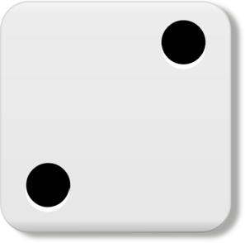
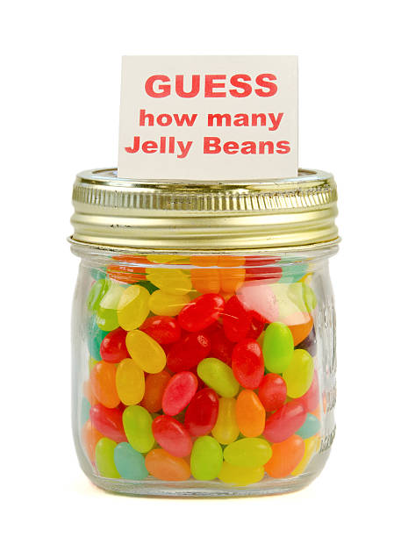
Week02
TODO: record lecture
🦜
NOTE: Jim has jury duty on thu 🎉
🦜
arrays
array examples
swap
array examples that use swaps
WARMUP
Guess how many arrays we used to make this:
https://youtu.be/dadIdXQMBi4
NOTE: an array is a fixed-length sequence of elements, all the same type

Slide 154
how many arrays?
ARRAYS (not counting tiny arrays of 3 double's, which i use to represent points)
NOTE: Counts are very approximate
==========
strings for loading files >5
huge arrays for drawing random stuff (the floor, etc) 2
random stuff in my cow.cpp library (keyboard state, OpenGL objects, etc.) >20
random global variables 1
building the simulation >6
simulation state 3
simulation itself >20
dragon head mesh 7
dragon body mesh 7
dragon mesh 7
sphere mesh 3
cylinder mesh 3
motor configuration 3
arrays that just move data back and forth between C++ <-> unity 8
inverse kinematics >15
physics >10
----------
definitely at least 100; probably less than 1000

Slide 155
arrays

Slide 156
metaphor

Slide 157
an array is like a very organized person's flower planter - one flower per square - the planter can't change size (it is made of artisinal woods or something)

Slide 158
🌻
🌺
🥀
🌹

Slide 159
mental model of an array

Slide 160
mental model of an array
a fixed number of equally-sized boxes, all right next to each other
the array itself lives "in memory"
1 | 5 | 3 | 2 | 7
int[] foo = new int[5];
foo[0] = 1;
foo[1] = 5;
foo[2] = 3;
foo[3] = 2;
foo[4] = 7;

Slide 161
the array itself lives "in memory"
1 | 5 | 3 | 2 | 7

Slide 162

1 | 5 | 3 | 2 | 7

Slide 163
learn about memory and become a real CS pro a couple important questions to ask yourself: https://www.youtube.com/watch?v=BNtcWpY4YLY

Slide 164
arrays

Slide 165
arrays (1/2)
an array is a fixed-length sequence of elements, all of the same type
"an array of 4372 double's"
"an array of 1 int's"
"an array of 64 Student's"

Slide 166
arrays (2/2)
we will often write an array using curly braces
{ 7, 7, 9 } is an array containing 7, 7, and 9
optionally, you can include a comma after the last element
{ 7, 7, 9, }
☠ even though sets from math also use curly braces, Java arrays have nothing to do with sets; in a set, all elements must be unique; in an array, elements do NOT have to be unique

Slide 167
array operations

Slide 168
array operations

Slide 169
creating an array (1/2)
you can create an array by specifying its length (the number of elements); if you do, the array is zero-initialized (all elements are initially set to zero)
int[] A = new int[8]; // { 0, 0, 0, 0, 0, 0, 0, 0 }
double[] B = new double[1]; // { 0.0 }
boolean[] C = new boolean[2]; // { false, false }
char[] D = new char[4]; // { '\0', '\0', '\0', '\0' }
String[] E = new String[3]; // { null, null, null }
[visualize in Eclipse]

Slide 170
creating an array (2/2)
you can also create an array by specifying its elements; if you do, the array's length is the number of elements you specified
int[] array = { 7, 7, 9 }; // new int[3] is implied
NOTE: this syntax can only be used for creation
🙅 NOT OKAY to do later: array = { 4, 5, 6 };
🙆 OKAY to do later:
array[0] = 4;
array[1] = 5;
array[2] = 6;
boolean[] array = { true };
String[] array = { "hello", "world" };

Slide 171
getting an array's length
after creating an array, you can get (but not set) its length
int[] array = { 7, 7, 9 };
PRINT(array.length); // 3
int[] array = new int[8];
PRINT(array.length); // 8
Error: cannot assign a value to final variable length
array.length = 42;

Slide 172
getting the value of an element of an array
you can get the value of an element of an array using the square brackets and the index of the element
this is also called "accessing the array"
int[] array = { 3, 4, 5 };
int foo = array[0]; // 3
int[] array = { 3, 4, 5 };
int foo = array[42];
java.lang.ArrayIndexOutOfBoundsException: 42

Slide 173
setting the value of an element of an array
you can set the value of an element of an array using the square brackets and the index of the element
int[] array = { 7, 7, 9 };
array[1] = 8;
// { 7, 8, 9 }
int[] array = { 7, 7, 9 };
array[-1] = 1000;
java.lang.ArrayIndexOutOfBoundsException: -1

Slide 174
☠ printing the elements of an array
☠ in Java, you don't simply call System.out.println(array)
instead, you call System.out.println(Arrays.toString(array));
note: this prints with square brackets instead of curly brackets
🤷‍♂️
or just call PRINT(array);
🐄💖✨
(note: also uses square brackets)

Slide 175
iterating over an array

Slide 176
iterating over an array
a for loop can be used to iterate over an array
for (int i = 0; i < array.length; ++i) {
array[i] = ...;
}

Slide 177
[example in Eclipse]

Slide 178
array examples

Slide 179
example: creating an array of the first 100 non-negative integers

Slide 180
example: creating an array of the first 100 non-negative integers [ 0, 1, ..., 99 ]
class Main extends Cow {
public static void main(String[] arguments) {
int[] array = new int[100];
for (int i = 0; i < array.length; ++i) {
array[i] = i;
}
PRINT(array);
}
}

Slide 181
example: (deep) array copy

Slide 182
example: array copy
class Main extends Cow {
public static void main(String[] arguments) {
int[] source = { 3, 4, 5 };
int[] destination = new int[source.length];
for (int i = 0; i < source.length; ++i) {
destination[i] = source[i];
}
PRINT(source);
PRINT(destination);
}
}

Slide 183
☠ example: bad very bad broken array copy

Slide 184
☠ example: bad very bad broken array copy
import java.util.*;
class Main {
public static void main(String[] arguments) {
int[] source = { 3, 4, 5 };
int[] destination = source;
source[0] = 7;
System.out.println(Arrays.toString(source));
System.out.println(Arrays.toString(destination));
}
}

Slide 185
example: circular array
3, 4, 5, 6, 7, 8, 9, 10, 11,

Slide 186
example: circular array
import java.util.*;
class Main {
public static void main(String[] arguments) {
int[] array = new int[5];
int indexToWriteIntoNext = 0;
while (true) {
array[indexToWriteIntoNext] = getIntFromUser();
indexToWriteIntoNext = (indexToWriteIntoNext + 1) % array.length;
System.out.println(Arrays.toString(array));
}
}
static int getIntFromUser() {
Scanner scanner = new Scanner(System.in);
while (!scanner.hasNextInt()) { scanner.nextLine(); }
return scanner.nextInt();
}
}

Slide 187
example: finding the index (and value) of an array's maximum element

Slide 188
example: finding the index (and value) of an array's maximum element
import java.util.*;
class Main {
public static void main(String[] arguments) {
double[] array = { 1.0, 3.0, -42.0, 1000.0, 99.0 };
int indexOfMaximumElement = -1;
double valueOfMaximumElement = Double.NEGATIVE_INFINITY;
for (int i = 0; i < array.length; ++i) {
if (array[i] > valueOfMaximumElement) {
indexOfMaximumElement = i;
valueOfMaximumElement = array[i];
}
}
System.out.println("array[" + indexOfMaximumElement + "] = " + valueOfMaximumElement);
}
}

Slide 189
multi-dimensional arrays

Slide 190
multi-dimensional arrays

Slide 191
multi-dimensional arrays (arrays of arrays of ...)
multi-dimensional arrays are sometimes really handy
int[][] array = { { 3, 4 }, { 5, 6 }, { 7, 8 } };
System.out.println(Arrays.deepToString(array));
// [[3, 4], [5, 6], [7, 8]]
System.out.println(array[0][1]); // 4
int[][][] array = new int[2][3][4];
array[0][0][0] = 42;
System.out.println(Arrays.deepToString(array));
// [[[42, 0, 0, 0], [0, 0, 0, 0], [0, 0, 0, 0]], [[0, 0, 0, 0], [0, 0, 0, 0], [0, 0, 0, 0]]]

Slide 192
swap

Slide 193
🐍 Python swap

Slide 194
🐍 Python swap
a = 0
b = 1
a, b = b, a # Python swap
# a is now 1
# b is now 0

Slide 195
☠️ BAD VERY BAD BROKEN swap

Slide 196
☠️ BAD VERY BAD BROKEN swap
int a = 0;
int b = 1;
{ // BAD VERY BAD BROKEN swap
a = b; // a <- 1
b = a; // b <- 1
}

Slide 197
swap

Slide 198
swap
int a = 0;
int b = 1;
{ // swap
int tmp = a; // tmp <- 0
a = b; // a <- 1
b = tmp; // b <- 0
}

Slide 199
array algorithms that use swaps

Slide 200
reversing an array

Slide 201
out-of-place reverse
we can reverse an array out-of-place using an additional array
static int[] outOfPlaceReverse(int[] array) {
int[] result = new int[array.length];
for (int i = 0; i < array.length; ++i) {
int j = (array.length - 1) - i;
result[i] = array[j];
}
return result;
}

Slide 202
in-place reverse
we can reverse an array in-place using "swaps" (no additional array)
static void inPlaceReverse(int[] array) {
for (int i = 0; i < array.length / 2; ++i) {
int j = (array.length - 1) - i;
int tmp = array[i];
array[i] = array[j];
array[j] = tmp;
}
}

Slide 203
bubble sort

Slide 204
bubble sort
bubble sort is a simple in-place sorting algorithm that uses swaps
import java.util.*;
class Main {
public static void main(String[] arguments) {
int[] array = { 2, 4, 1, 6, 0, 3, 5 };
boolean arrayIsSorted;
do {
arrayIsSorted = true;
for (int i = 0; i < array.length - 1; ++i) {
if (array[i] > array[i + 1]) {
arrayIsSorted = false;
// swap
int tmp = array[i];
array[i] = array[i + 1];
array[i + 1] = tmp;
}
}
} while (!arrayIsSorted);
System.out.println(Arrays.toString(array));
}
}

Slide 205
big O

Slide 206
big O

Slide 207
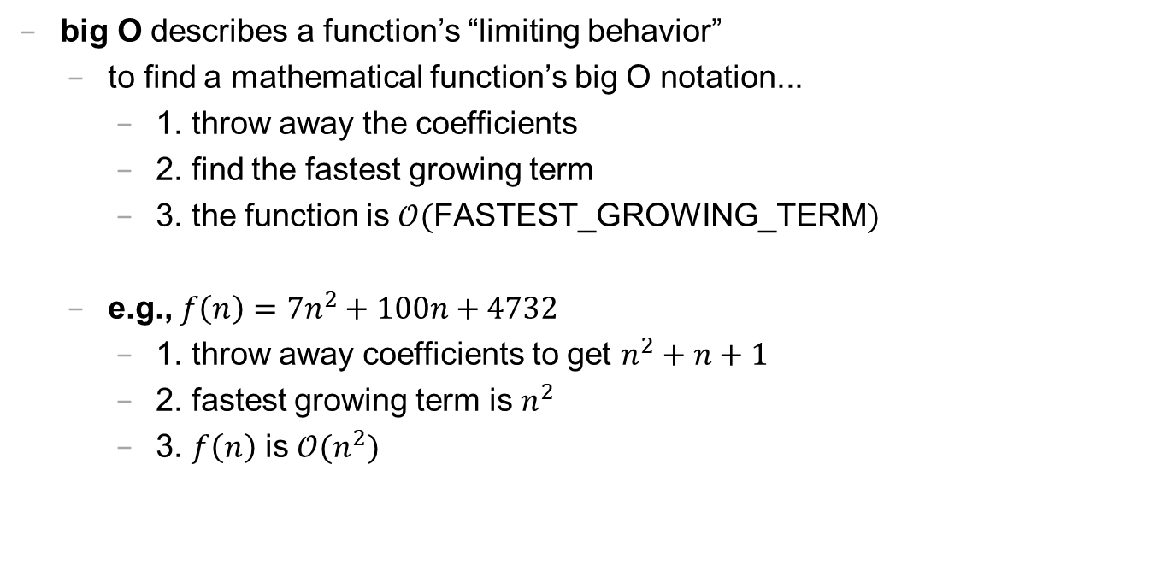
big O (1/2)
big O describes a function’s “limiting behavior”
to find a mathematical function’s big O notation...
1. throw away the coefficients
2. find the fastest growing term
3. the function is $𝒪($FASTEST_GROWING_TERM$)$
e.g., $f\left(n\right)=7n^{2}+100n+4732$
1. throw away coefficients to get $n^{2}+n+1$
2. fastest growing term is $n^{2}$
3. $f\left(n\right)$ is $𝒪(n^{2})$

Slide 208
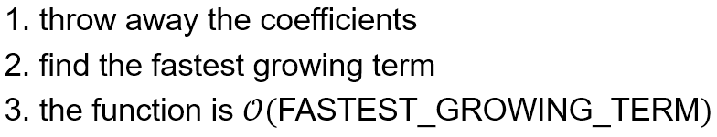
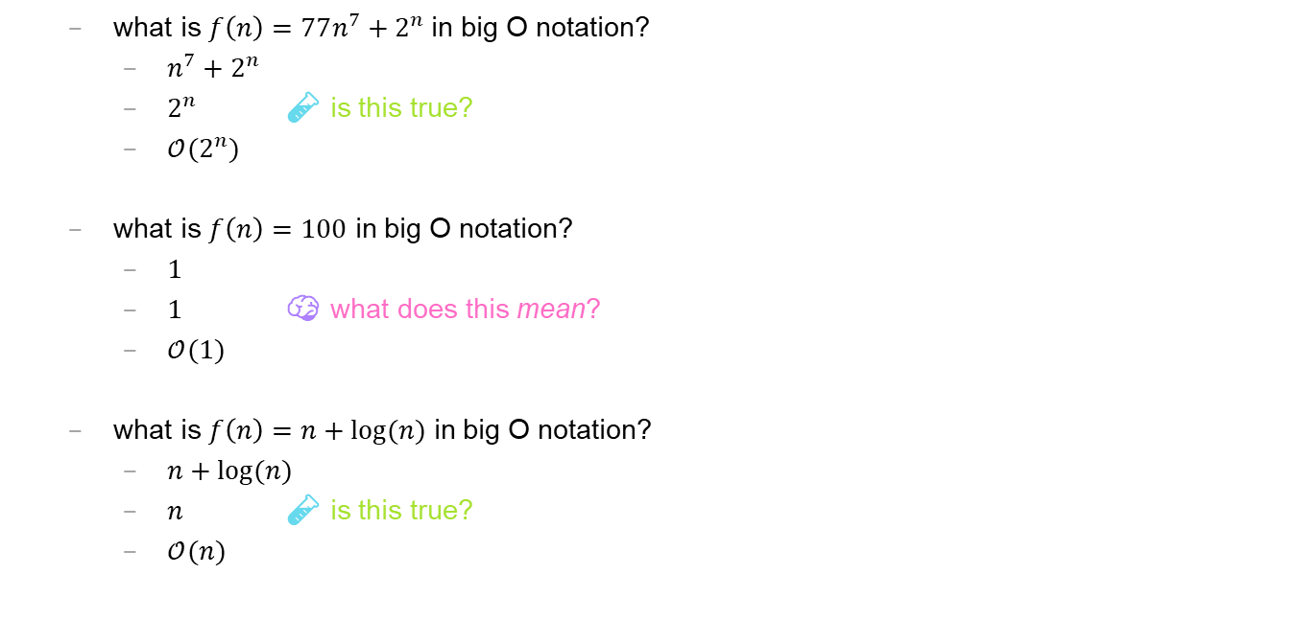
big O (2/2)
what is $f\left(n\right)=77n^{7}+2^{n}$ in big O notation?
$n^{7}+2^{n}$
$2^{n}$ 🧪 is this true?
$𝒪(2^{n})$
what is $f\left(n\right)=100$ in big O notation?
$1$
$1$ 🧠 what does this mean?
$𝒪(1)$
what is $f\left(n\right)=n+log⁡(n)$ in big O notation?
$n+log⁡(n)$
$n$ 🧪 is this true?
$𝒪(n)$

Slide 209
🗣 what is the big O digitSum(int n)? can you do better?

Slide 210
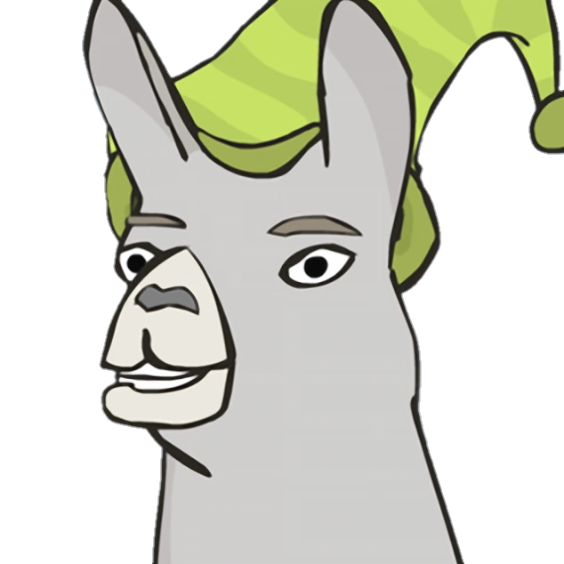
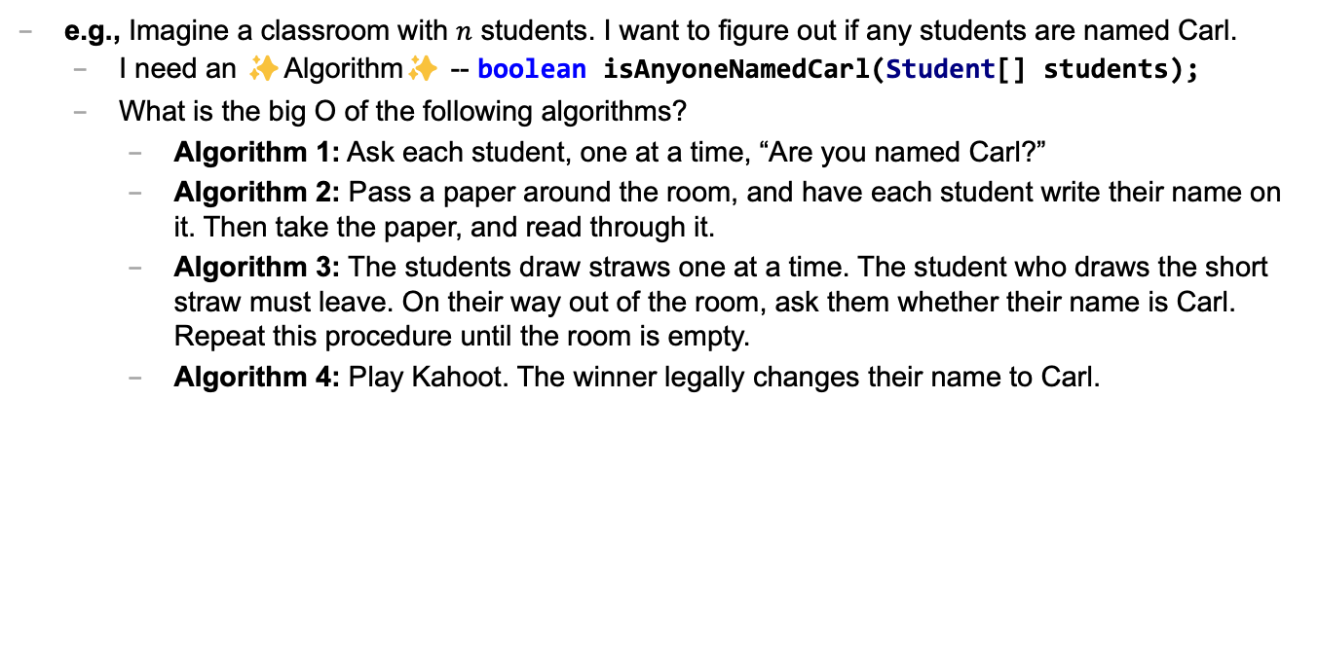
Caaaaaaaaaaaarl
e.g., Imagine a classroom with $n$ students. I want to figure out if any students are named Carl.
I need an ✨Algorithm✨ -- boolean isAnyoneNamedCarl(Student[] students);
What is the big O of the following algorithms?
Algorithm 1: Ask each student, one at a time, “Are you named Carl?”
Algorithm 2: Pass a paper around the room, and have each student write their name on it. Then take the paper, and read through it.
Algorithm 3: The students draw straws one at a time. The student who draws the short straw must leave. On their way out of the room, ask them whether their name is Carl. Repeat this procedure until the room is empty.
Algorithm 4: Play Kahoot. The winner legally changes their name to Carl.

Slide 211
runtime of array operations

Slide 212
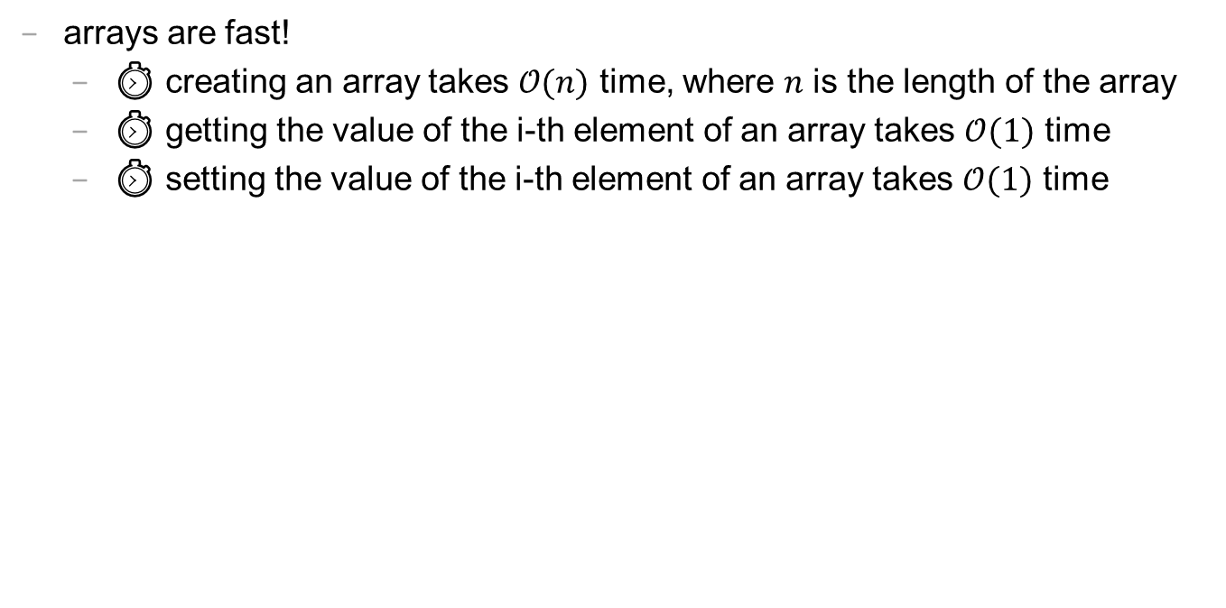
runtime of array operations
arrays are fast!
⏱️ creating an array takes $𝒪(n)$ time, where $n$ is the length of the array
⏱️ getting the value of the i-th element of an array takes $𝒪(1)$ time
⏱️ setting the value of the i-th element of an array takes $𝒪(1)$ time

Slide 213
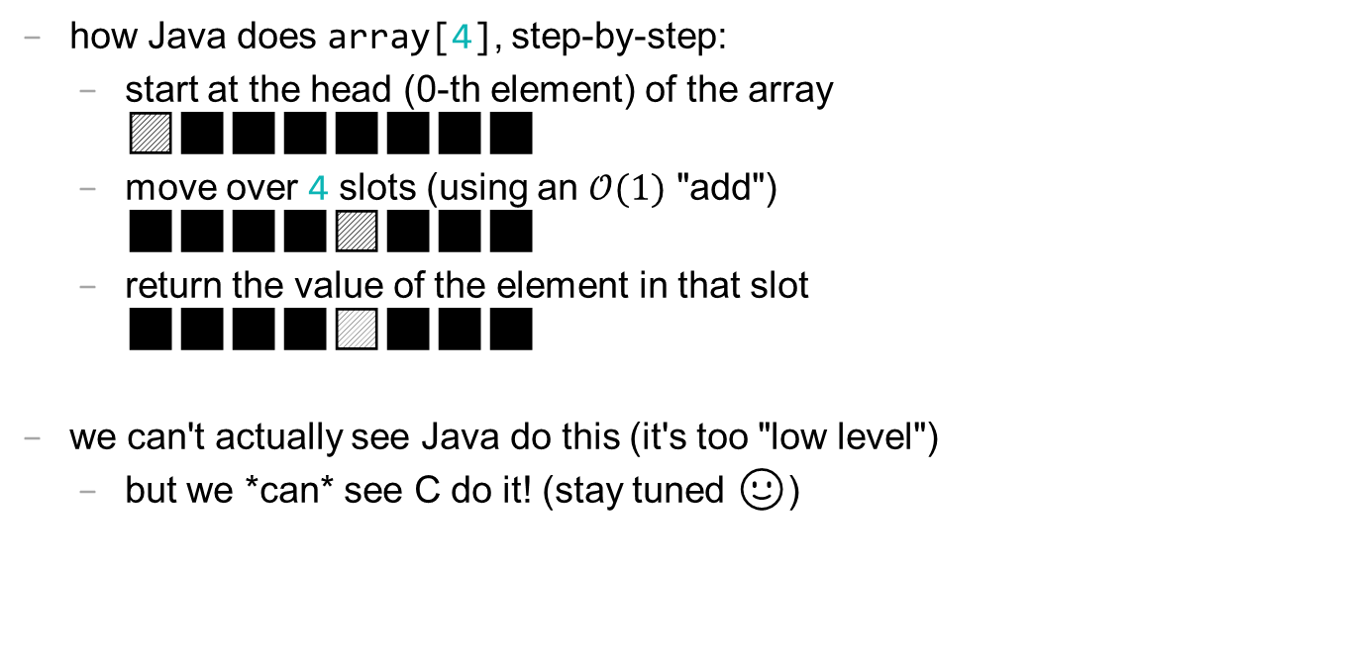
accessing an array "under the hood"
how Java does array[4], step-by-step:
start at the head (0-th element) of the array 🟦⬛⬛⬛⬛⬛⬛⬛
move over 4 slots (using an $𝒪(1)$ "add") ⬛⬛⬛⬛🟦⬛⬛⬛
return the value of the element in that slot ⬛⬛⬛⬛🟨⬛⬛⬛
we can't actually see Java do this (it's too "low level")
but we *can* see C do it! (stay tuned 🙂)

Slide 214
💻 array tutorial

Slide 215
💻 array tutorial (this time with a wiki page)

Slide 216
💻 array tutorial
// 🟢 ([5, 4, 7, 0, 0, 7], 7) -> 2
// 🟢 ([5, 4, 7, 0, 0, 7], 3) -> -1
static int findFirstIndexOf(int[] array, int value);
// 🟦 ([1, 3, 3, 2, 3, 4], 3) -> [1, 2, 4]
static int[] removeAllOccurences(int[] array, int value);
// ♦️ [[1, 3], [2, 4, 5], [0, 5]] -> [0, 1, 2, 3, 4, 5, 5]
static int[] mergeArrayOfSortedArrays(int[][] arrays);

Slide 220
☕️ the art of coding things in the right order compile and run early compile and run often

Slide 221
why implement Rule 22 first? why not just skip straight to the general case?

Slide 222

well, let us imagine...

Slide 223
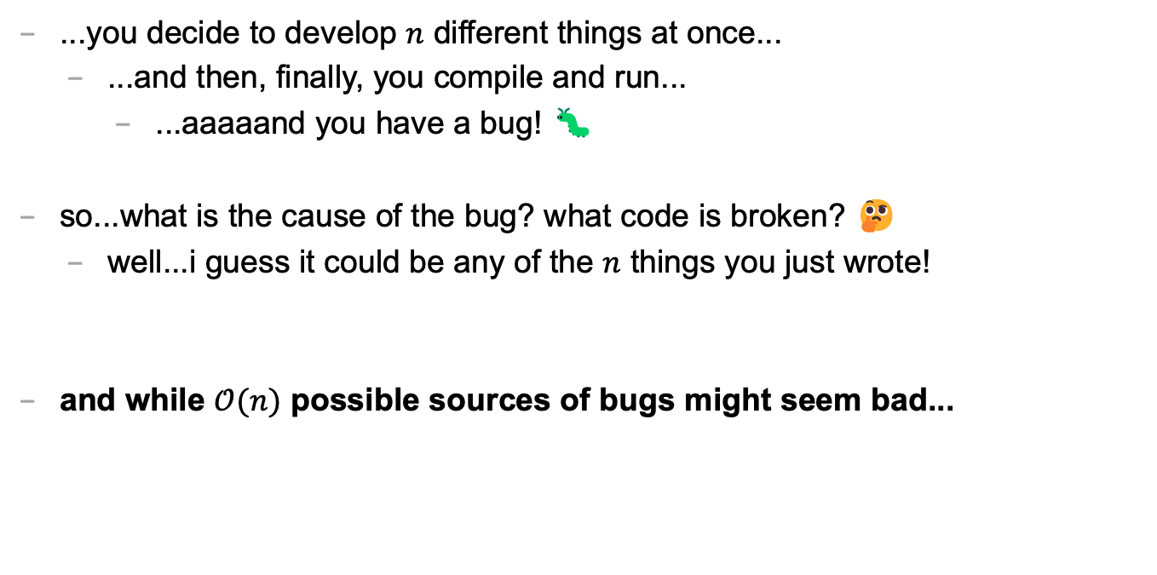
let's imagine...
...you decide to develop $n$ different things at once...
...and then, finally, you compile and run...
...aaaaand you have a bug! 🐛
so...what is the cause of the bug? what code is broken? 🤔
well...i guess it could be any of the $n$ things you just wrote!
and while $𝒪(n)$ possible sources of bugs might seem bad...

Slide 224
...the reality is ✨so much worse✨!

Slide 225

because broken code likes to interact with other broken code, to make✨super bugs✨!

Slide 227
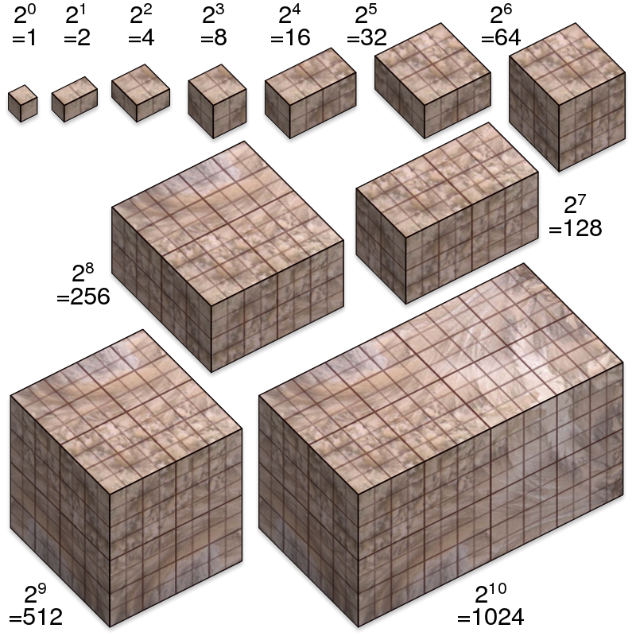
not broken
broken
developing one thing at a time

Slide 228
not broken
A is broken
B is broken
A and B are both broken
developing two things at a time

Slide 229

asymptotic bug-finding time

Slide 230
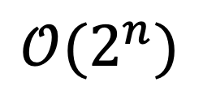
$$𝒪(2^{n})$$
gl;hf 🙂👍

Slide 231
big lesson
implement code one thing at a time
compile and run and test after implementing every single thing
this is a learned skill!
how i would actually implement the automata homework
make the array
print the array as an array
print the array as a string
update the array once using Rule 22 and print the result
wrap the printing and update in a for loop
implement code to handle all rules and test it on Rule 22
test it on the other rules

Slide 232
this is a learned skill!

Slide 233

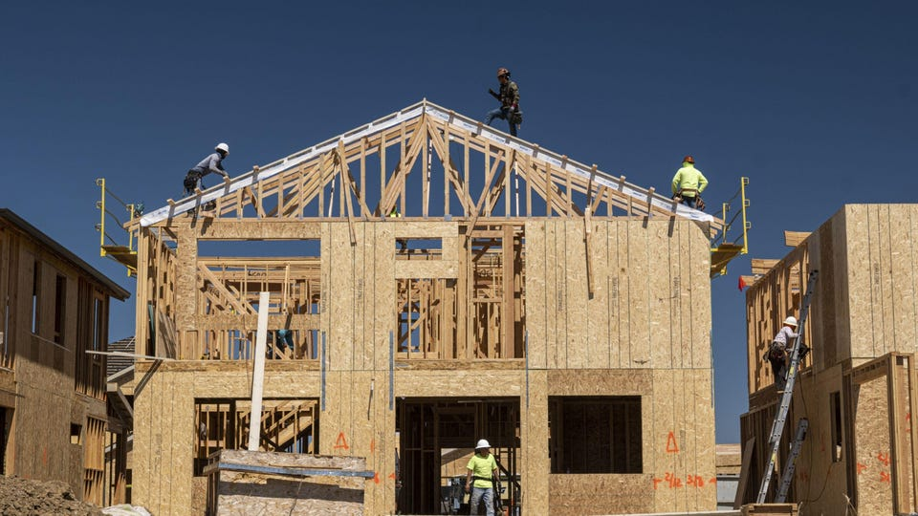
in summary

Slide 234
CHATGPT TODO: help hours start monday
🙅🙆🙅‍♂️🙆‍♂️🙅‍♀️🙆‍♀️

Slide 235
expectations
🙅🙆🙅‍♂️🙆‍♂️🙅‍♀️🙆‍♀️

Slide 236
ANNOUNCEMENTS today is No Laptop Monday! 🙅‍♂️💻🎉 WARMUP (discuss with people you don't know) what does 2 + 2 like...mean? 🧠 🌞 TODAY Fundamentals of Java Part 1

Slide 237
thank you to those who emailed DrJava questions! note: my email responses tend to be really short; it doesn't mean i'm annoyed; i just have to write emails really fast because there are ~64 students in this class 🙂👍 ps screenshots are really helpful if you email me!

Slide 238
is there anyone here who is not yet enrolled in CS 136 and would like to be?

Slide 239
questions before we begin?

Slide 240
record lecture?

Slide 241
type

Slide 242
variables in Java have a specified type
# okay in Python
foo = 7 # foo is an int
foo = False # now, foo is a boolean
// NOT okay in Java
int foo = 7; // foo is an int
foo = false; // Error: incompatible types:
// boolean cannot be converted to int

Slide 243
in Java, declaring and initializing variables are separate things
// Option A: one line int foo = 7; // declare int foo and initialize it to 7
// Option B: two lines int foo; // declare a variable foo of type int foo = 7; // initialize foo to 7

Slide 244
built-in data types

Slide 245
primitive data types

Slide 246
boolean, char, double, int
a boolean stores a truth value
true, false
a char stores a character
'\0', 'a', 'Z', '!', '\n'
a double stores a floating point number
0.0, -0.5, 3.1415926, Double.NEGATIVE_INFINITY
an int stores an integer number
0, -1, 4

Slide 247
primitive data type Venn diagram
integers
numbers
char
double
boolean
int

Slide 248
char is an integer type
a char is an integer type
each char has a corresponding integer, for example ('a' == 97)
the letters are in order ('a' == 97), ('b' == 98), ('c' == 99)...
the numbers are also in order ('0' == 48), ('1' == 49)...
you can do math with char's
char foo = 'a' + 2; // foo is 'c'
char bar = '0' + 7; // bar is '7'
int baz = '6' - '0'; // baz is 6

Slide 249
zero
each primitive data type has its own notion of what it means to "be zero"
int zero = 0;
double zero = 0.0;
boolean zero = false;
char zero = '\0'; // the "null character"

Slide 250
String

Slide 251
String (1/2)
a String is a sequence of characters
"Hello World", "Foo123"

Slide 252
String (2/2)
String's have several useful functions/methods (which are described in our Documentation)
String string = "Hello"; // makes a new String
System.out.println(string.length()); // 5
System.out.println(string.charAt(1)); // 'e'
System.out.println(string.substring(0, 3)); // "Hel"

Slide 253
operators (except for bitwise operators, which we'll do later maybe)

Slide 254
assignment operator

Slide 255
assignment operator
= assigns the value on the right-hand side to the variable on the left-hand side
int i = 0; // 0 ("int i now has the value 0")
double foo = coolFunction();
☠ the assignment operator returns the value it assigned this is usually pretty confusing
boolean b = false;
boolean c = (b = foo());

Slide 256
arithmetic operators

Slide 257
basic arithmetic (number) operators
+ adds two numbers
- subtracts two numbers
* multiplies two numbers
/ divides two numbers
☠ an int divided by an int is an int
int foo = 8 / 2; // 4
int bar = 7 / 2; // 3
Java "throws away the remainder"
- returns the negative of a number
int bar = -7; // -7 ("negative 7" or "minus 7")
int baz = -bar; // 7

Slide 258
modulo
x % y returns the remainder of (x / y) and is read "x modulo y"
int foo = 17 % 5; // 2 ("17 divided by 5 is 3 remainder 2")
☠ % probably doesn't do what you expect for negative numbers; if x can be negative, use Math.floorMod(x, y) instead
5 % 3 // 2
4 % 3 // 1
3 % 3 // 0
2 % 3 // 2
1 % 3 // 1
0 % 3 // 0
-1 % 3 // -1 🤔
Math.floorMod(-1, 3) // 2 🙂👍

Slide 259
logical operators

Slide 260
logical operators (1/2)
|| returns whether the left-hand side or the right-hand side is true
(true || true) // true
(true || false) // true
(false || true) // true
(false || false) // false
&& returns whether the left-hand side and the right-hand side are true
(true && true) // true
(true && false) // false
(false && true) // false
(false && false) // false
! returns the opposite of a boolean, and is read as "not"
(!true) // false ("not true")
(!false) // true

Slide 261
logical operators (2/2)
// example, step by step
boolean a = (2 + 2 == 5); // false
boolean b = true; // true
boolean c = (a || b); // true
boolean d = !c; // false
// same thing all on one line
boolean d = !((2 + 2 == 5) || true); // false
// equivalent code
boolean d = false;

Slide 262
☠ logical operator short-circuiting
(false && foo()) "lazily" evaluates to false without evaluating foo()
(true || foo()) "lazily" evaluates to true without evaluating foo()

Slide 263
comparison operators

Slide 264
☠ equality (is equal to)
== returns whether the left-hand side is equal to the right-hand side
boolean b = (foo == bar);
if (foo == bar) { ... }
☠ this does NOT work for String's
instead, use (stringA.equals(stringB) )
☠ this (usually) does NOT work for double's
instead, use (Math.abs(double1 - double2) < 0.00001)

Slide 265
is greater than, is less than
> returns whether the left-hand side is greater than the right-hand side
< returns whether the left-hand side is less than the right-hand side

Slide 266
convenient operators (feel free to ignore these for now)

Slide 267
inequality
!= returns whether the left-hand side is not equal to the right-hand side
(left != right) is exactly the same as (!(left == right))

Slide 268
greater than or equal to, less than or equal to
>= returns whether the left-hand side is greater than or equal to the right-hand side
(left >= right) is basically the same as ((left > right) || (left == right)) greater-than or equal
<= returns whether the left-hand side is less than or equal to the right-hand side

Slide 269
arithmetic assignment operators
a += b; // a = a + b;
a -= b; // a = a - b;
a *= b; // a = a * b;
a /= b; // a = a / b;

Slide 270
String concatenation
+ concatenates two String's
// String foo = "Hello".concat("World"); String foo = "Hello" + "World"; // "HelloWorld"
it also does some conversions for you (very convenient, kind of consuming)
// String foo = "Hello".concat(Integer.toString(2)); String foo = "Hello" + 2; // "Hello2"

Slide 271
increment operator
to "increment" means to increase the value of a number by one
i = i + 1;
i += 1;
the pre-increment ++i increments i and returns the new value of i
j = ++i; // i = i + 1;
// j = i;
the post-increment i++ increments i and returns the old value of i
j = i++; // j = i;
// i = i + 1;

Slide 272
decrement operator
to "decrement" means to decrease the value of a number by one
i = i - 1;
i -= 1;
the pre-decrement --i decrements i and returns the new value of i
j = --i; // i = i - 1;
// j = i;
the post-decrement i-- decrements i and returns the old value of i
j = i--; // j = i;
// i = i - 1;

Slide 273
ANNOUNCEMENTS today is No Laptop Wednesday! 🙅‍♂️💻🎉🔥 WARMUP is it bad when programs crash? 🌞🌞 TODAY Fundamentals of Java Part 2

Slide 274
Homework-00 was due in Gradescope two nights ago; if you didn't submit it yet, probably do that ASAP 🙂👍

Slide 275
Homework-01 will be harder than Homework-00; Homework-02 will be harder than Homework-01; and then hopefully we more or less plateau (feel free to reach out with any questions about course difficulty 🙂👍)

Slide 276
record LEC 01

Slide 277
flow control

Slide 278
the execution of a Java program starts at the top of main(...) and flows down down down

Slide 279
let's step through this program in our minds, and then in a debugger
class Main {
public static void main(String[] arguments) {
double a = 3.0;
double b = 4.0;
double result = Math.sqrt(a * a + b * b);
System.out.println(result);
}
}

Slide 280
functions (preview)

Slide 281
functions (preview)
when a function is called, control flow jumps to the top of the function, flows down through it, and then jumps back to right after the function call
class Main {
static double pythagoreanTheorem(double a, double b) {
return Math.sqrt(a * a + b * b);
}
public static void main(String[] arguments) {
double hypotenuse = pythagoreanTheorem(3.0, 4.0);
System.out.println(hypotenuse);
}
}

Slide 282
assert

Slide 283
assert condition; (1/2)
an assert statement crashes the program if its condition is false
assert false; crashes the program no matter what
class Main {
static double pythagoreanTheorem(double a, double b) {
assert a > 0.0;
assert b > 0.0;
return Math.sqrt(a * a + b * b);
}
public static void main(String[] arguments) {
double hypotenuse = pythagoreanTheorem(3.0, 4.0);
System.out.println(hypotenuse);
}
}

Slide 284
assert condition; (2/2)
☠ asserts are actually disabled by default in Java, and are ignored
DrJava enables them by default 🙂👍

Slide 285
if and else

Slide 286
if (condition) { body }
an if statement lets a program make a decision (instead of just stepping down down down forever down)
int choice = getIntFromUser();
if (choice == 0) {
System.out.println("The user chose 0. What a fine choice");
}

Slide 287
if (...) { if-body } else { else-body }
the body of an else statement is executed if its corresponding if statement's condition is false
int choice = getIntFromUser();
if (choice == 0) {
System.out.println("The user chose 0. What a fine choice");
} else {
System.out.println("The user did not choose 0.");
System.out.println("How avant-garde!");
}

Slide 288
if (...) { ... } else if (...) { ... } ... else { ... }
if and else statements can be chained together
this is great for decisions with many options
int choice = getIntFromUser();
if (choice == 0) {
...
} else if (choice == 1) {
...
} else if (choice == 2) {
...
} else {
assert false;
}

Slide 289
while and do...while

Slide 290
while (condition) { body }
a while loop repeats a block of code as long as the condition holds (if the condition is false the first time we see it, we never execute the body)
while (true) { ... } is an infinite loop
while (!gameOver) {
...
if (player.health <= 0) {
gameOver = true;
}
}

Slide 291
do { ... } while (...);
a do...while loop is (sometimes) useful when you know you need to do something at least once (and then potentially a bunch more times)
int choice;
do {
choice = getIntFromUser();
} while (!(0 <= choice && choice <= 2));
int choice = getIntFromUser();
while (!(0 <= choice && choice <= 2)) {
choice = getIntFromUser();
}

Slide 292
for

Slide 293
for (...; condition; ...) { ... } (1/2)
a for loop can be a convenient alternative to a while loop
for (int i = 0; i < n; ++i) {
...
}
{
int i = 0;
while (i < n) {
...
++i;
}
}

Slide 294
for (...; condition; ...) { ... } (2/2)
for loops can be kind of wild (probably stick with simple ones for now)
for (double a = 10.0; (a > 1.01); a = Math.sqrt(a)) {
...
}
for (int j = n - 1, i = 0; (i < n); j = i++) {
...
}
for (;;) {
...
}

Slide 295
break and continue

Slide 296
break
break breaks out of a loop
while (true) {
...
if (player.health <= 0) {
break;
}
}

Slide 297
continue
continue continues to the next iteration of a loop
for (int i = 0; i < numberOfSlots; ++i) {
if (!slots[i].isOccupied) {
continue;
}
... // do something with whatever is in the i-th slot
}

Slide 298
scope

Slide 299
{ ... }

Slide 300
scope
a scope is a region of code in which variables live
in Java, a scope is (usually) defined by a pair of curly braces
OUTER_SCOPE { INNER_SCOPE } OUTER_SCOPE
{
int i;
{
int j;
// you CAN use i here 🙆‍♂️
// you CAN use j here 🙆‍♂️
}
// you CAN use i here 🙆‍♂️
// you CANNOT use j here 🙅
}

Slide 301
common scope-related errors

Slide 302
cannot find symbol (1/2)
Error: cannot find symbol
symbol: variable foo
location: class Main
class Main {
public static void main(String[] arguments) {
if (...) {
int foo = 0;
} else {
int foo = 1;
}
System.out.println(foo);
}
}

Slide 303
cannot find symbol (2/2)
Compilation completed.
class Main {
public static void main(String[] arguments) {
int foo;
if (...) {
foo = 0;
} else {
foo = 1;
}
System.out.println(foo);
}
}

Slide 304
variable already defined (1/2)
Error: variable foo is already defined in method main(java.lang.String[])
class Main {
public static void main(String[] arguments) {
int foo;
if (...) {
int foo = 0;
} else {
foo = 1;
}
System.out.println(foo);
}
}

Slide 305
variable already defined (2/2)
Compilation completed.
class Main {
public static void main(String[] arguments) {
int foo;
if (...) {
foo = 0;
} else {
foo = 1;
}
System.out.println(foo);
}
}

Slide 306
whitespace

Slide 307
whitespace
whitespace includes spaces and newlines
🐍 Python does care about whitespace (indentation changes what code does)
Java does NOT care about whitespace
🗣️ do you care about whitespace?
some guidelines:
be consistent!
carefully indent your scopes (and make sure your curly braces line up)
✨ DrJava can do this for you! no excuses!
sparks joy | NOT equivalent -- doesn’t spark joy
for (int i = 0; i < 10; ++i) { if (i % 3 == 0) { System.out.println("fizz"); } } | for (int i = 0; i < 10; ++i) { if (i % 3 == 0) { } System.out.println("fizz"); }

Slide 308
exceptions to scope being the same as curly braces

Slide 309
for (...; ...; ...) { ... }
variables declared inside the parentheses of a for loop are not available outside of the for loop (this is probably the behavior you already expected)
Error: cannot find symbol
symbol: variable i
location: class Main
class Main {
public static void main(String[] arguments) {
for (int i = 0; i < 10; ++i) {
...
}
System.out.println(i);
}
}

Slide 310
☠ if, else, for, while without braces (1/2)
☠ if you (intentionally or unintentionally) forget your curly braces, then Java will assume you wanted them go around the first statement after the if (...), else, for (...), or while (...)
in this class, i highly recommend always using curly braces
if (choice == 0)
System.out.println("The user chose 0. What a fine choice");
if (choice == 0) {
System.out.println("The user chose 0. What a fine choice");
}

Slide 311
☠ if, for, while without braces (2/2)
if (choice == 0)
System.out.println("The user chose 0. What a fine choice");
else
System.out.println("The user did not choose 0.");
System.out.println("How avant-garde!");
if (choice == 0) {
System.out.println("The user chose 0. What a fine choice");
} else {
System.out.println("The user did not choose 0.");
} // whoops!
System.out.println("How avant-garde!");

Slide 312
let's do the homework (including infinite loop example)

Slide 313
ANNOUNCEMENTS hexDigitSum CORRECTION -- don't print error message and return; instead, just crash using an assert false; 🙂👍 today is Fun Friday! 🎉🎉🎉🔥🚨🚨 WARMUP compress this code! 🙆‍♂️ TODAY goto and big O notation
boolean isEven;
if (i % 2 == 0) {
isEven = true;
} else if (i % 2 != 0) {
isEven = false;
}
if (isEven) {
...
}

Slide 314
homework hints

Slide 315
homework hints (1/2)
char is an integer type!
// char c
48 <= c
'0' <= c
we have ✨Documentation✨ linked on the website! (it's really good!)
for (char c : string.toCharArray()) {
for (int i = 0; i < string.length(); ++i) {
char c = string.charAt(i);
// i know it's more typing but you'll thank me (much) later
the starter code has ✨Examples✨ (they're relevant!)

Slide 316
homework hints (2/2)
if you get a weird "illegal start of expression" compiler error...
highlight your code and press Tab!
you're probably missing a curly brace somewhere above the error
import java.util.*;
class Main {
// returns the length of the hypotenuse of right triangle with legs of lengths a and b
static double pythagoreanTheorem(double a, double b) {
return Math.sqrt(a * a + b * b);
// returns whether n is prime
static boolean isPrime(int n) {
if (n < 2) { return false; }
for (int i = 2; i < n / 2; ++i) {
if (n % i == 0) {
return false;
}
}
return true;
}
}

Slide 317
Java doesn't have a goto

Slide 318
goto label;
a goto "goes to" some label
it turns out loops are just convenient alternatives to goto's
goto's are considered *spooky*👻
while (condition) {
...
}
label BEGINNING_OF_WHILE:
if (!condition) {
goto END_OF_WHILE;
}
...
goto BEGINNING_OF_WHILE;
label END_OF_WHILE:

Slide 323
story time ☕️

Slide 327
{
}
goto fail;

Slide 328
did the bug really happen because they left out the curly braces?

Slide 331
did the bug really happen because they left out the curly braces?

Slide 332
no, the bug happened because they didn't code in DrJava!

Slide 333
highlight your code and press Tab!

Slide 334
big O

Slide 335
big O (1/2)
big O describes a function’s “limiting behavior”
to find a mathematical function’s big O notation...
1. throw away the coefficients
2. find the fastest growing term
3. the function is $𝒪($FASTEST_GROWING_TERM$)$
e.g., $f\left(n\right)=7n^{2}+100n+4732$
1. throw away coefficients to get $n^{2}+n+1$
2. fastest growing term is $n^{2}$
3. $f\left(n\right)$ is $𝒪(n^{2})$

Slide 336
big O (2/2)
what is $f\left(n\right)=77n^{7}+2^{n}$ in big O notation?
$n^{7}+2^{n}$
$2^{n}$ 🧪 is this true?
$𝒪(2^{n})$
what is $f\left(n\right)=100$ in big O notation?
$1$
$1$ 🧠 what does this mean?
$𝒪(1)$
what is $f\left(n\right)=n+log⁡(n)$ in big O notation?
$n+log⁡(n)$
$n$ 🧪 is this true?
$𝒪(n)$

Slide 337
🗣 what is the big O of your isPrime(int n)? can you do better?

Slide 338
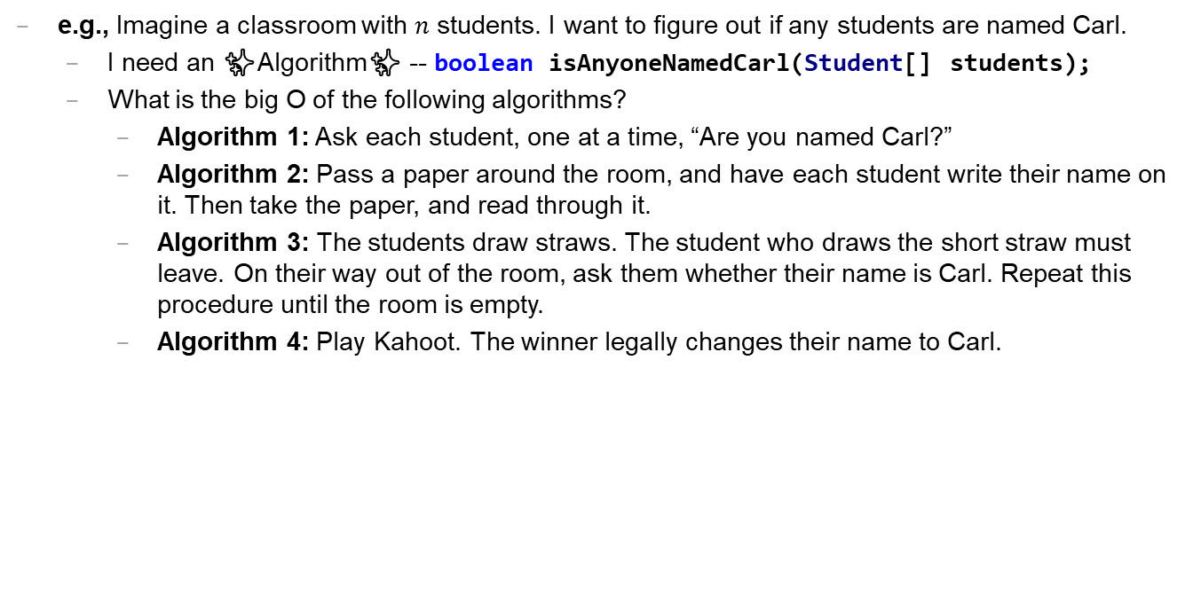
Caaaaaaaaaaaarl
e.g., Imagine a classroom with $n$ students. I want to figure out if any students are named Carl.
I need an ✨Algorithm✨ -- boolean isAnyoneNamedCarl(Student[] students);
What is the big O of the following algorithms?
Algorithm 1: Ask each student, one at a time, “Are you named Carl?”
Algorithm 2: Pass a paper around the room, and have each student write their name on it. Then take the paper, and read through it.
Algorithm 3: The students draw straws. The student who draws the short straw must leave. On their way out of the room, ask them whether their name is Carl. Repeat this procedure until the room is empty.
Algorithm 4: Play Kahoot. The winner legally changes their name to Carl.

Slide 339
extra time: practice exam questions 🤷‍♂️

Slide 340

ANNOUNCEMENTS today is No Laptop Monday WARMUP how many arrays does this app use? (answer on Friday) TODAY arrays, aka, The Best Data Structure Ever
arrays

Slide 341
record LEC 02

Slide 342
mental model of an array

Slide 343
mental model of an array
elements live in equally-sized boxes all right next to each other
🟩🟩🟩🟩🟩🟩🟩🟩
the array itself lives "in memory"

Slide 344

mental model of an array
elements live in equally-sized boxes all right next to each other
🟩🟩🟩🟩🟩🟩🟩🟩
the array itself lives "in memory"

Slide 345
arrays

Slide 346
arrays (1/2)
an array is a fixed-size sequence of elements, all of the same type
"an array of 4372 double's"
"an array of 1 int's"
"an array of 64 Student's"

Slide 347
arrays (2/2)
we will often write an array using curly braces
{ 7, 7, 9 } is an array containing 7, 7, and 9
optionally, you can include a comma after the last element
{ 7, 7, 9, }
☠ even though sets from math also use curly braces, Java arrays have nothing to do with sets; in a set, all elements must be unique

Slide 348
array operations

Slide 349
creating an array (1/2)
you can create an array by specifying its length (the number of elements); if you do, the array is zero-initialized (all elements are initially set to zero)
int[] array = new int[8]; // { 0, 0, 0, 0, 0, 0, 0, 0 }
boolean[] array = new boolean[2]; // { false, false }
String[] array = new String[3]; // { null, null, null }

Slide 350
creating an array (2/2)
you can also create an array by specifying its elements; if you do, the array's length is the number of elements you specified
int[] array = { 7, 7, 9 };
boolean[] array = { true };
String[] array = { "hello", "world" };

Slide 351
getting an array's length
after creating an array, you can get (but not set) its length
int[] array = { 7, 7, 9 };
System.out.println(array.length); // 3
int[] array = new int[8];
System.out.println(array.length); // 8
Error: cannot assign a value to final variable length
array.length = 42;

Slide 352
getting the value of an element of an array
you can get the value of an element of an array using the square brackets and the index of the element
this is also called "accessing the array"
int[] array = { 3, 4, 5 };
int foo = array[0]; // 3
int[] array = { 3, 4, 5 };
int foo = array[42];
java.lang.ArrayIndexOutOfBoundsException: 42

Slide 353
setting the value of an element of an array
you can set the value of an element of an array using the square brackets and the index of the element
int[] array = { 7, 7, 9 };
array[1] = 8;
// { 7, 8, 9 }
int[] array = { 7, 7, 9 };
array[-1] = 1000;
java.lang.ArrayIndexOutOfBoundsException: -1

Slide 354
☠ printing the elements of an array
☠ in Java, you don't simply call System.out.println(array)
instead, you call System.out.println(Arrays.toString(array));
note: this prints with square brackets instead of curly brackets
🤷‍♂️

Slide 355
runtime of array operations

Slide 356
runtime of array operations
arrays are fast!
⏱️ creating an array takes $𝒪(n)$ time, where $n$ is the length of the array
⏱️ getting the value of the i-th element of an array takes $𝒪(1)$ time
⏱️ setting the value of the i-th element of an array takes $𝒪(1)$ time

Slide 357
accessing an array "under the hood"
how Java does array[4], step-by-step:
start at the head (0-th element) of the array 🟦⬛⬛⬛⬛⬛⬛⬛
move over 4 slots (using an $𝒪(1)$ "add") ⬛⬛⬛⬛🟦⬛⬛⬛
return the value of the element in that slot ⬛⬛⬛⬛🟨⬛⬛⬛
we can't actually see Java do this (it's too "low level")
but we *can* see C do it! (stay tuned 🙂)

Slide 358
iterating over an array

Slide 359
iterating over an array
a for loop can be used to iterate over an array
for (int i = 0; i < array.length; ++i) {
array[i] = ...;
}

Slide 360
array examples

Slide 361
example: creating an array of the first 100 non-negative integers

Slide 362
example: creating an array of the first 100 non-negative integers
import java.util.*;
class Main {
public static void main(String[] arguments) {
int[] array = new int[100];
for (int i = 0; i < array.length; ++i) {
array[i] = i;
}
System.out.println(Arrays.toString(array));
}
}

Slide 363
example: array copy

Slide 364
example: array copy
import java.util.*;
class Main {
public static void main(String[] arguments) {
int[] source = { 3, 4, 5 };
int[] destination = new int[source.length];
for (int i = 0; i < source.length; ++i) {
destination[i] = source[i];
}
System.out.println(Arrays.toString(source));
System.out.println(Arrays.toString(destination));
}
}

Slide 365
☠ example: bad very bad broken array copy

Slide 366
☠ example: bad very bad broken array copy
import java.util.*;
class Main {
public static void main(String[] arguments) {
int[] source = { 3, 4, 5 };
int[] destination = source;
source[0] = 7;
System.out.println(Arrays.toString(source));
System.out.println(Arrays.toString(destination));
}
}

Slide 367
ANNOUNCEMENTS today is Laptop Wednesday 💻 🎉 WARMUP internally, a String is an array of characters what must stringA + stringB *do*? why might this be scary? 👻
TODAY more arrays; arrays of arrays; arrays arrays arrays

Slide 368
Homework-02 (refresh the page!) 📚

Slide 369
Pre-Lab Post-Lab

Slide 370
record LEC 02

Slide 371
example: circular array
3, 4, 5, 6, 7, 8, 9, 10, 11,

Slide 372
example: circular array
import java.util.*;
class Main {
public static void main(String[] arguments) {
int[] array = new int[5];
int indexToWriteIntoNext = 0;
while (true) {
array[indexToWriteIntoNext] = getIntFromUser();
indexToWriteIntoNext = (indexToWriteIntoNext + 1) % array.length;
System.out.println(Arrays.toString(array));
}
}
static int getIntFromUser() {
Scanner scanner = new Scanner(System.in);
while (!scanner.hasNextInt()) { scanner.nextLine(); }
return scanner.nextInt();
}
}

Slide 373
example: finding the index (and value) of an array's maximum element

Slide 374
example: finding the index (and value) of an array's maximum element
import java.util.*;
class Main {
public static void main(String[] arguments) {
double[] array = { 1.0, 3.0, -42.0, 1000.0, 99.0 };
int indexOfMaximumElement = -1;
double valueOfMaximumElement = Double.NEGATIVE_INFINITY;
for (int i = 0; i < array.length; ++i) {
if (array[i] > valueOfMaximumElement) {
indexOfMaximumElement = i;
valueOfMaximumElement = array[i];
}
}
System.out.println("array[" + indexOfMaximumElement + "] = " + valueOfMaximumElement);
}
}

Slide 375
multi-dimensional arrays

Slide 376
multi-dimensional arrays

Slide 377
multi-dimensional arrays (arrays of arrays of ...)
multi-dimensional arrays are sometimes really handy
int[][] array = { { 3, 4 }, { 5, 6 }, { 7, 8 } };
System.out.println(Arrays.deepToString(array));
// [[3, 4], [5, 6], [7, 8]]
System.out.println(array[0][1]); // 4
int[][][] array = new int[2][3][4];
array[0][0][0] = 42;
System.out.println(Arrays.deepToString(array));
// [[[42, 0, 0, 0], [0, 0, 0, 0], [0, 0, 0, 0]], [[0, 0, 0, 0], [0, 0, 0, 0], [0, 0, 0, 0]]]

Slide 378
swap

Slide 379
🐍 Python swap

Slide 380
🐍 Python swap
a = 0
b = 1
a, b = b, a # Python swap
# a is now 1
# b is now 0

Slide 381
☠️ BAD VERY BAD BROKEN swap

Slide 382
☠️ BAD VERY BAD BROKEN swap
int a = 0;
int b = 1;
{ // BAD VERY BAD BROKEN swap
a = b; // a <- 1
b = a; // b <- 1
}

Slide 383
swap

Slide 384
swap
int a = 0;
int b = 1;
{ // swap
int tmp = a; // tmp <- 0
a = b; // a <- 1
b = tmp; // b <- 0
}

Slide 385
array algorithms that use swaps

Slide 386
reversing an array

Slide 387
out-of-place reverse
we can reverse an array out-of-place using an additional array
static int[] outOfPlaceReverse(int[] array) {
int[] result = new int[array.length];
for (int i = 0; i < array.length; ++i) {
int j = (array.length - 1) - i;
result[i] = array[j];
}
return result;
}

Slide 388
in-place reverse
we can reverse an array in-place using "swaps" (no additional array)
static void inPlaceReverse(int[] array) {
for (int i = 0; i < array.length / 2; ++i) {
int j = (array.length - 1) - i;
int tmp = array[i];
array[i] = array[j];
array[j] = tmp;
}
}

Slide 389
bubble sort

Slide 390
bubble sort
bubble sort is a simple in-place sorting algorithm that uses swaps
import java.util.*;
class Main {
public static void main(String[] arguments) {
int[] array = { 2, 4, 1, 6, 0, 3, 5 };
boolean arrayIsSorted;
do {
arrayIsSorted = true;
for (int i = 0; i < array.length - 1; ++i) {
if (array[i] > array[i + 1]) {
arrayIsSorted = false;
// swap
int tmp = array[i];
array[i] = array[i + 1];
array[i + 1] = tmp;
}
}
} while (!arrayIsSorted);
System.out.println(Arrays.toString(array));
}
}

Slide 391
ANNOUNCEMENTS today is Fun Laptop Friday 💻 🎉
Post-Lab @ 1:00 – 2:00
colloquium @ 2:35; juggling club @ 4:00 WARMUP i finished my paper video (ish)!
let's count the arrays! 🐉
TODAY retry of the array tutorial; live-code; super bugs

Slide 392
how many arrays?
ARRAYS (not counting tiny arrays of 3 double's, which i use to represent points)
NOTE: Counts are very approximate
==========
strings for loading files >5
huge arrays for drawing random stuff (the floor, etc) 2
random stuff in my cow.cpp library (keyboard state, OpenGL objects, etc.) >20
random global variables 1
building the simulation >6
simulation state 3
simulation itself >20
dragon head mesh 7
dragon body mesh 7
dragon mesh 7
sphere mesh 3
cylinder mesh 3
motor configuration 3
arrays that just move data back and forth between C++ <-> unity 8
inverse kinematics >15
physics >10
----------
definitely at least 100; probably less than 1000

Slide 393
💻 array tutorial

Slide 394
💻 array tutorial (this time with a wiki page)

Slide 395
💻 array tutorial
// 🟢 ([5, 4, 7, 0, 0, 7], 7) -> 2
// 🟢 ([5, 4, 7, 0, 0, 7], 3) -> -1
static int findFirstIndexOf(int[] array, int value);
// 🟦 ([1, 3, 3, 2, 3, 4], 3) -> [1, 2, 4]
static int[] removeAllOccurences(int[] array, int value);
// ♦️ [[1, 3], [2, 4, 5], [0, 5]] -> [0, 1, 2, 3, 4, 5, 5]
static int[] mergeArrayOfSortedArrays(int[][] arrays);

Slide 396
record LEC 02

Slide 397
attempt to live-code the solutions while half-asleep 🙂👍

Slide 398
☕️ the art of coding things in the right order compile and run early compile and run often

Slide 399
why implement Rule 22 first? why not just skip straight to the general case?

Slide 400
well, let us imagine...

Slide 401
let's imagine...
...you decide to develop $n$ different things at once...
...and then, finally, you compile and run...
...aaaaand you have a bug! 🐛
so...what is the cause of the bug? what code is broken? 🤔
well...i guess it could be any of the $n$ things you just wrote!
and while $𝒪(n)$ possible sources of bugs might seem bad...

Slide 402
...the reality is ✨so much worse✨!

Slide 403
because broken code likes to interact with other broken code, to make✨super bugs✨!

Slide 405
not broken
broken
developing one thing at a time

Slide 406
not broken
A is broken
B is broken
A and B are both broken
developing two things at a time

Slide 407
asymptotic bug-finding time

Slide 408
$$𝒪(2^{n})$$
gl;hf 🙂👍

Slide 409
big lesson
implement code one thing at a time
compile and run and test after implementing every single thing
this is a learned skill!
how i would actually implement the automata homework
make the array
print the array as an array
print the array as a string
update the array once using Rule 22 and print the result
wrap the printing and update in a for loop
implement code to handle all rules and test it on Rule 22
test it on the other rules

Slide 410
this is a learned skill!

Slide 411
in summary

Slide 412
ANNOUNCEMENTS today is No Laptop Monday! WARMUP what is a 3, 4, 5 right triangle (from geometry)?
what are points and vectors (from geometry)?
why would you write a function?
why would you write a class?
TODAY a very class-y lecture lol

Slide 413
draw some points and lines on the board

Slide 414
monday memes

Slide 415
code up the entire program without compiling it
compile early; compile often

Slide 416
compilers

Slide 417
record LEC 01

Slide 418
functions

Slide 419
anatomy of a function

Slide 420
anatomy of a function (1/2)
a function is a lil chunk of code you can call from elsewhere
a function takes any number of arguments
... foo(int arg) { ... } // function foo takes an int
a function with a non-void return type must return a value of that type
int bar(...) { ... } // bar returns an int
void baz(...) { ... } // baz doesn't return anything
ReturnType functionName(ArgumentOneType argumentOne, ...) {
...
}

Slide 421
anatomy of a function (2/2)
void drawLine(Vector2 pointA, Vector2 pointB, Vector3 color) {
...
}

Slide 422
function arguments

Slide 423
arguments
a function can take arguments

Slide 424
return

Slide 425
return (1/2)
a return statement stops execution of a function and returns the program to where the function was called
some return statements return a value
return 123;
others do not
return;

Slide 426
return (2/2)
a function with a non-void return type must return a value of that type, regardless of the path taken through the function
Error: missing return statement
static boolean isPrime(int n) {
if (n <= 1) { return false; }
for (int i = 2; i <= Math.sqrt(n); ++i) {
if (n % i == 0) { return false; }
}
}

Slide 427
return (2/2)
a function with a non-void return type must return a value of that type, regardless of the path taken through the function
static boolean isPrime(int n) {
if (n <= 1) { return false; }
for (int i = 2; i <= Math.sqrt(n); ++i) {
if (n % i == 0) { return false; }
}
return true;
}

Slide 428
void

Slide 429
void
void is a special return type meaning a function does not return a value
void functions often modify (the objects referenced by) their arguments
static void reverseArrayInPlace(int[] array) { ... }
// no need to return a reference to array // (user of the function already has one)
in Java, the main method is a void function
public static void main(String[] arguments) { ... }

Slide 430
the call stack

Slide 431
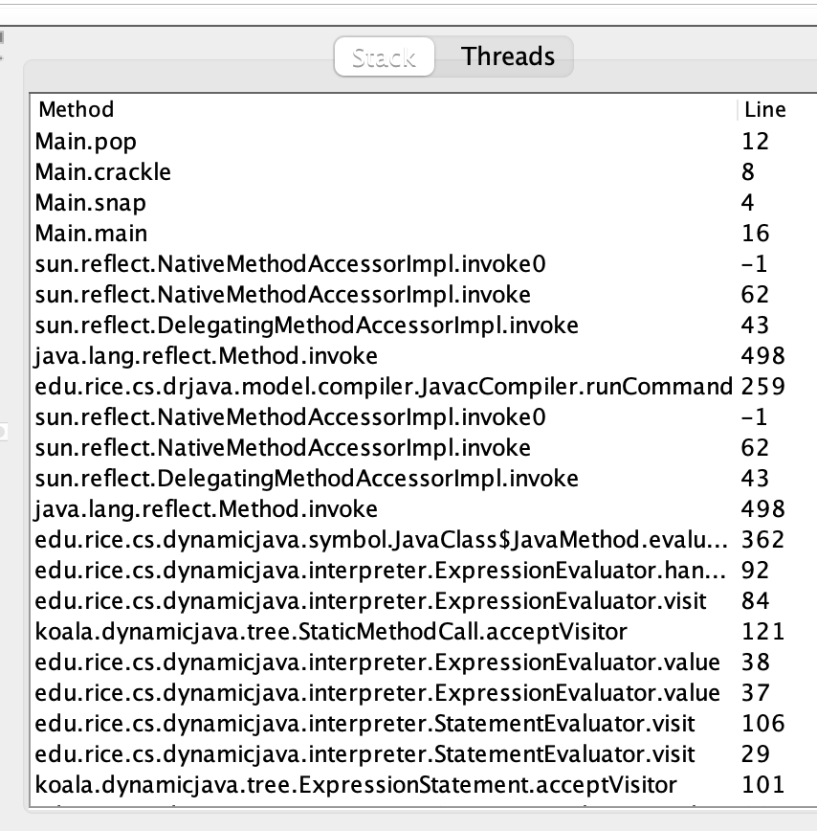
the call stack
functions can call other functions
the resulting "stack" of function calls is called the call stack
class Main {
static void snap() {
crackle();
}
static void crackle() {
pop();
}
static void pop() {
return;
}
public static void main(String[] arguments) {
snap();
}
}

Slide 432
🤔

Slide 433
recursion

Slide 434
recursion (1/2)
a recursive function is a function that calls itself
each call must make progress towards a base case (when the function finally returns without calling itself)
✨ when in doubt, try something like zero for your base case
class Main {
static int digitSum(int n) {
if (n == 0) {
return 0;
}
return digitSum(n / 10) + (n % 10);
}
public static void main(String[] arguments) {
System.out.println(digitSum(256)); // 13
}
}

Slide 435
static int digitSum(int n) {
if (n == 0) {
return 0;
}
return digitSum(n / 10) + (n % 10);
}
return 0;
return digitSum(0) + 2;
return digitSum(2) + 5;
return digitSum(25) + 6;
int a = digitSum(256);

Slide 436
static int digitSum(int n) {
if (n == 0) {
return 0;
}
return digitSum(n / 10) + (n % 10);
}
return 0;
return digitSum(0) + 2;
return digitSum(2) + 5;
return digitSum(25) + 6;
int a = digitSum(256);

Slide 437
static int digitSum(int n) {
if (n == 0) {
return 0;
}
return digitSum(n / 10) + (n % 10);
}
return 0 + 2;
return digitSum(2) + 5;
return digitSum(25) + 6;
int a = digitSum(256);

Slide 438
static int digitSum(int n) {
if (n == 0) {
return 0;
}
return digitSum(n / 10) + (n % 10);
}
return 2;
return digitSum(2) + 5;
return digitSum(25) + 6;
int a = digitSum(256);

Slide 439
static int digitSum(int n) {
if (n == 0) {
return 0;
}
return digitSum(n / 10) + (n % 10);
}
return 2;
return digitSum(2) + 5;
return digitSum(25) + 6;
int a = digitSum(256);

Slide 440
static int digitSum(int n) {
if (n == 0) {
return 0;
}
return digitSum(n / 10) + (n % 10);
}
return 2 + 5;
return digitSum(25) + 6;
int a = digitSum(256);

Slide 441
static int digitSum(int n) {
if (n == 0) {
return 0;
}
return digitSum(n / 10) + (n % 10);
}
return 7;
return digitSum(25) + 6;
int a = digitSum(256);

Slide 442
static int digitSum(int n) {
if (n == 0) {
return 0;
}
return digitSum(n / 10) + (n % 10);
}
return 7;
return digitSum(25) + 6;
int a = digitSum(256);

Slide 443
static int digitSum(int n) {
if (n == 0) {
return 0;
}
return digitSum(n / 10) + (n % 10);
}
return 7 + 6;
int a = digitSum(256);

Slide 444
static int digitSum(int n) {
if (n == 0) {
return 0;
}
return digitSum(n / 10) + (n % 10);
}
return 13;
int a = digitSum(256);

Slide 445
static int digitSum(int n) {
if (n == 0) {
return 0;
}
return digitSum(n / 10) + (n % 10);
}
return 13;
int a = digitSum(256);

Slide 446
static int digitSum(int n) {
if (n == 0) {
return 0;
}
return digitSum(n / 10) + (n % 10);
}
int a = 13;

Slide 447
fin.

Slide 448
recursion (2/2)
a stack overflow error happens when functions call too many functions without returning; these errors are usually caused by broken recursive code
class Main {
static void stackOverflow() {
stackOverflow();
}
public static void main(String[] arguments) {
stackOverflow();
}
}
java.lang.StackOverflowError
at Main.stackOverflow(Tmp.java:3)
at Main.stackOverflow(Tmp.java:3)
at Main.stackOverflow(Tmp.java:3)
at Main.stackOverflow(Tmp.java:3)
at Main.stackOverflow(Tmp.java:3)
at Main.stackOverflow(Tmp.java:3)
at Main.stackOverflow(Tmp.java:3)
at Main.stackOverflow(Tmp.java:3)
at Main.stackOverflow(Tmp.java:3)
at Main.stackOverflow(Tmp.java:3)
at Main.stackOverflow(Tmp.java:3)
at Main.stackOverflow(Tmp.java:3)
at Main.stackOverflow(Tmp.java:3)
at Main.stackOverflow(Tmp.java:3)
at Main.stackOverflow(Tmp.java:3)
at Main.stackOverflow(Tmp.java:3)
at Main.stackOverflow(Tmp.java:3)
at Main.stackOverflow(Tmp.java:3)
at Main.stackOverflow(Tmp.java:3)
at Main.stackOverflow(Tmp.java:3)
at Main.stackOverflow(Tmp.java:3)
at Main.stackOverflow(Tmp.java:3)
at Main.stackOverflow(Tmp.java:3)
at Main.stackOverflow(Tmp.java:3)
at Main.stackOverflow(Tmp.java:3)
at Main.stackOverflow(Tmp.java:3)
at Main.stackOverflow(Tmp.java:3)
at Main.stackOverflow(Tmp.java:3)
at Main.stackOverflow(Tmp.java:3)
at Main.stackOverflow(Tmp.java:3)
at Main.stackOverflow(Tmp.java:3)
at Main.stackOverflow(Tmp.java:3)
at Main.stackOverflow(Tmp.java:3)
at Main.stackOverflow(Tmp.java:3)
at Main.stackOverflow(Tmp.java:3)
at Main.stackOverflow(Tmp.java:3)
at Main.stackOverflow(Tmp.java:3)
at Main.stackOverflow(Tmp.java:3)
at Main.stackOverflow(Tmp.java:3)
at Main.stackOverflow(Tmp.java:3)
at Main.stackOverflow(Tmp.java:3)
at Main.stackOverflow(Tmp.java:3)
at Main.stackOverflow(Tmp.java:3)
at Main.stackOverflow(Tmp.java:3)
at Main.stackOverflow(Tmp.java:3)
at Main.stackOverflow(Tmp.java:3)
at Main.stackOverflow(Tmp.java:3)
at Main.stackOverflow(Tmp.java:3)
at Main.stackOverflow(Tmp.java:3)
at Main.stackOverflow(Tmp.java:3)
at Main.stackOverflow(Tmp.java:3)
at Main.stackOverflow(Tmp.java:3)
at Main.stackOverflow(Tmp.java:3)
at Main.stackOverflow(Tmp.java:3)
at Main.stackOverflow(Tmp.java:3)
at Main.stackOverflow(Tmp.java:3)
at Main.stackOverflow(Tmp.java:3)
at Main.stackOverflow(Tmp.java:3)
at Main.stackOverflow(Tmp.java:3)
at Main.stackOverflow(Tmp.java:3)
at Main.stackOverflow(Tmp.java:3)
at Main.stackOverflow(Tmp.java:3)
at Main.stackOverflow(Tmp.java:3)
at Main.stackOverflow(Tmp.java:3)
at Main.stackOverflow(Tmp.java:3)
at Main.stackOverflow(Tmp.java:3)

Slide 449
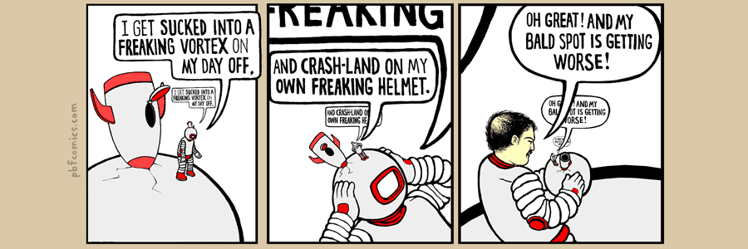

Slide 450
classes

Slide 451
anatomy of a class

Slide 452
anatomy of a class (1/2)
class ClassName {
VariableOneType variableOne;
...
FunctionOneReturnType functionOneName(...) { ... }
...
}
a class is (a blueprint for) a lil chunk of data that you can make elsewhere
a class may have any number of variables (fields)
int foo; // objects of this class have an int called foo
a class may have any number of functions (methods)
int bar() { ... } // objects of class have function bar

Slide 453
anatomy of a class (2/2)
class Vector2 {
// instance variables
double x;
double y;
// constructor
Vector2(double x, double y) { ... }
// instance methods
double length() { ... }
...
}

Slide 454
dot

Slide 455
dot
the dot operator is used to access an object's variables and functions
Vector2 a = new Vector2();
a.x = 3.0;
a.y = 4.0;
System.out.println(a.length()); // 5.0

Slide 456
terminology

Slide 457
class vs. object (instance of a class)
a class is NOT the same thing as an object
a class is "a blueprint for making objects"
we can make an instance of a class (an object) using the new keyword
this is called "instantiating the class"

Slide 458
new and constructors

Slide 459
new
the new keyword create a new instance of a class and calls its appropriate constructor
int[] array = new int[5]; // { 0, 0, 0, 0, 0 }
Vector2 a = new Vector2(3.0, 4.0); // (3.0, 4.0)
☠️ you don't need new to create a new string
String string = "strings are their own thing";
☠️ you don't need new to create a new array when using {} syntax
int[] array = { 1, 2, 3 };
☠️ new doesn't actually return the object it created; it returns a reference to the object it created

Slide 460
constructors (1/2)
a constructor is called when an object is created
if the class does not have a constructor, then the default constructor must be called, which takes no arguments and sets all variables to zero
Vector2 a = new Vector2(3.0, 4.0); // (3.0, 4.0)
Vector2 b = new Vector2(); // (0.0, 0.0)

Slide 461
constructors (2/2)
a (non-default) constructor is never necessary, but is often convenient
Vector2 a = new Vector2(3.0, 4.0); // a: (3.0, 4.0)
Vector2 a = new Vector2(); // a: (0.0, 0.0)
a.x = 3.0; // a: (3.0, 0.0)
a.y = 4.0; // a: (3.0, 4.0)

Slide 462
this 🐍 in Python, this is self

Slide 463
this (1/2)
this is a reference to the instance of the class whose function we're inside of
class Vector2 {
double x;
double y;
Vector2(double x, double y) {
this.x = x;
this.y = y;
}
Vector2 plus(Vector2 other) {
return new Vector2(this.x + other.x, this.y + other.y);
}
...
}

Slide 464
this (2/2)
this is especially useful inside a constructor (elsewhere it's usually optional)
class Vector2 {
double x;
double y;
Vector2(double x, double y) {
this.x = x;
this.y = y;
}
Vector2 plus(Vector2 other) {
return new Vector2(x + other.x, y + other.y);
}
...
}

Slide 465

ANNOUNCEMENTS today is Laptop Wednesday!
✨ would you like Your Homework-02 Code to be prominently featured in our tutorial today?! first come first served WARMUP what is memory?
what is a memory?
can you trust your memory?
TODAY class tutorial

Slide 466
HW-00 has been graded

Slide 467
HW-01 is being graded...

Slide 468
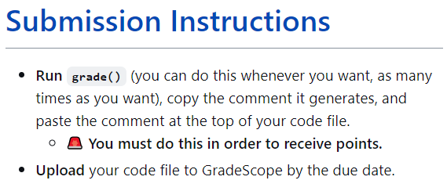

Slide 471
most of you did not do this

Slide 472


Slide 473
you have 24 hours to do this

Slide 474
record LEC 01

Slide 475
Java memory model (references to objects)

Slide 476
references and null

Slide 477
references (1/2)
in Java, we deal with references to objects
int[] foo; // foo is a reference to an int array
String bar; // bar is a reference to a String object
Vector2 a; // a is a reference to a Vector2 object

Slide 478
references (2/2)
☠️ you can (unintentionally) make multiple reference to one object
Vector2 a = new Vector2(3.0, 4.0);
Vector2 b = a;
// a and b are references to the same Vector2 object!
a
x
y
3.0
4.0
b

Slide 479
null
a null reference doesn't refer to any object
Vector2[] array = new Vector2[3]; // { null, null, null }
Vector2 a = null;

Slide 480
the heap a reference is a memory address a memory address is an integer

Slide 481
the heap
objects made using new are stored "on the heap"
the heap is a huuuuuge chunk of memory
objects have an address in that memory (that says where they live)
0x00110022
0x00a20038
0x0ff0a147

Slide 483
Vector2 a = new Vector2(3.0, 4.0);
a
0x00000008
3.0
4.0
0x00000000
0x00000003
0x00000013
0x00000001
0x00000002
0x00000010
0x00000011
0x00000004
0x00000007
0x0000000b
0x00000012
0x00000005
0x00000006
0x00000008
0x00000009
0x0000000a
0x00000014
0x0000000c
0x0000000f
0x00000015
0x0000000d
0x00000008
0x0000000e

Slide 484
references (1/2)
= assigns the value on the right-hand side to the variable on the left-hand side
int a = 3;
int b = a;
a
b
3
3

Slide 485
references (1/2)
= assigns the value on the right-hand side to the variable on the left-hand side
int a = 3;
int b = a;
a = 7;
a
b
7
3

Slide 486
references (2/2)
int a = 3;
int b = a;
a
b
☠️ new doesn't actually return the object it created; it returns a reference to the object it created
a reference is an object's location in memory
this reference is a number (it acts like an int)!
3
3
Foo a = new Foo();
Foo b = a;
a
b
0x7aae6227
0x7aae6227
0x7aae6227

Slide 487
references (2/2)
int a = 3;
int b = a;
a
b
☠️ new doesn't actually return the object it created; it returns a reference to the object it created
a reference is an object's location in memory
this reference is a number (it acts like an int)!
3
3
Foo a = new Foo();
Foo b = a;
a = null;
a
b
0x7aae6227
null
0x7aae6227

Slide 488
references (3/2)
i told a small lie last time we talked
System.out.println(array); does NOT actually print array's memory address
rather, it prints a number called array's "hash code"
(the hash code is typically calculated using the memory address)
🤷
the important point is that a reference is a memory address
and a memory address is an integer (often written in hex) 🙂👍

Slide 489
static

Slide 490
static variables and static methods

Slide 491
instance variables vs. static variables
an instance variable is part of an instance of a class
a static variable (class variable) is part of the class itself
there is only one, period. (it's a global variable that lives "on the class")
class Vector3 {
double x;
double y;
double z;
static Vector3 red = new Vector3(1.0, 0.0, 0.0);
...
}
// drawLine(a, b, Vector3.red);

Slide 492
instance methods vs. static methods
an instance method must be called on an instance (object) of a class
a static method (class method) can be called on the class itself
✅ there is no this in a static method
class Vector2 {
double length() { ... }; // (non-static method)
static double distanceBetween(Vector2 a, Vector2 b) { ... }
...
}
// a.length();
// Vector2.distanceBetween(a, b);

Slide 493
example

Slide 494
class Dog {
static int numTimesAllDogsBarked;
String bark;
Dog(String bark) {
this.bark = bark;
}
void makeBark() {
System.out.println(this.bark);
Dog.numTimesAllDogsBarked++;
}
> public static void main(String[] args) {
Dog rex = new Dog("woof!");
> Dog fido = new Dog("yip!");
rex.makeBark();
fido.makeBark();
System.out.println(Dog.numTimesAllDogsBarked);
}
}
Dog
(the class)
int numTimesAllDogsBarked;
args
(an instance/object of String[])
rex
(an instance of Dog)
rex.bark
(an instance of String)
String bark;
"woof!"
String[] args;
Dog rex;
Dog fido;
fido
(an instance of Dog)
fido.bark
(an instance of String)
main()
(stack frame)
String bark;
"yip!"
(these are references!)
----Stack----
(local variables)
-------Heap-------
(instances aka objects)
-----Static-----
(static data)

Slide 495
💻Class Tutorial

Slide 496
ANNOUNCEMENTS today is Jim Codes At You For 50 Minutes Friday 🎉🎉
WARMUP explain!
TODAY Homework-03
65 turrets = new Turret[100];
66 for (int i = 0; i < turrets.length; i++) {
67 Turret turret = turrets[i];
68 turret = new Turret();
69 }
70 turrets[0].position = new Vector2(40.0, 0.0);
java.lang.NullPointerException
at HW03.setup(HW03.java:70)

Slide 497
record LEC 01

Slide 498
example

Slide 499
turrets = new Turret[100]; for (int i = 0; i < turrets.length; i++) { // consider iteration i <- 0 Turret turret = turrets[i]; turret = new Turret(); } turrets[0].position = new Vector2(40.0, 0.0);
turret
turrets
0x00000010
0x00000010
null
null
null
null
0x00000000
0x00000003
0x00000013
0x00000001
0x00000002
0x00000010
0x00000011
0x00000004
0x00000007
0x0000000b
0x00000012
0x00000005
0x00000006
0x00000008
0x00000009
0x0000000a
0x00000014
0x0000000c
0x0000000f
0x00000015
0x0000000d
0x0000000e

Slide 500
turrets = new Turret[100]; for (int i = 0; i < turrets.length; i++) { // consider iteration i <- 0 Turret turret = turrets[i]; turret = new Turret(); } turrets[0].position = new Vector2(40.0, 0.0);
turret
turrets
0x00000002
0x00000010
null
null
0.0, 0.0
0
0.0, 0.0
null
null
0x00000000
0x00000003
0x00000013
0x00000001
0x00000002
0x00000010
0x00000011
0x00000004
0x00000007
0x0000000b
0x00000012
0x00000005
0x00000006
0x00000008
0x00000009
0x0000000a
0x00000014
0x0000000c
0x0000000f
0x00000015
0x0000000d
0x0000000e

Slide 501
ANNOUNCEMENTS today is Jim Codes At You For 50 Minutes Friday 🎉🎉
Help Hours
WARMUP explain!
TODAY Homework-03
65 turrets = new Turret[100];
66 for (int i = 0; i < turrets.length; i++) {
67 turrets[i] = new Turret();
68 // Turret turret = turrets[i]; OK here
69 }
70 turrets[0].position = new Vector2(40.0, 0.0);

Slide 502
stack trace
a stack trace is the state of the call stack (all the functions that got called and haven't returned yet), usually printed when your program crashes
java.lang.NullPointerException
at HW03.setup(HW03.java:70)
at App.paintComponent(Cow.java:397)
at javax.swing.JComponent.paint(JComponent.java:1056)
at javax.swing.JComponent.paintChildren(JComponent.java:889)
at javax.swing.JComponent.paint(JComponent.java:1065)
at javax.swing.JComponent.paintChildren(JComponent.java:889)
at javax.swing.JComponent.paint(JComponent.java:1065)
at javax.swing.JLayeredPane.paint(JLayeredPane.java:586)
at javax.swing.JComponent.paintChildren(JComponent.java:889)
at javax.swing.JComponent.paintToOffscreen(JComponent.java:5217)
at javax.swing.RepaintManager$PaintManager.paintDoubleBuffered(RepaintManager.java:1579)
at javax.swing.RepaintManager$PaintManager.paint(RepaintManager.java:1502)
at javax.swing.RepaintManager.paint(RepaintManager.java:1272)
at javax.swing.JComponent.paint(JComponent.java:1042)
at java.awt.GraphicsCallback$PaintCallback.run(GraphicsCallback.java:39)
at sun.awt.SunGraphicsCallback.runOneComponent(SunGraphicsCallback.java:79)
at sun.awt.SunGraphicsCallback.runComponents(SunGraphicsCallback.java:116)
at java.awt.Container.paint(Container.java:1978)
at java.awt.Window.paint(Window.java:3906)
at javax.swing.RepaintManager$4.run(RepaintManager.java:842)
at javax.swing.RepaintManager$4.run(RepaintManager.java:814)
at java.security.AccessController.doPrivileged(Native Method)
at java.security.ProtectionDomain$JavaSecurityAccessImpl.doIntersectionPrivilege(ProtectionDomain.java:74)
at javax.swing.RepaintManager.paintDirtyRegions(RepaintManager.java:814)
at javax.swing.RepaintManager.paintDirtyRegions(RepaintManager.java:789)
at javax.swing.RepaintManager.prePaintDirtyRegions(RepaintManager.java:738)
at javax.swing.RepaintManager.access$1200(RepaintManager.java:64)
at javax.swing.RepaintManager$ProcessingRunnable.run(RepaintManager.java:1732)
at java.awt.event.InvocationEvent.dispatch(InvocationEvent.java:311)
at java.awt.EventQueue.dispatchEventImpl(EventQueue.java:758)
at java.awt.EventQueue.access$500(EventQueue.java:97)
at java.awt.EventQueue$3.run(EventQueue.java:709)
at java.awt.EventQueue$3.run(EventQueue.java:703)
at java.security.AccessController.doPrivileged(Native Method)
at java.security.ProtectionDomain$JavaSecurityAccessImpl.doIntersectionPrivilege(ProtectionDomain.java:74)
at java.awt.EventQueue.dispatchEvent(EventQueue.java:728)
at java.awt.EventDispatchThread.pumpOneEventForFilters(EventDispatchThread.java:205)
at java.awt.EventDispatchThread.pumpEventsForFilter(EventDispatchThread.java:116)
at java.awt.EventDispatchThread.pumpEventsForHierarchy(EventDispatchThread.java:105)
at java.awt.EventDispatchThread.pumpEvents(EventDispatchThread.java:101)
at java.awt.EventDispatchThread.pumpEvents(EventDispatchThread.java:93)
at java.awt.EventDispatchThread.run(EventDispatchThread.java:82)

Slide 503
stack trace
a stack trace is the state of the call stack (all the functions that got called and haven't returned yet), usually printed when your program crashes
java.lang.NullPointerException
at HW03.setup(HW03.java:70)

Slide 504
how did the starter code come to be?

Slide 505
run the starter code

Slide 506
delete the starter code

Slide 507
get familiar with App setup() runs once at the beginning loop() runs over and over, once per frame during a frame (like a frame of a movie) we update and draw the world

Slide 508
loop(); // update and draw
loop(); // update and draw
loop(); // update and draw
loop(); // update and draw
loop(); // update and draw
loop(); // update and draw
loop(); // update and draw
loop(); // update and draw
loop(); // update and draw

Slide 509
draw a circle for the player get something (anything) on the screen ☺

Slide 510
move the player around the player's position must "persist across frames" the simplest approach is to make playerPosition an instance variable of the HW03 class we will initialize it in setup() and update it in loop() keyboard input is explained in the ✨Documentation✨

Slide 511
DOCUMENTATION

Slide 512
make Player a class optional, but seems reasonable in Java (would have been okay to skip straight to this step; i tend not to)

Slide 513
make a Turret class keep it simple!--make it similar to Player

Slide 514
write usage code for how we'll create and update the bullets since it's Week-03, we'll store a bunch of "slots" for bullets in a huuuge array i'll call currently unused slots "not alive" ("dead") to fire a bullet, find the first empty slot in the bullets array and make that bullet alive 🧟

Slide 515
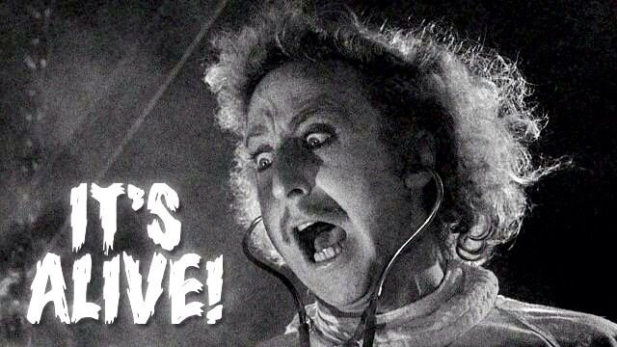

Slide 516
starting the homework

Slide 517
multiple turrets

Slide 518
fire function

Slide 519
extensions

Slide 520
turrets flashing upon hit i like having an instance variable called int framesSinceHitByBullet;

Slide 522
🎥 time

Slide 523
object-oriented programming

Slide 524
in Java, everything is a class

Slide 525
object-orientation != my-code-has-objects

Slide 526
compression-oriented programming

Slide 527
neo in the matrix (int) int a; int b

Slide 528
int[] nums; nums = new int[4]; int[] nums = new int[4];

Slide 529
details

Slide 530
garbage collection

Slide 531
garbage collector
the garbage collector is like a trash truck that drives around in memory; when it notices an object that your program no longer has any references to, it frees up that memory for future use
🌊 C does NOT have a garbage collector; in C you free heap-allocated memory yourself by calling free(...)

Slide 532
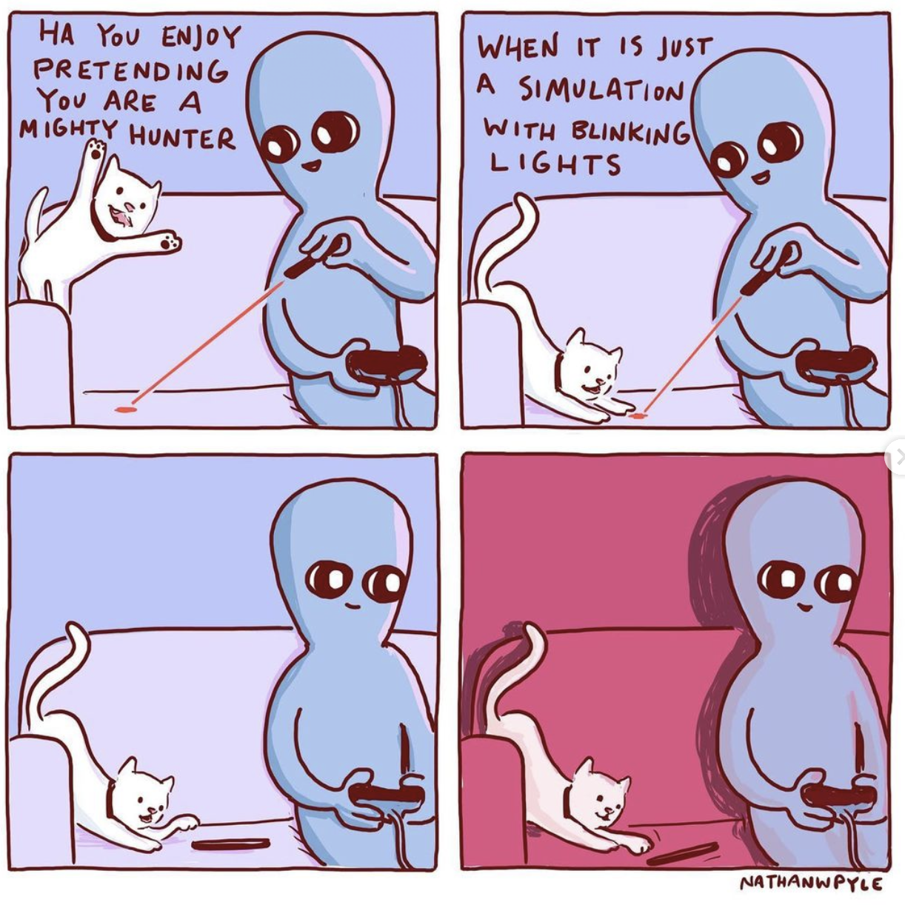
ANNOUNCEMENTS this week, the role of Jim will be played by Jeannie & Mark
WARMUP what is a (real-world) TODO list?
why are lists useful?
TODAY array lists

Slide 533
warmup: using lists
When are some real-life list examples?
What actions do you perform on lists?
What properties of lists do you care about?
Keep these in mind!

Slide 534
array list

Slide 535
motivation

Slide 536
limitations of arrays
think back to your days of using lists in Python
how do they compare to arrays in Java?
what are the pros/cons of arrays?

Slide 537
arrays are fixed-length
🔄 an array is a fixed-length sequence of elements all of the same type
🙂 simple, fast ($𝒪(1)$ access)
☹️ fixed-length (what if we don't know how many elements we'll have?)
solution A: make an array that's longer than you'll ever need
🔄 bullets = new Bullet[256]; // from HW-03
🙂 simple
☹️ wastes space, might end up not actually be long enough
solution B: make an array that grows as needed (an array list)

Slide 538
array list

Slide 539
array list
an array list (dynamic array, stretchy buffer, vector) acts like an array that can grow as needed
like an array, the user can access the $i$-th element in an array list
get the value of an element that is already there
set the value of an element that is already there
unlike an array, the user can always add a new element to an array list, no matter how many elements it already has
append (push back) a new element to the back or end
insert a new element at any index
the user can also remove elements from an array list

Slide 540
implementing array list
what properties of lists do we care about?
The items
Total number of items
what actions do we perform on lists?
adding item to end
removing item(s)
inserting item in middle
maybe sorting items? we’ll discuss this later…
these features will guide our implementation
properties: instance variables
actions: instance methods

Slide 541
the internal (private) array
an array list stores its elements inside of an array
an array list's capacity is the length of this array
an array list's size (length) is the number of (non-null) elements currently actually stored in this array
class ArrayList<ElementType> {
private ElementType[] privateArray;
private int numberOfElementsActuallyStoredInPrivateArray;
// int capacity() { return privateArray.length; }
int size() {
return numberOfElementsActuallyStoredInPrivateArray;
};
}

Slide 542
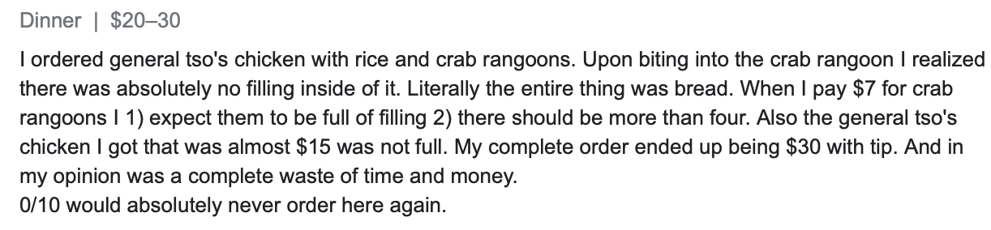
array list
☠️ an array list's capacity is NOT the same thing as its size
imagine ArrayList<String> bestaurants; with capacity 5 and size 3 // if we could print bestaurants.privateArray... ["Blango", "Sproot", "Sparket", null, null] ...we would see 5 – 3 = 2 "empty slots."

Slide 543
array list
☠️ even though another name for an array list is a "vector," the array list is NOT related to Vector2 (vector from math/physics)

Slide 544
Java's ArrayList<ElementType>

Slide 545
generic
Replace ElementType with the type of object being stored in your array list
Java's ArrayList<ElementType> is generic
// make a list of Foo's ArrayList<Foo> list = new ArrayList<>(); ArrayList<Foo> list = new ArrayList<Foo>();
// make a list of int's // NOTE: you must use Integer instead of int inside the <> ArrayList<Integer> list = new ArrayList<>();
ArrayList<Boolean> list = new ArrayList<>();
ArrayList<Double> list = new ArrayList<>();

Slide 546
generic
Java's ArrayList<ElementType> is generic
// make a list of lists of Vector2's ArrayList<ArrayList<Vector2>> list = new ArrayList<>();

Slide 547
internal array is private
Java's ArrayList<ElementType> uses access modifiers
specifically, its internal array is private (so is the int storing its size)
private means you can't access a variable/function directly
instead, you will need to use the functions (instance methods) given in our Documentation
class ArrayList<ElementType> {
int size(); // number of elements in the list
void add(ElementType element); // add element to the end of the list
void add(int index, ElementType element); // insert element into the list at index
ElementType get(int index); // get element at index
void removeElementAt(int index); // remove element by index
boolean removeElement(ElementType element); // remove element by value
}

Slide 548
the user doesn't think about the "empty slots"
ArrayList<String> list = new ArrayList<>();
System.out.println(list); // []
list.add("Hello");
list.add("World");
System.out.println(list); // [Hello, World]
list.add(1, "Cruel");
System.out.println(list); // [Hello, Cruel, World]
System.out.println(list.size()); // 3
System.out.println(list.get(1)); // Cruel
list.removeElementAt(0);
System.out.println(list); // [Cruel, World]

Slide 549
array list functions (under the hood)

Slide 550
ArrayList() { ... } // constructor
a new array list should have...
this.privateArray = new ElementType[STARTING_CAPACITY];
this.numberOfElementsActuallyStoredInPrivateArray = 0;
there isn't one right answer to what the STARTING_CAPACITY should be
perhaps...8?
8 sounds good.
🙂👍
note: in the tutorial, we'll use 1 🤷

Slide 551
ElementType get(int index) { ... }
to get an element with a given index...
return privateArray[index];
this is a "getter"
we need it because privateArray is private
users never access privateArray directly

Slide 552
void add(ElementType element) { ... }
to append (push back) a new element to the back (end) of an array list...
write the new element to the first available empty slot in privateArray
increment numberOfElementsActuallyStoredInPrivateArray
potential problems?
what if privateArray is full?
need to make room, but how?

Slide 553
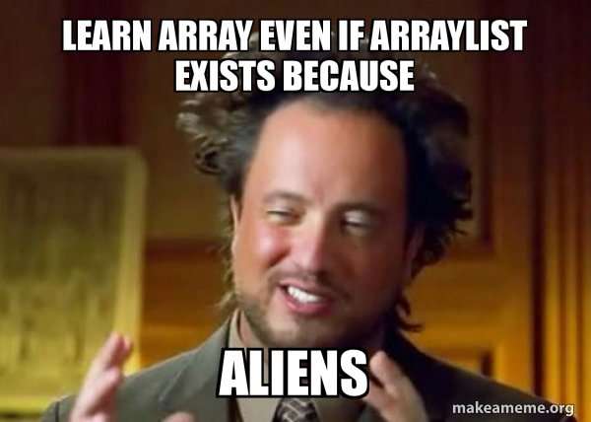
TODAY array lists (continued!)

Slide 554
array list
an array list (dynamic array, stretchy buffer, vector) acts like an array that can grow as needed
like an array, the user can access the $i$-th element in an array list
get the value of an element that is already there
set the value of an element that is already there
unlike an array, the user can always add a new element to an array list, no matter how many elements it already has
append (push back) a new element to the back or end
insert a new element at any index
the user can also remove elements from an array list

Slide 555
generic
Replace ElementType with the type of object being stored in your array list
Java's ArrayList<ElementType> is generic
// make a list of Foo's ArrayList<Foo> list = new ArrayList<>(); ArrayList<Foo> list = new ArrayList<Foo>();
// make a list of int's // NOTE: you must use Integer instead of int inside the <> ArrayList<Integer> list = new ArrayList<>();
ArrayList<Boolean> list = new ArrayList<>();
ArrayList<Double> list = new ArrayList<>();

Slide 556
internal array is private
Java's ArrayList<ElementType> uses access modifiers
specifically, its internal array is private (so is the int storing its size)
private means you can't access a variable/function directly
instead, you will need to use the functions (instance methods) given in our Documentation
class ArrayList<ElementType> {
int size(); // number of elements in the list
void add(ElementType element); // add element to the end of the list
void add(int index, ElementType element); // insert element into the list at index
ElementType get(int index); // get element at index
void removeElementAt(int index); // remove element by index
boolean removeElement(ElementType element); // remove element by value
}

Slide 557
ArrayList() { ... } // constructor
a new array list should have...
this.privateArray = new ElementType[STARTING_CAPACITY];
this.numberOfElementsActuallyStoredInPrivateArray = 0;
there isn't one right answer to what the STARTING_CAPACITY should be
perhaps...8?
8 sounds good.
🙂👍
note: in the tutorial, we'll use 1 🤷

Slide 558
ElementType get(int index) { ... }
to get an element with a given index...
return privateArray[index];
this is a "getter"
we need it because privateArray is private
users never access privateArray directly

Slide 559
void add(ElementType element) { ... }
to append (push back) a new element to the back (end) of an array list...
write the new element to the first available empty slot in privateArray
increment numberOfElementsActuallyStoredInPrivateArray
potential problems?
what if privateArray is full?
need to make room, but how?

Slide 560
void add(ElementType element) { ... }
to append (push back) a new element to the back (end) of an array list...
if privateArray is full...
make a new array two times the length of the current private array
copy the elements of the current private array into this new array (using a for loop)
update the privateArray reference to refer to this new array
write the new element to the first available empty slot in privateArray
increment numberOfElementsActuallyStoredInPrivateArray
food for thought: why is new array 2x size of old array? why not just add 1 extra spot? should we ever shrink the array?
this is an example of the time-space tradeoff!

Slide 561
void add(int index, ElementType element)
to insert a new element so it has a given index...
assert that the given index is valid!
0 OK ("prepend")
numberOfElementsActuallyStoredInPrivateArray OK (append)
-1 BAD VERY BAD (out of bounds)
if privateArray is full...
double its length (see previous slide)
make room for the new element!
move elements with index greater than or equal to the given index one slot to the right
how?

Slide 562
b c d e f g h .
a b c d e f g h

Slide 563

for (int i = index; i < numberOfElements-2, ++i) {
privateArray[i+1] = privateArray[i];
}
...
b c d e f g h .
a b b b b b b b

Slide 564

for (int i = numberOfElements-1; i >= index, --i) {
//copy from right to left
privateArray[i+1] = privateArray[i];
}
...
b c d e f g h .
a b c d e f g h

Slide 565
void add(int index, ElementType element)
to insert a new element so it has a given index...
assert that the given index is valid!
0 OK ("prepend")
numberOfElementsActuallyStoredInPrivateArray OK (append)
-1 BAD VERY BAD (out of bounds)
if privateArray is full...
double its length (see previous slide)
make room for the new element!
move elements with index greater than or equal to the given index one slot to the right (starting at the back!)
✨ for (int i = ...; i >= index, --i) { ... }
write the new element to the given index in privateArray
increment numberOfElementsActuallyStoredInPrivateArray

Slide 566
✨ functions can call other functions
the less general add (append) can be implemented using the more general add (insert)
void add(ElementType element) { add(numberOfElementsActuallyStoredInPrivateArray, element); }
☠️ however, if i were implementing an array list from scratch, i would implement the less general version first because it is simpler

Slide 567
void remove(int index) { ... }
to remove an element with a given index...
move elements with index greater than or equal to the given index one slot to the left
decrement numberOfElementsActuallyStoredInPrivateArray

Slide 568
💻 Array List Tutorial (linked on website)

Slide 569
Tut04() {
// TODO: construct new array list with starting capacity of 1
this.privateArray = new String[1];
this.numberOfElementsActuallyStoredInPrivateArray = 0;
}
String get(int index) {
// TODO: get element at given index
assert index >= 0 && index < numberOfElementsActuallyStoredInPrivateArray;
return privateArray[index];
}

Slide 570
void add(String element) {
// TODO: append element to the back of the list
add(numberOfElementsActuallyStoredInPrivateArray, element);
}
void add(int index, String element) {
// TODO: insert element so it has given index in the list
assert index >= 0 && index <= numberOfElementsActuallyStoredInPrivateArray;
if (numberOfElementsActuallyStoredInPrivateArray == privateArray.length) {
//must make array bigger
String tempArray[] = new String[privateArray.length * 2];
for (int i=0; i<privateArray.length; i++){
tempArray[i]=privateArray[i];
}
privateArray = tempArray; // update the reference
}
//room in the array
//copy from right to left down to index
for (int i=numberOfElementsActuallyStoredInPrivateArray-1; i>=index; --i){
privateArray[i+1]=privateArray[i];
}
privateArray[index] = element;
numberOfElementsActuallyStoredInPrivateArray++;
}

Slide 571
void remove(int index) {
// TODO: remove element at given index
assert index >= 0 && index < numberOfElementsActuallyStoredInPrivateArray;
for (int i=index; i<privateArray.length-1; ++i){
privateArray[i]=privateArray[i+1];
}
privateArray[numberOfElementsActuallyStoredInPrivateArray-1] = null;
numberOfElementsActuallyStoredInPrivateArray--;
}
void repeatElements(int numRepeats) {
int saveValue = size();
for (int i=0; i<saveValue; ++i){
for (int j=0; j<numRepeats-1; j++) {
add(i*numRepeats, get(i*numRepeats));
}
}
}

Slide 572
runtime of array list functions

Slide 573
runtime of array list operations
get() – a single operation that retrieves a value from privateArray
O(1)
set() - a single operation that sets a value in privateArray
O(1)
add() – insert element, shift other elements down to make room in for loop
O(1) – if adding to back (and no need to make room)
O(n) – if adding to middle
O(n) – if adding to any location and we have to grow privateArray (ideally this won’t happen often)
remove() – remove element, shift other elements down to eliminate gap
O(n)

Slide 574
ANNOUNCEMENTS Jim is back; Jim got sick
Midterm info on website
Midterm review session info on website
WARMUP is this code good?
were array lists helpful?
TODAY array list wrap-up
abstraction 🙂 and ☹️
void repeatElements(int numRepeats) {
int numBefore = size();
for (int i = 0; i < numBefore; ++i) {
int index = i * numRepeats;
for (int rep = 0; rep < (numRepeats - 1); ++rep) {
add(index, get(index));
}
}
}

Slide 575
big-O runtime of void add(...);

Slide 576
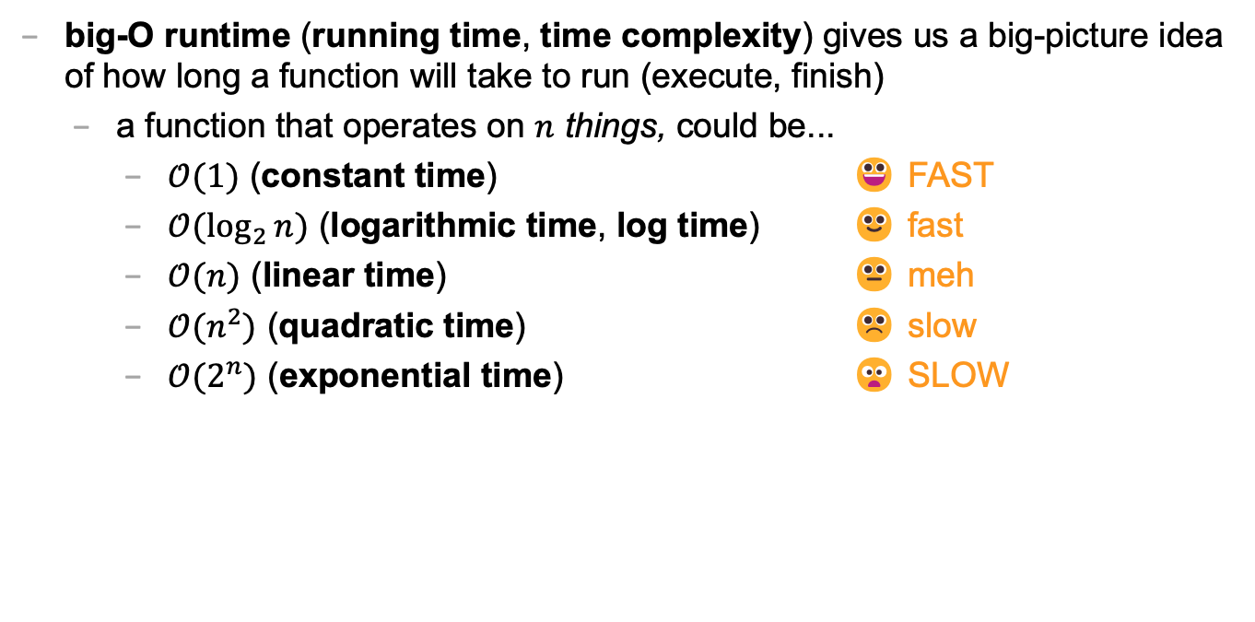
big-O runtime
big-O runtime (running time, time complexity) gives us a big-picture idea of how long a function will take to run (execute, finish)
a function that operates on $n$ things, could be...
$𝒪(1)$ (constant time) 😀 FAST
$𝒪(\log_{2}{n})$ (logarithmic time, log time) 🙂 fast
$𝒪(n)$ (linear time) 😐 meh
$𝒪(n^{2})$ (quadratic time) ☹️ slow
$𝒪(2^{n})$ (exponential time) 😦 SLOW

Slide 577
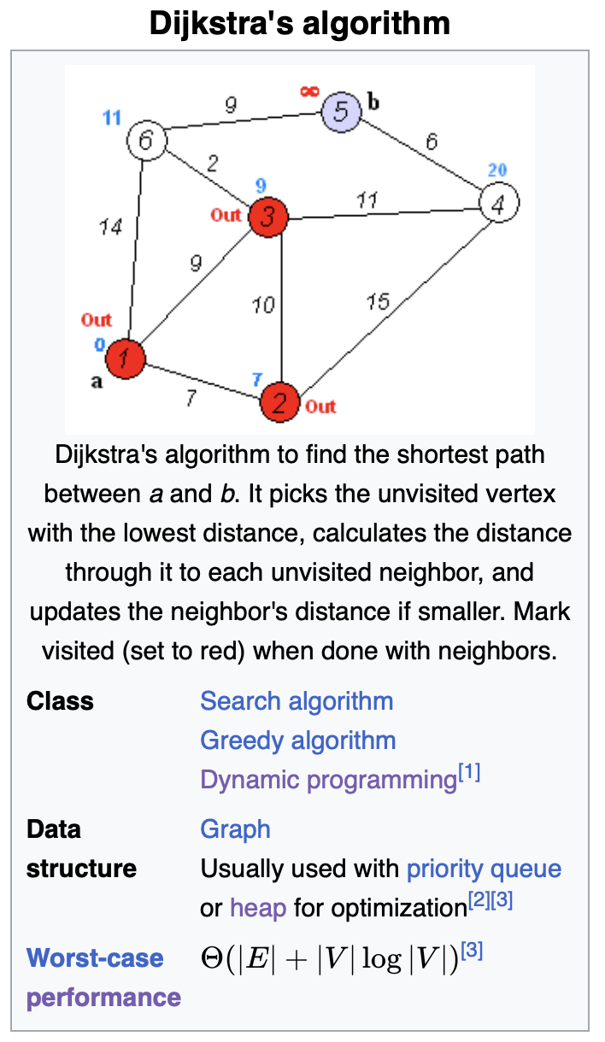
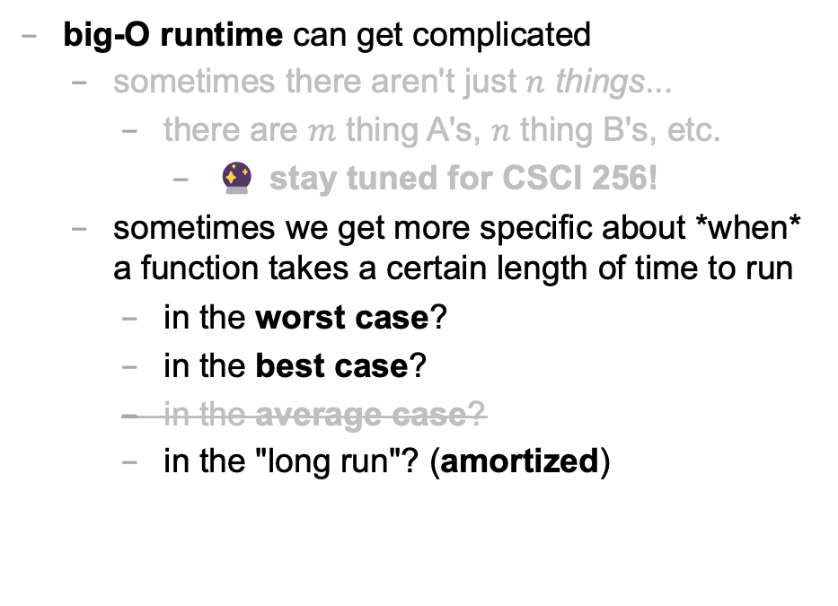
big-O runtime
big-O runtime can get complicated
sometimes there aren't just $n$ things...
there are $m$ thing A's, $n$ thing B's, etc.
🔮 stay tuned for CSCI 256!
sometimes we get more specific about *when* a function takes a certain length of time to run
in the worst case?
in the best case?
in the average case?
in the "long run"? (amortized)

Slide 578
best case and worst case runtime of adding to the back of an array list

Slide 579
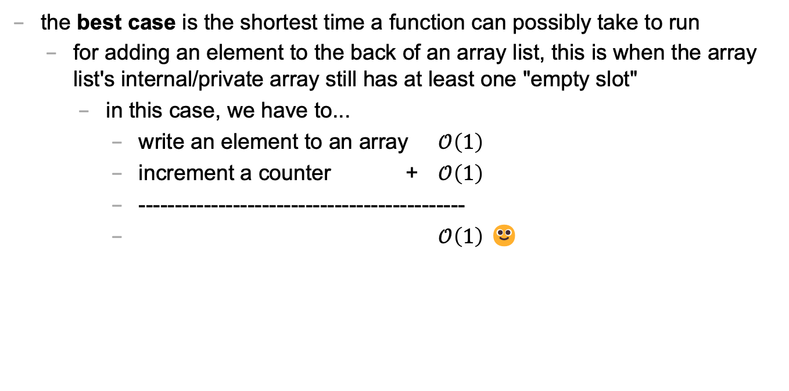
best case
the best case is the shortest time a function can possibly take to run
for adding an element to the back of an array list, this is when the array list's internal/private array still has at least one "empty slot"
in this case, we have to...
write an element to an array $𝒪\left(1\right)$
increment a counter + $𝒪\left(1\right)$
---------------------------------------------
$𝒪\left(1\right)$ 🙂

Slide 580
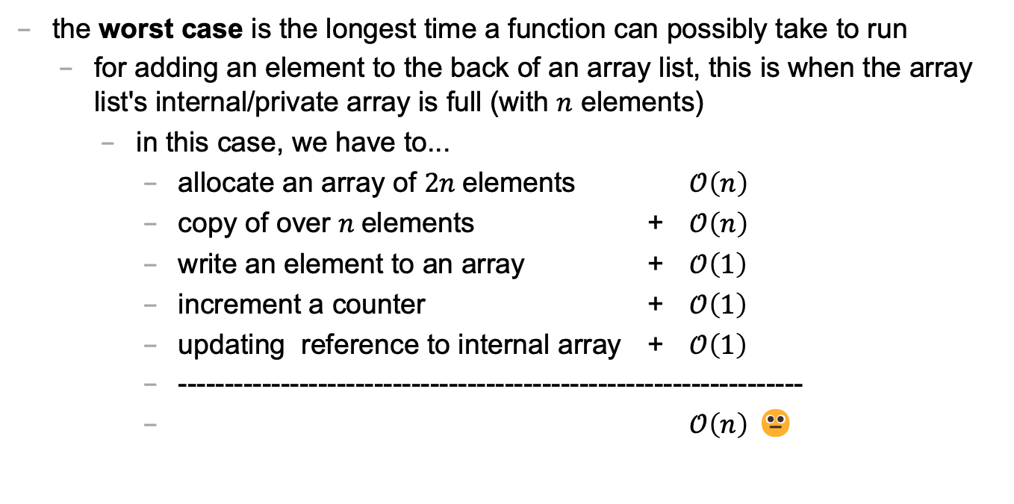
worst case
the worst case is the longest time a function can possibly take to run
for adding an element to the back of an array list, this is when the array list's internal/private array is full (with $n$ elements)
in this case, we have to...
allocate an array of $2n$elements $𝒪\left(n\right)$
copy of over $n$elements + $𝒪\left(n\right)$
write an element to an array + $𝒪\left(1\right)$
increment a counter + $𝒪\left(1\right)$
updating reference to internal array + $𝒪\left(1\right)$
-------------------------------------------------------------------
$𝒪\left(n\right)$ 😐

Slide 581
sometimes the best case and worst case are very different

Slide 582
amortized runtime of adding to the back of an array list

Slide 583
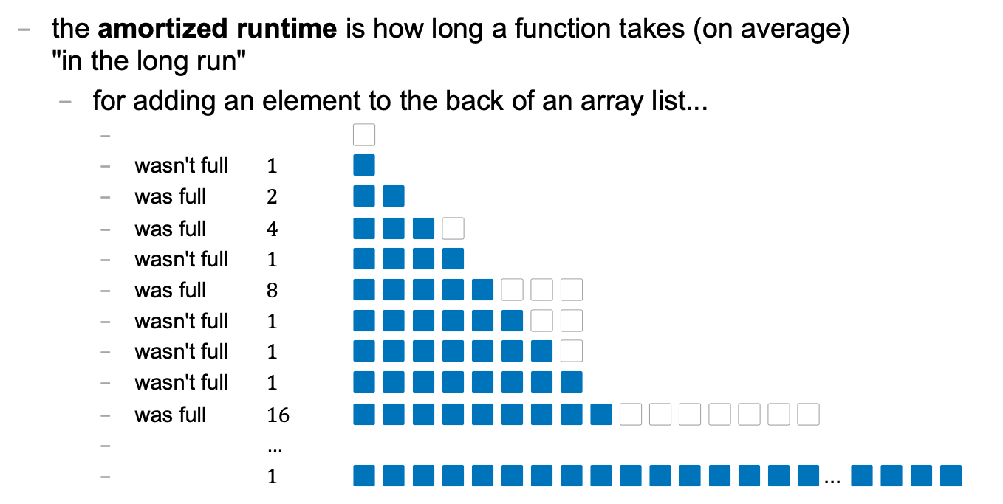
amortized
the amortized runtime is how long a function takes (on average) "in the long run"
for adding an element to the back of an array list...
⬜️
wasn't full $1$ 🟦
was full $2$ 🟦🟦
was full $4$ 🟦🟦🟦⬜️
wasn't full $1$ 🟦🟦🟦🟦
was full $8$ 🟦🟦🟦🟦🟦⬜️⬜️⬜️
wasn't full $1$ 🟦🟦🟦🟦🟦🟦⬜️⬜️
wasn't full $1$ 🟦🟦🟦🟦🟦🟦🟦⬜️
wasn't full $1$ 🟦🟦🟦🟦🟦🟦🟦🟦
was full $16$ 🟦🟦🟦🟦🟦🟦🟦🟦🟦⬜️⬜️⬜️⬜️⬜️⬜️⬜️
$…$
$1$ 🟦🟦🟦🟦🟦🟦🟦🟦🟦🟦🟦🟦🟦🟦🟦🟦... 🟦🟦🟦🟦

Slide 584
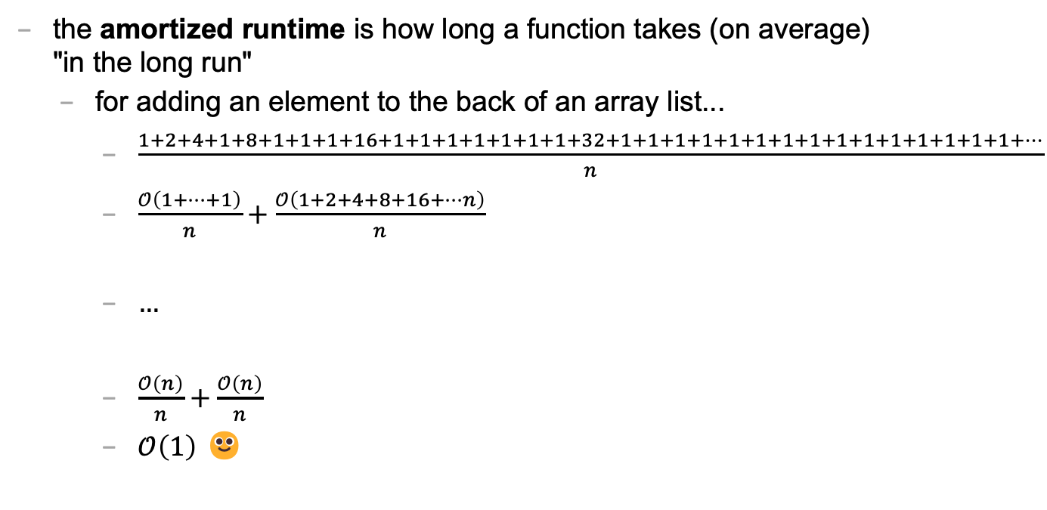
amortized
the amortized runtime is how long a function takes (on average) "in the long run"
for adding an element to the back of an array list...
$\frac{1+2+4+1+8+1+1+1+16+1+1+1+1+1+1+1+32+1+1+1+1+1+1+1+1+1+1+1+1+1+1+1+…}{n}$
$\frac{𝒪\left(1+…+1\right)}{n}+\frac{𝒪\left(1+2+4+8+16+…n\right)}{n}$
$…$
$\frac{𝒪\left(n\right)}{n}+\frac{𝒪\left(n\right)}{n}$
$𝒪\left(1\right)$ 🙂

Slide 585
the amortized run time is less "pessimistic" than worst case

Slide 586
the most relevant runtime depends on context 💭 when might worst case be more relevant? 💭 when might amortized be more relevant?

Slide 587
best case and worst case runtime of inserting into the front of an array list

Slide 588
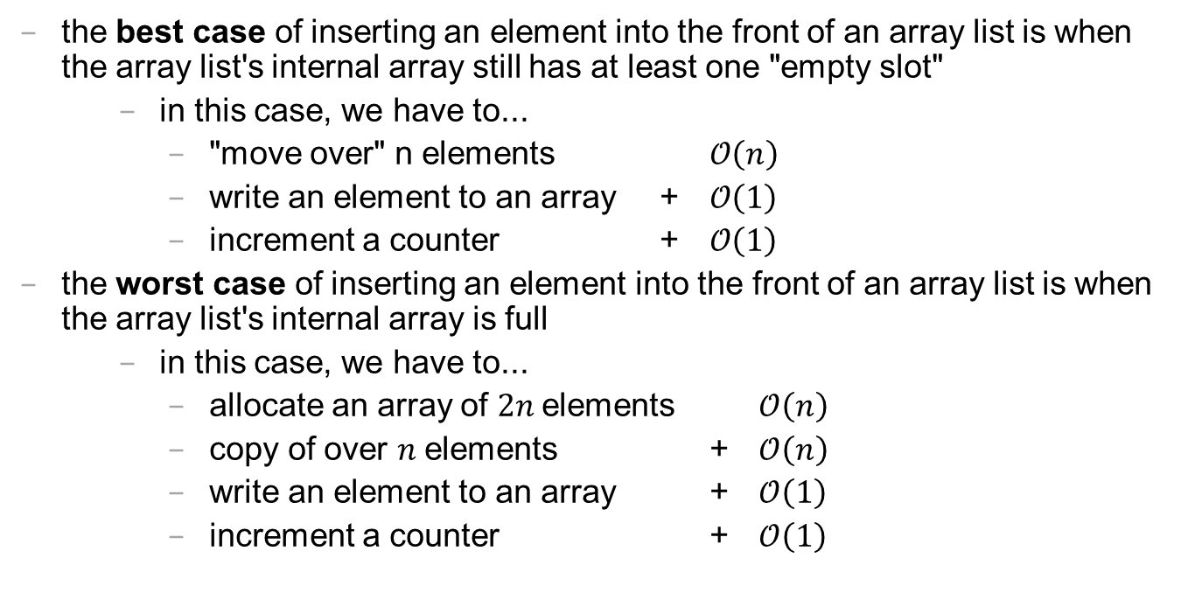
best case and worst cast
the best case of inserting an element into the front of an array list is when the array list's internal array still has at least one "empty slot"
in this case, we have to...
"move over" n elements $𝒪\left(n\right)$
write an element to an array + $𝒪\left(1\right)$
increment a counter + $𝒪\left(1\right)$
the worst case of inserting an element into the front of an array list is when the array list's internal array is full
in this case, we have to...
allocate an array of $2n$elements $𝒪\left(n\right)$
copy of over $n$elements + $𝒪\left(n\right)$
write an element to an array + $𝒪\left(1\right)$
increment a counter + $𝒪\left(1\right)$

Slide 589
lesson?: sometimes best case and worst case are the same

Slide 590
abstraction

Slide 591
repeatElements two ways

Slide 592
naive array solution
void repeatElementsArrayVersion(int numRepeats) {
int numBefore = size();
// allocate a new array O(n) String[] newPrivateArray = new String[numRepeats * numBefore];
// fill it + O(n)
int k = 0; for (int i = 0; i < numBefore; ++i) { for (int rep = 0; rep < numRepeats; ++rep) { newPrivateArray[k++] = privateArray[i]; } }
// "swap" references + O(1)
privateArray = newPrivateArray; }

Slide 593
the naive array solution is linear

Slide 594
naive array list solution
void repeatElements(int numRepeats) { int numBefore = size(); for (int i = 0; i < numBefore; ++i) { // n * int index = i * numRepeats; for (int rep = 0; rep < (numRepeats - 1); ++rep) { add(index, get(index)); // insert an element } // O(n) because we have to } // "move stuff over" }

Slide 595
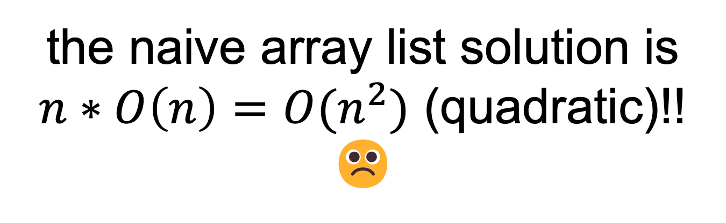
the naive array list solution is $n∗O\left(n\right)={O(n}^{2})$ (quadratic)!! ☹️

Slide 596
🧪

Slide 597
lesson: ignoring what's actually happening under the hood is dangerous!

Slide 598
int a = 5; int b=8;

Slide 599
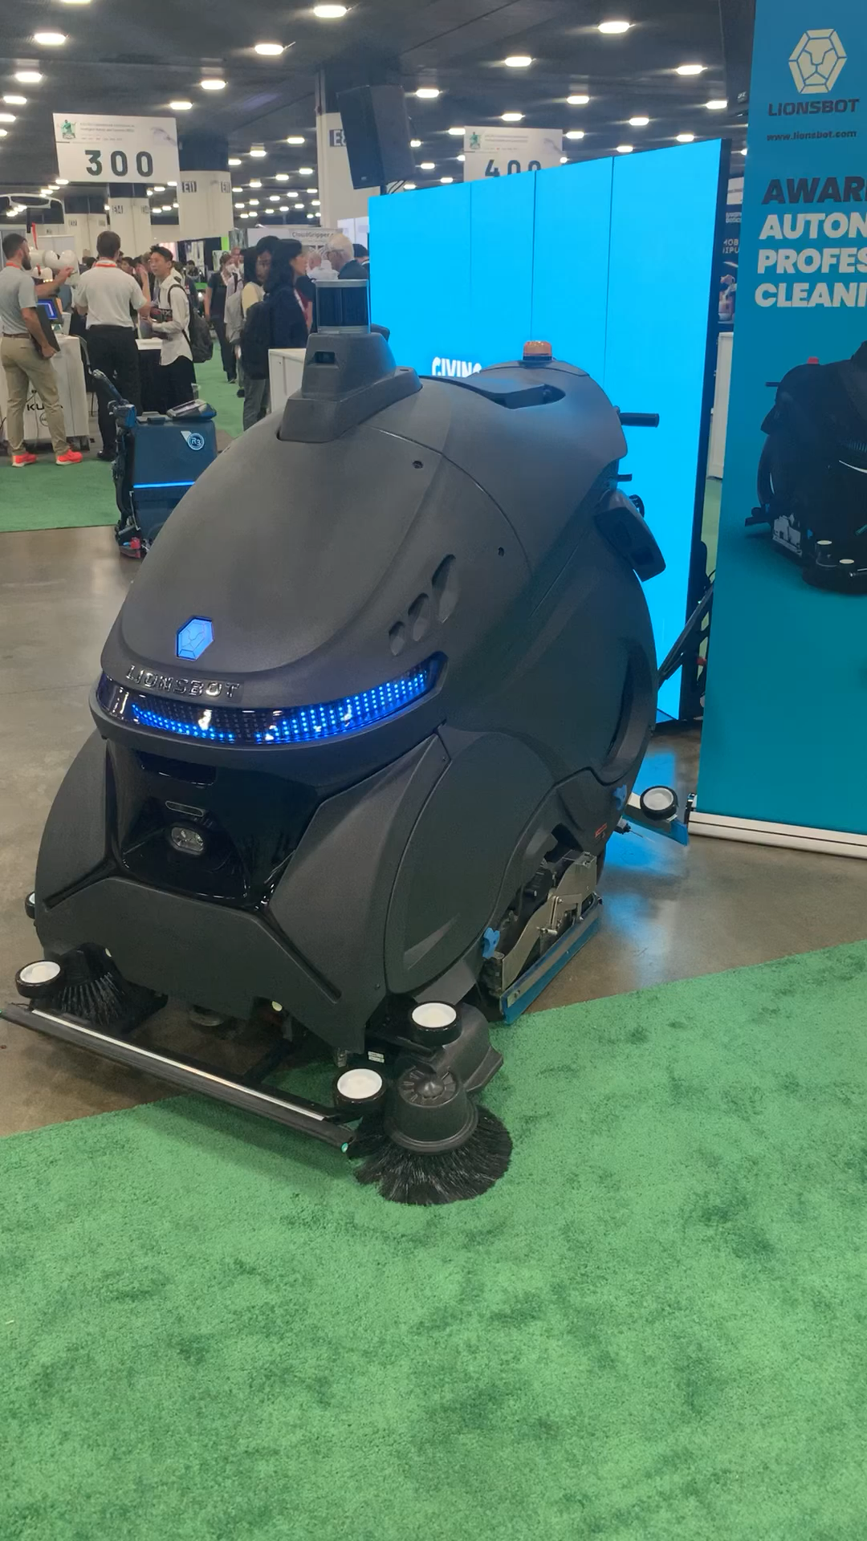
ANNOUNCEMENTS welcome back i hope you had a nice mountain day :)
WARMUP what is this robot for? →
TODAY stacks and queues

Slide 600
record LEC-02

Slide 601
where are we?

Slide 602
recap of first half

Slide 603
we built a foundation
Java!
types, operators, & compiler errors
when should we compile?
early and often!
avoid repetition!
functions!
for when we have the same chunk of logic repeated in multiple places
classes!
for when we repeatedly pass around the same chunk of data

Slide 604
we started thinking about code more deeply
the array!
how *fast* is an array?
what are pros and cons of the array?
how might we address the cons of an array?
the array list!
how *fast* is an array list? best case? worst case? ...
what are pros and cons of the array list?
how might we address the cons of an array list?
...

Slide 605


Slide 606
preview of second half

Slide 607
we will look at how to structure data
we will meet a whole menagerie of data structures
stacks
queues
hash tables
linked lists
trees
graphs
heaps
we will analyze speed and space

Slide 608
we will learn to choose the right data structure for the job
fun homeworks (at least in my opinion) 🙂👍
Flip Book
array list of array lists of array lists of Vector2's
PostScript Interpreter
stack and hash table
Text Generator
hash table of hash tables
...

Slide 609
data structures

Slide 610
what is a data structure? why is a data structure?

Slide 611
data structures
In computer science, a data structure is a data organization, management, and storage format that is usually chosen for efficient access to data.^{[1][2][3]} More precisely, a data structure is a collection of data values, the relationships among them, and the functions or operations that can be applied to the data,^{[4]} i.e., it is an algebraic structure about data. --Wikipedia

Slide 612
data structures
In computer science, a data structure is the organization and implementation of values and information. In simple words, it is the way of organizing information in a computer so that it can be more easily understood and worked with. --Simple Wikipedia

Slide 613
data structures
A data structure is...a system for organizing and using information... It...make[s] information easier to understand and work with.. --Simple Wikipedia, further simplified by ChatGPT

Slide 614
data structures
data means numbers (and letters)
a data structure organizes your data
for a particular task...
...a good data structure is...
easy to work with (programmer time)
runs fast (runtime / user's time)

Slide 615
were array lists a good choice for implementing a Flip Book? 💭 (how) could you have done it with just arrays?

Slide 616
we didn't know how many...
frames in each animation
strokes in each frame
points (Vector2's) in each stroke

Slide 617
"Alternative" 1: just use arrays, but resize them yourself when needed (essentially, implement the functionality of an array list without actually having a class)

Slide 618
"Alternative" 2: // ~30,000,000 elements Vector2[][][] animation = new Vector2[64][512][1024]; // need all these counter variables // can't just call .size() like before! int numFrames = 0; int[] numStrokes = ...; int[][] numPoints = ...;

Slide 619
interface

Slide 620
interface
add, get, set, remove, ...
ArrayList<ElementType>'s
state
your state

Slide 621
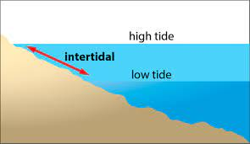

Slide 622
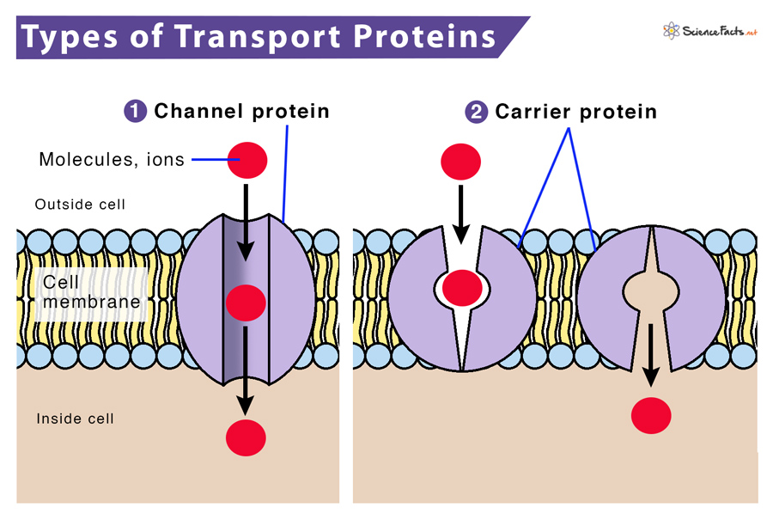

Slide 623
interface
a data structure's interface (API) or abstract data type is a set of functions a data structure must have
a list has...
get
set
add
remove
etc.
a data structure is a specific implementation (code that does the thing) of that interface
an array list implements the list interface using an array
🔮 a linked list implements a list using nodes that refer to nodes

Slide 624
you can get (very) formal about this
The abstract list type L with elements of some type E (a monomorphic list) is defined by the following functions:
nil: () → L
cons: E × L → L
first: L → E
rest: L → L
with the axioms
first (cons (e, l)) = e
rest (cons (e, l)) = l
for any element e and any list l. It is implicit that
cons (e, l) ≠ l
cons (e, l) ≠ e
cons (e₁, l₁) = cons (e₂, l₂) if e₁ = e₂ and l₁ = l₂
Note that first (nil ()) and rest (nil ()) are not defined.
These axioms are equivalent to those of the abstract stack data type.

Slide 625
i typically won't. just know there is a difference between interface ("list") and implementation (ArrayList<Element>)

Slide 626
Tungsten break 😀 did you know the density of Tungsten is 19.25 g/cm³? Gold is 19.32 g/cm³ did you know Tungsten is really hard? Tungsten alloys can be as hard as Sapphire! that's really hard! Tungsten is expensive (that cube is $60) but not like...that expensive what could YOU do with Tungsten?

Slide 627
stacks

Slide 628
stack

Slide 629
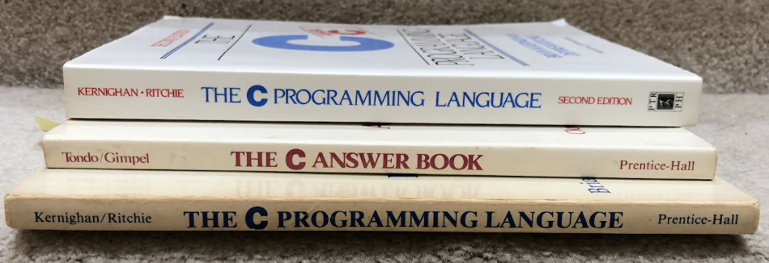

Slide 630


Slide 631

pushing
popping

Slide 632


Slide 633
stack interface
// Push (add) a new element to the top of the stack. void push(ElementType element);
// Pop (remove) the top element of the stack. // and returns it. ElementType pop();
// Peek (look) at the top element of the stack // (without removing it) and return it. ElementType peek();
// Returns the number of elements currently in the stack. int size();

Slide 634
queues

Slide 635
queue

Slide 636


Slide 637

Back

Slide 638

Back
add
remove

Slide 639
queue interface
// Add (enqueue) a new element to the back of the queue. void add(ElementType element);
// Remove (dequeue) the front element of the queue // and return it. ElementType remove();
// Peek (look) at the front element of the queue // (without removing it) and return it. ElementType peek();
// Returns the number of elements currently in the queue. int size();

Slide 640
why stacks and queues in the same lecture?

Slide 641
stack interface
// Push (add) a new element to the top of the stack. void push(ElementType element);
// Remove (pop) the top element of the stack. // and returns it. ElementType pop();
// Peek (look) at the top element of the stack // (without removing it) and return it. ElementType peek();
// Returns the number of elements currently in the stack. int size();

Slide 642
queue interface
// Add (enqueue) a new element to the back of the queue. void add(ElementType element);
// Remove (dequeue) the front element of the queue // and return it. ElementType remove();
// Peek (look) at the front element of the queue // (without removing it) and return it. ElementType peek();
// Returns the number of elements currently in the queue. int size();

Slide 643
💭 what are some example uses of stacks and queues in computer science?

Slide 644



Slide 645

ANNOUNCEMENTS today is Laptop Wednesday!
replace interpret(...tokens) with version from the Writeup
WARMUP a couple (slightly silly) interview questions
- implement a stack using a (basic) queue
- just implement push and pop (and peek?)
- (don't worry about efficiency)
- pseudocode is fine
- what is the runtime (big O)?
- implement a queue using 2 stacks TODAY stacks and queue tutorial

Slide 646
record LEC-02

Slide 647
Stack and Queue tutorial 💻

Slide 648
the midterm 😱

Slide 649
i graded the midterm over the weekend

Slide 650
i had so much fun

Slide 651
not really

Slide 652


Slide 654
the midterm
overall, i think it went well!
MEAN ~ 87
STANDARD DEVIATION ~ 11
if you have any questions (how to prep for final, why did you lose points), let's chat in Lab (we can also schedule a chat)
notes on grading
some feedback just for your benefit (no lost points) – variable names, etc.
feedback is very sparse! (please ask questions if unsure what i mean)

Slide 655


some common pain points
i have removed them from the HW-03;
let's take a look
let's also redo this problem together on the board
"convenience variables" created lots of problems
this is an example of modifying an array while you're iterating over it (see HW-02 README)
let's redo it together on the board

Slide 656
ANNOUNCEMENTS today is Friday! (fun Colloquium today at 2:35 in TCL 123)
apply to TA next semester! also next next (next?) semester!
WARMUP implement a queue using two stacks
- just implement add and remove (and peek?)
- (don't worry about efficiency)
- pseudocode is fine
- what is the runtime (big O)?
TODAY odds and ends

Slide 657
record LEC-02

Slide 658
tricky midterm questions

Slide 659
Player -> Player[]

Slide 660
question
class HW03 extends App { // BEFORE
Player player;
void setup() {
player = new Player();
player.color = Vector3.cyan;
player.radius = 4.0;
player.position = new Vector2(0.0, 0.0)
}
}

Slide 661
answer
class HW03 extends App { // AFTER
Player[] players;
void setup() {
players = new Player[4];
for (int i = 0; i < players.length; i++) {
players[i] = new Player();
players[i].radius = 4.0;
players[i].position = new Vector2(0.0, 0.0);
}
players[0].color = Vector3.red;
players[1].color = Vector3.orange;
players[2].color = Vector3.yellow;
players[3].color = Vector3.green;
}
}

Slide 662
alternate answer
class HW03 extends App { // AFTER
Player[] players;
Vector3[] colors =
{ Vector3.red, Vector3.orange, Vector3.yellow, Vector3.green };
void setup() {
players = new Player[4];
for (int i = 0; i < players.length; i++) {
players[i] = new Player();
players[i].radius = 4.0;
players[i].position = new Vector2(0.0, 0.0);
players[i].color = colors[i];
}
}
}

Slide 663
what will this code print? (arrays and array lists)

Slide 664
question
int[] array = { 2, 3, 4 };
ArrayList<Integer> list = new ArrayList<>();
for (int i = 0; i < array.length; ++i) {
for(int rep = 0; rep < 3; ++rep) {list.add(array[i]);}
}

Slide 665
question
int[] array = { 2, 3, 4 };
ArrayList<Integer> list = new ArrayList<>();
int i = 0;
for (int rep = 0; rep < 3; ++rep) { list.add(array[i]); }
i = 1;
for (int rep = 0; rep < 3; ++rep) { list.add(array[i]); }
i = 2;
for (int rep = 0; rep < 3; ++rep) { list.add(array[i]); }

Slide 666
question
int[] array = { 2, 3, 4 };
ArrayList<Integer> list = new ArrayList<>();
for (int rep = 0; rep < 3; ++rep) { list.add(array[0]); }
for (int rep = 0; rep < 3; ++rep) { list.add(array[1]); }
for (int rep = 0; rep < 3; ++rep) { list.add(array[2]); }

Slide 667
question
int[] array = { 2, 3, 4 };
ArrayList<Integer> list = new ArrayList<>();
list.add(array[0]);
list.add(array[0]);
list.add(array[0]);
list.add(array[1]);
list.add(array[1]);
list.add(array[1]);
list.add(array[2]);
list.add(array[2]);
list.add(array[2]);

Slide 668
question
int[] array = { 2, 3, 4 };
ArrayList<Integer> list = new ArrayList<>();
list.add(2);
list.add(2);
list.add(2);
list.add(3);
list.add(3);
list.add(3);
list.add(4);
list.add(4);
list.add(4);

Slide 669
question
int[] array = { 2, 3, 4 };
ArrayList<Integer> list = new ArrayList<>();
list.add(2);
list.add(2);
list.add(2);
list.add(3);
list.add(3);
list.add(3);
list.add(4);
list.add(4);
list.add(4);
// { 2, 2, 2, 3, 3, 3, 4, 4, 4 }

Slide 670
question
// { 2, 2, 2, 3, 3, 3, 4, 4, 4 }
for (int i = 0; i < list.size() / 2; ++i) {
int j = (list.size() - 1) - i;
int tmp = list.get(i);
list.set(i, list.get(j));
list.set(j, tmp);
}

Slide 671
question
// { 2, 2, 2, 3, 3, 3, 4, 4, 4 }
for (int i = 0; i < list.size() / 2; ++i) {
int j = (list.size() - 1) - i;
int tmp = list.get(i);
list.set(i, list.get(j));
list.set(j, tmp);
} // { 4, 4, 4, 3, 3, 3, 2, 2, 2 }

Slide 672
question
// { 4, 4, 4, 3, 3, 3, 2, 2, 2 }
for (int i = 0; i < list.size(); ++i) {
list.set(i, list.get(list.get(i)));
}

Slide 673
question
// { 4, 4, 4, 3, 3, 3, 2, 2, 2 }
for (int i = 0; i < list.size(); ++i) {
int j = list.get(i);
list.set(i, list.get(j));
}

Slide 674
question
// { 4, 4, 4, 3, 3, 3, 2, 2, 2 }
for (int i = 0; i < list.size(); ++i) {
int j = list.get(i);
list.set(i, list.get(j));
}
// 0 1 2 3 4 5 6 7 8
// { 4, 4, 4, 3, 3, 3, 2, 2, 2 }
// ^ ^
// | |
// | j
// |
// i

Slide 675
question
// { 4, 4, 4, 3, 3, 3, 2, 2, 2 }
for (int i = 0; i < list.size(); ++i) {
int j = list.get(i);
list.set(i, list.get(j));
}
// 0 1 2 3 4 5 6 7 8
// { 3, 4, 4, 3, 3, 3, 2, 2, 2 }
// ^ ^
// | |
// | j
// |
// i

Slide 676
question
// { 4, 4, 4, 3, 3, 3, 2, 2, 2 }
for (int i = 0; i < list.size(); ++i) {
int j = list.get(i);
list.set(i, list.get(j));
}
// 0 1 2 3 4 5 6 7 8
// { 3, 4, 4, 3, 3, 3, 2, 2, 2 }
// ^ ^
// | |
// | j
// |
// i

Slide 677
question
// { 4, 4, 4, 3, 3, 3, 2, 2, 2 }
for (int i = 0; i < list.size(); ++i) {
int j = list.get(i);
list.set(i, list.get(j));
}
// 0 1 2 3 4 5 6 7 8
// { 3, 3, 4, 3, 3, 3, 2, 2, 2 }
// ^ ^
// | |
// | j
// |
// i

Slide 678
question
// { 4, 4, 4, 3, 3, 3, 2, 2, 2 }
for (int i = 0; i < list.size(); ++i) {
int j = list.get(i);
list.set(i, list.get(j));
}
// 0 1 2 3 4 5 6 7 8
// { 3, 3, 4, 3, 3, 3, 2, 2, 2 }
// ^ ^
// | |
// | j
// |
// i

Slide 679
question
// { 4, 4, 4, 3, 3, 3, 2, 2, 2 }
for (int i = 0; i < list.size(); ++i) {
int j = list.get(i);
list.set(i, list.get(j));
}
// 0 1 2 3 4 5 6 7 8
// { 3, 3, 3, 3, 3, 3, 2, 2, 2 }
// ^ ^
// | |
// | j
// |
// i

Slide 680
question
// { 4, 4, 4, 3, 3, 3, 2, 2, 2 }
for (int i = 0; i < list.size(); ++i) {
int j = list.get(i);
list.set(i, list.get(j));
}
// 0 1 2 3 4 5 6 7 8
// { 3, 3, 3, 3, 3, 3, 2, 2, 2 }
// ^
// |
// j
// |
// i

Slide 681
question
// { 4, 4, 4, 3, 3, 3, 2, 2, 2 }
for (int i = 0; i < list.size(); ++i) {
int j = list.get(i);
list.set(i, list.get(j));
}
// 0 1 2 3 4 5 6 7 8
// { 3, 3, 3, 3, 3, 3, 2, 2, 2 }
// ^
// |
// j
// |
// i

Slide 682
question
// { 4, 4, 4, 3, 3, 3, 2, 2, 2 }
for (int i = 0; i < list.size(); ++i) {
int j = list.get(i);
list.set(i, list.get(j));
}
// 0 1 2 3 4 5 6 7 8
// { 3, 3, 3, 3, 3, 3, 2, 2, 2 }
// ^ ^
// | |
// j |
// |
// i

Slide 683
question
// { 4, 4, 4, 3, 3, 3, 2, 2, 2 }
for (int i = 0; i < list.size(); ++i) {
int j = list.get(i);
list.set(i, list.get(j));
}
// 0 1 2 3 4 5 6 7 8
// { 3, 3, 3, 3, 3, 3, 2, 2, 2 }
// ^ ^
// | |
// j |
// |
// i

Slide 684
question
// { 4, 4, 4, 3, 3, 3, 2, 2, 2 }
for (int i = 0; i < list.size(); ++i) {
int j = list.get(i);
list.set(i, list.get(j));
}
// 0 1 2 3 4 5 6 7 8
// { 3, 3, 3, 3, 3, 3, 2, 2, 2 }
// ^ ^
// | |
// j |
// |
// i

Slide 685
question
// { 4, 4, 4, 3, 3, 3, 2, 2, 2 }
for (int i = 0; i < list.size(); ++i) {
int j = list.get(i);
list.set(i, list.get(j));
}
// 0 1 2 3 4 5 6 7 8
// { 3, 3, 3, 3, 3, 3, 2, 2, 2 }
// ^ ^
// | |
// j |
// |
// i

Slide 686
question
// { 4, 4, 4, 3, 3, 3, 2, 2, 2 }
for (int i = 0; i < list.size(); ++i) {
int j = list.get(i);
list.set(i, list.get(j));
}
// 0 1 2 3 4 5 6 7 8
// { 3, 3, 3, 3, 3, 3, 2, 2, 2 }
// ^ ^
// | |
// j |
// |
// i

Slide 687
question
// { 4, 4, 4, 3, 3, 3, 2, 2, 2 }
for (int i = 0; i < list.size(); ++i) {
int j = list.get(i);
list.set(i, list.get(j));
}
// 0 1 2 3 4 5 6 7 8
// { 3, 3, 3, 3, 3, 3, 3, 2, 2 }
// ^ ^
// | |
// j |
// |
// i

Slide 688
question
// { 4, 4, 4, 3, 3, 3, 2, 2, 2 }
for (int i = 0; i < list.size(); ++i) {
int j = list.get(i);
list.set(i, list.get(j));
}
// 0 1 2 3 4 5 6 7 8
// { 3, 3, 3, 3, 3, 3, 3, 2, 2 }
// ^ ^
// | |
// j |
// |
// i

Slide 689
question
// { 4, 4, 4, 3, 3, 3, 2, 2, 2 }
for (int i = 0; i < list.size(); ++i) {
int j = list.get(i);
list.set(i, list.get(j));
}
// 0 1 2 3 4 5 6 7 8
// { 3, 3, 3, 3, 3, 3, 3, 3, 2 }
// ^ ^
// | |
// j |
// |
// i

Slide 690
question
// { 4, 4, 4, 3, 3, 3, 2, 2, 2 }
for (int i = 0; i < list.size(); ++i) {
int j = list.get(i);
list.set(i, list.get(j));
}
// 0 1 2 3 4 5 6 7 8
// { 3, 3, 3, 3, 3, 3, 3, 3, 2 }
// ^ ^
// | |
// j |
// |
// i

Slide 691
question
// { 4, 4, 4, 3, 3, 3, 2, 2, 2 }
for (int i = 0; i < list.size(); ++i) {
int j = list.get(i);
list.set(i, list.get(j));
}
// 0 1 2 3 4 5 6 7 8
// { 3, 3, 3, 3, 3, 3, 3, 3, 3 }
// ^ ^
// | |
// j |
// |
// i

Slide 692
HW06.java HW06.class ~HW06.java

Slide 693

filetypes
HW06.java is source code (input to the compiler)
HW06.class is bytecode (output from the compiler)
~HW06.java is a backup file created by DrJava 🤨

Slide 694
_thisUnderscoreMeansDoNotUse (unless you really know what you're doing)

Slide 695
constants and readability & searchability

Slide 696
if (token.type == 2) {
...
}
if (token.type == Token.TYPE_STRING) {
...
}

Slide 697
where did the Starter Code come from? (forgive me, I know this should have been on Wednesday)

Slide 698
the big decision in the Starter Code is that we're going to chop the program into a list of "tokens" and each token could be a boolean, double, String, or list

Slide 699
in Python, a variable's type is dynamic
token = True
print(type(token)) # <class 'bool'>
token = 5.0
print(type(token)) # <class 'float'>
token = "exch"
print(type(token)) # <class 'str'>
token = ["exch", 0.0, "add"]
print(type(token)) # <class 'list'>

Slide 700
in Java, a variable's type is static
class Token {
int type;
private boolean _valueIfTypeBoolean;
private double _valueIfTypeDouble;
private String _valueIfTypeString;
private ArrayList<Token> _valueIfTypeList;
static final int TYPE_BOOLEAN = 0;
static final int TYPE_DOUBLE = 1;
static final int TYPE_STRING = 2;
static final int TYPE_LIST = 3;
}
0 | false | 0.0 | null | null

Slide 701
examples
new Token(true)
new Token(5.0)
new Token("exch")
0 | true | 0.0 | null | null
1 | false | 5.0 | null | null
2 | false | 0.0 | 0x02343af34... | null
"exch"

Slide 702
in Java, a variable's type is static
// Create a String-type Token.
Token token = new Token();
token.type = Token.TYPE_STRING;
token._valueIfTypeString = "exch";
// Get the value of a String-type token.
assert token.type = Token.TYPE_STRING : "..."; // check type!
String string = token._valueIfTypeString;
this usage code makes me sad ☹️
let's write some ✨functions✨!

Slide 703
in Java, a variable's type is static
// Create a String-type Token.
Token token = new Token("exch");
// Get the value of a String-type token.
String string = token.getString();
all better 🙂

Slide 704
tl;dr

Slide 705

use these functions 🙂👍

Slide 706

and these functions!! 🙂👍

Slide 707
// Pop a double off the stack
assert _stack.size() > 0;
Token token = _stack.pop();
double num = token.getDouble();
// Push a double onto the stack.
_stack.push(new Token(5.0));
☹️

Slide 708
// Pop a double off the stack
double num = stackPopDouble();
// Push a double onto the stack.
stackPush(5.0);
🙂

Slide 709
midsemester feedback

Slide 710
do you want to give midsemester feedback?

Slide 711

help improve cs136
even though
you're never going to
take it again

Slide 712

tinyurl.com/yf725rdk

Slide 713
ANNOUNCEMENTS today is No Laptop For the First Half of Lecture Monday!
today is Prof. Bill Jannen Is Visiting LEC-02 Monday!
WARMUP long, long, ago, many people owned a large, physical book called a ✨Dictionary✨
- what was it used for?
- did you know there were different kinds of dictionaries?
TODAY maps (dictionaries, tables)

Slide 714
record LEC-01

Slide 715



HashMap<String, String> dictionary;
// {Dog=A cute, four-legged mammal, ...}
HashMap<String, String> englishToSpanishDictionary;
// {Gato=Cat, Perro=Dog, ...}
HashMap<String, ArrayList<String>> rhymingDictionary;
// {Dog=[Bog, Cog, Frog], ...}

Slide 716


Slide 717


Slide 718
maps

Slide 719
map interface

Slide 720
map
a pair is two things
a map (dictionary, table) stores key-value pairs
a map is used to lookup a key's value
a map in Java's standard library is HashMap<KeyType, ValueType>
HashMap<String, ArrayList<String>> rhymingDictionary;

Slide 721
let us imagine...

Slide 722
you have a three week long road trip planned to Bennington, but your prized parrot Hans is deathly afraid of driving it's time to put Hans in the bird kennel

Slide 723
🤵
🦜
map.put("Hans", 🦜)

Slide 724
you return invigorated from a lovely trek to Bennington it's time to get Hans from the bird kennel

Slide 725

here is Hans
🤵
Hans
squack
🦜
map.get("Hans")

Slide 726
HashMap<String, Bird>
🤵

Slide 727
map interface
// Put (add, insert) a new key-value pair into the map. // NOTE: Can also be used to update a key's value. void put(KeyType key, ValueType value);
// Get (lookup) a key's value in the map. ValueType get(KeyType key);
// Get the (unordered) set of all keys. // NOTE: Use this to iterate through all keys. // for (KeyType key : map.keySet()) { ... } Set<KeyType> keySet();

Slide 728
motivating example

Slide 729

Pokémon
there are 151 Pokémon
each has its own number
Bulbasaur
Ivysaur
Venusaur
Charmander
...

Slide 730
number → name
1 → "Bulbasaur"
2 → "Ivysaur"
3 → "Venusaur"
4 → "Charmander"
...

Slide 731
number → name (Option I)
String[] names = { "Bulbasaur", "Ivysaur", ... };
int number = ...;
String name = names[number – 1]; // NOTE: Bulbasaur is #1

Slide 732
number → name (Option II)
String[] _names = { "Bulbasaur", "Ivysaur", ... };
String getName(int number) {
return _names[number – 1];
}
int number = ...;
String name = getName(number);

Slide 733
number → name (Option I)
String[] names = { "Bulbasaur", "Ivysaur", ... };
int number = ...;
String name = names[number – 1]; // NOTE: Bulbasaur is #1

Slide 734
number → name (Option III)
String[] names = { "", "Bulbasaur", "Ivysaur", ... };
int number = ...;
String name = names[number];

Slide 735
lesson: if you're mapping from A → B, and A is something like 0, 1, 2, 3, ... ...then you can just use an array 🙂👍

Slide 736
buuut, if you're mapping from A → B, and A is nothing like 0, 1, 2, 3, ... ...then you're going to want a map 🗺️

Slide 737
name → number
🗺️ solve this problem using a
HashMap<KeyType, ValueType>
"Bulbasaur" → 1
"Ivysaur" → 2
"Venusaur" → 3
"Charmander" → 4
...
// Put (add, insert) a new key-value pair into the map. // NOTE: Can also be used to update a given key's value. void put(KeyType key, ValueType value);
// Get (look up) a key's value in the map. ValueType get(KeyType key);
what data structures will you need?
how will you set them up?
how will you use them?

Slide 738
name → number
// data structures
HashMap<String, Integer> numberFromName;
// setup
String[] names = { "Bulbasaur", "Ivysaur", ... };
numberFromName = new HashMap<>();
for (int i = 0; i < names.length; ++i) {
// Bulbasaur = 1
numberFromName.put(names[i], i + 1);
}
// usage
String name = ...;
int number = numberFromName.get(name);

Slide 739
let's implement numberFromName TODO (Jim): use keySet() method in test code

Slide 740
PokemonExample
import java.util.*;
class PokemonExample {
public static void main(String[] arguments) {
// setup
HashMap<String, Integer> numberFromName = new HashMap<>();
String[] names = { "Bulbasaur", "Ivysaur", "Venusaur", ... };
for (int number = 0; number < names.length; number++) {
numberFromName.put(names[number], number + 1);
}
// usage
for (String name : numberFromName.keySet()) {
System.out.println(name + " -> " + numberFromName.get(name));
}
}
}
Mewtwo -> 150
Raichu -> 26
Arbok -> 24
Kabuto -> 140
Charmander -> 4
Charmeleon -> 5
Shellder -> 90
Fearow -> 22
Kangaskhan -> 115
Mankey -> 56
Dodrio -> 85
Vaporeon -> 134
Golem -> 76
Marowak -> 105
Pikachu -> 25
Raticate -> 20
Kadabra -> 64
Primeape -> 57
Venomoth -> 49
Magikarp -> 129
Pidgeotto -> 17
Slowbro -> 80
Gastly -> 92
Magneton -> 82
Jolteon -> 135
Metapod -> 11
Diglett -> 50
Eevee -> 133
Caterpie -> 10
Goldeen -> 118
Abra -> 63
Blastoise -> 9
Magnemite -> 81
Pinsir -> 127
Machoke -> 67
Graveler -> 75
Meowth -> 52
Staryu -> 120
Gengar -> 94
Moltres -> 146
Dragonite -> 149
Golbat -> 42
Persian -> 53
Dugtrio -> 51
Onix -> 95
Hypno -> 97
Machop -> 66
Victreebel -> 71
Krabby -> 98
Jynx -> 124
Seadra -> 117
Rhydon -> 112
Jigglypuff -> 39
Machamp -> 68
Psyduck -> 54
Rapidash -> 78
Pidgey -> 16
Horsea -> 116
Poliwrath -> 62
Omastar -> 139
Clefairy -> 35
Exeggutor -> 103
Farfetch'd -> 83
Clefable -> 36
Oddish -> 43
Weedle -> 13
Gloom -> 44
Vileplume -> 45
Vulpix -> 37
Slowpoke -> 79
Lickitung -> 108
Golduck -> 55
Tentacruel -> 73
Weezing -> 110
Zapdos -> 145
Doduo -> 84
Haunter -> 93
Poliwhirl -> 61
Squirtle -> 7
Omanyte -> 138
Wigglytuff -> 40
Arcanine -> 59
Hitmonlee -> 106
Kabutops -> 141
Sandshrew -> 27
Venusaur -> 3
Kakuna -> 14
Tangela -> 114
Ekans -> 23
Wartortle -> 8
Venonat -> 48
Muk -> 89
Articuno -> 144
Electrode -> 101
Electabuzz -> 125
Cubone -> 104
Nidoran♀ -> 29
Magmar -> 126
Nidoran♂ -> 32
Dewgong -> 87
Tauros -> 128
Mr. Mime -> 122
Koffing -> 109
Starmie -> 121
Bulbasaur -> 1
Gyarados -> 130
Nidoqueen -> 31
Seel -> 86
Mew -> 151
Alakazam -> 65
Nidoking -> 34
Drowzee -> 96
Seaking -> 119
Rattata -> 19
Sandslash -> 28
Tentacool -> 72
Grimer -> 88
Ponyta -> 77
Exeggcute -> 102
Ditto -> 132
Flareon -> 136
Growlithe -> 58
Beedrill -> 15
Nidorina -> 30
Ivysaur -> 2
Cloyster -> 91
Kingler -> 99
Nidorino -> 33
Scyther -> 123
Dratini -> 147
Spearow -> 21
Charizard -> 6
Hitmonchan -> 107
Paras -> 46
Aerodactyl -> 142
Parasect -> 47
Butterfree -> 12
Snorlax -> 143
Weepinbell -> 70
Zubat -> 41
Chansey -> 113
Lapras -> 131
Voltorb -> 100
Dragonair -> 148
Ninetales -> 38
Bellsprout -> 69
Rhyhorn -> 111
Porygon -> 137
Geodude -> 74
Pidgeot -> 18
Poliwag -> 60

Slide 741
maps in other languages

Slide 742
🐍 Python has a built-in map (dictionary)
numbers = {}
numbers['Bulbasaur'] = 1
numbers['Ivysaur'] = 2
print(numbers['Bulbasaur']) # 1
print(numbers) # {'Bulbasaur': 1, 'Ivysaur': 2}
# Map + Dynamic type = hmm...
map = {}
map[True] = False
map['Jim'] = 3
map[-1] = map
print(map) # {True: False, 'Jim': 3, -1: {...}}

Slide 743
🥰 Lua's only data structure is a map (table)
why?
how?
what about like...arrays?
names = {}
names[1] = "Bulbasaur" -- okay fine, Lua has strings too
names[2] = "Ivysaur"
print(names[1]) -- Bulbasaur

Slide 744


Slide 745
ANNOUNCEMENTS
today is Prof. Bill Is Visiting LEC-02 Laptop Wednesday! WARMUP what is 7 % 3 ?
- ✏️do it on paper
- ☕️do it in Java (java means coffee)
- 🐍 do it in Python (a python is a kind of snake)
what is (-7) % 3 ?
- ✏️do it on paper
- ☕️do it in Java
- 🐍 do it in Python TODAY hash maps

Slide 746
record LEC-01

Slide 747
let's learn someting upsetting 🙂👍

Slide 748
7 % 3
2
R1
3
7
-
6
1

Slide 749
🐍 -7 % 3
☕️ Math.floorMod(-7, 3)
☕️ -7 % 3
-2
R-1
3
-7
-7 - (-6)
= -7 + 6
= -1
+ 3 = 2
-
-6
-1
-1

Slide 750
%
x % y returns the remainder of (x / y) and is read "x modulo y"
int foo = 17 % 5; // 2 ("17 divided by 5 is 3 remainder 2")
☠ % probably doesn't do what you expect for negative numbers; if x can be negative, use Math.floorMod(x, y) instead
5 % 3 // 2
4 % 3 // 1
3 % 3 // 0
2 % 3 // 2
1 % 3 // 1
0 % 3 // 0
-1 % 3 // -1 WAIT WHAT 🤔
Math.floorMod(-1, 3) // 2 🙂👍

Slide 751
Math.floorMod(x, y)
Math.floorMod( 5, 3) // 2
Math.floorMod( 4, 3) // 1
Math.floorMod( 3, 3) // 0
Math.floorMod( 2, 3) // 2
Math.floorMod( 1, 3) // 1
Math.floorMod( 0, 3) // 0
Math.floorMod(-1, 3) // 2
Math.floorMod(-2, 3) // 1
Math.floorMod(-3, 3) // 0
Math.floorMod(-4, 3) // 2
Math.floorMod(-5, 3) // 1
Math.floorMod(-6, 3) // 0
Math.floorMod(-7, 3) // 2

Slide 752
hash maps

Slide 753

hash map
a hash map (hash table) is a great way to implement a map
hash map are implemented using an array and a hash function
hash maps are FAST
put(key, value) is $𝒪\left(1\right)$ 😀 FAST
get(key) is $𝒪(1)$ 😀 FAST
there are many different "flavors" of hash maps
separate chaining (today)
linear probing (friday)
and so much more!

Slide 754
hash function

Slide 755
hash function
a hash function takes some data and returns an int called the data's hash code (hash, hash value)
this is called "hashing" the data
🚨 a hash function MUST be deterministic
given the same data, a hash function MUST return the same value
a hash collision (hash clash) happens when two different pieces of data have the hash code
a good hash function has very few collisions

Slide 756


Slide 757
hash function
all Java objects have a (fine) built-in hash function called hashCode()
hashCode() can be negative!
System.out.println( "Hans".hashCode()); // 2241694
System.out.println( "Gary".hashCode()); // 2212033
System.out.println("Kahoot".hashCode()); // -2054990942
System.out.println("Kahoot".hashCode()); // -2054990942

Slide 758
hash function
often, you want to turn a hash code into an index
✨ Math.floorMod(object.hashCode(), array.length)
System.out.println(Math.floorMod( "Hans".hashCode(), 10)); // 4
System.out.println(Math.floorMod( "Gary".hashCode(), 10)); // 3
System.out.println(Math.floorMod("Kahoot".hashCode(), 10)); // 8
System.out.println(Math.floorMod("Kahoot".hashCode(), 10)); // 8

Slide 759
separate chaining

Slide 760
separate chaining
separate chaining is one way of implementing a hash map
key-value pairs are stored in an array of buckets
one good choice of bucket is an array list
ArrayList<KeyValuePair> bucket;
in practice, you don't have to use an array list; you can use linked lists, binary search trees, or some mixture of the two (this is actually what Java does)

Slide 761

previously, on Hans the Parrot

Slide 762
you have a three week long road trip planned to Bennington, but your prized parrot Hans is deathly afraid of driving it's time to put Hans in the bird kennel

Slide 763
🤵
🦜
map.put("Hans", 🦜)

Slide 764
you return invigorated from a lovely trek to Bennington it's time to get Hans from the bird kennel

Slide 765
here is Hans
🤵
Hans
squack
🦜
map.get("Hans")

Slide 766
HashMap<String, Bird>
🤵

Slide 767
now, let us imagine again...

Slide 768
in a thrilling twist, it turns out that the Bennington trip was secretly cover for Agent Hans's corporate espionage of the bird kennel (rumor had it they were keeping the birds in buckets 🤨) it's time to get Hans back to the hideout

Slide 769
🐧🦉
🦜
🐤
🪣
🪣
🐦
🦆🐓🦃
🪣
🪣
🪣
Joe Kahoot Cheep Hans Doug Io Gary Max
0
1
2
3
4
👮

Slide 770
is this Hans?
buckets[bucketIndex].get(i).key.equals("Hans")?
🐧🦉
🦜
🐤
🪣
🪣
🐦
🦆🐓🦃
🪣
🪣
🪣
Joe Kahoot Cheep Hans Doug Io Gary Max
0
1
2
2
3
4
👮
which bucket is Hans in?
Math.floorMod("Hans".hashCode(), buckets.length)
map.get("Hans")

Slide 771
// Bucket[] buckets ArrayList<KeyValuePair>[] buckets;

Slide 772
ArrayList<KeyValuePair>[] buckets;
to construct the hash map
create a new buckets array
iterate through the array and create a new (empty) bucket in each slot

Slide 773
ArrayList<KeyValuePair>[] buckets;
to put a key-value pair into the hash map
// NOTE: hashCode() can be negative bucketIndex = Math.floorMod(key.hashCode(), buckets.length)
// update value if key in the map iterate through that bucket
if you find a key-value pair with matching key...
update its value
return;
if you did NOT find any key-value pair with matching key
add the key-value pair to the bucket

Slide 774
ArrayList<KeyValuePair>[] buckets;
to get a key's value from the hash map
// NOTE: hashCode() can be negative bucketIndex = Math.floorMod(key.hashCode(), buckets.length)
// return value if key in the map iterate through that bucket
if you find a key-value pair with matching key...
return its value
if you did NOT find any key-value pair with matching key
return null;

Slide 775
ANNOUNCEMENTS
today is an important Colloquium! 2:35 in Wege (TCL 123)
also juggling club after colloquium :)
🦉 today is Kahoot Friday! today is also No Blazer Friday :(
WARMUP last class, i said that hash maps have O(1) put and O(1) get
why is this sus? 🤨 list as many reasons as you can
TODAY more hash maps

Slide 776
record LEC-01

Slide 777
what happens when we call get(key)?

Slide 778
is this Hans?
buckets[bucketIndex].get(i).key.equals("Hans")?
🐧🦉
🦜
🐤
🪣
🪣
🐦
🦆🐓🦃
🪣
🪣
🪣
Joe Kahoot Cheep Hans Doug Io Gary Max
0
1
2
2
3
4
👮
which bucket is Hans in?
Math.floorMod("Hans".hashCode(), buckets.length)
map.get("Hans")

Slide 779
step 1: hashing the key (in our specific case, where key is a String and we use key.hashCode())

Slide 780
hashing the key (our specific case, where key is a String and we use key.hashCode())
// hash the key (not including the Math.floorMod) hash = 0 foreach character in string hash *= 31 hash += character return hash
🤨 this is O(numberOfCharactersInString)
but, if we assume all strings are less than, say, 64 characters... (assume a constant time hash function)
O(1) 😀

Slide 781
getting (a reference to) the correct bucket (our specific case, where bucket is an unsorted ArrayList<KeyValuePair>)
// get the bucket int bucketIndex = Math.floorMod(hash, buckets.length); ArrayList<KeyValuePair> bucket = buckets[bucketIndex];
O(1) 😀

Slide 782
searching the bucket for the key (our specific case, where bucket is an unsorted ArrayList<KeyValuePair>)
// find a key-value pair in the bucket with matching key // (or conclude no such pair exists)
foreach pair in bucket if (key matches pair.key): return pair.value return null
🤨 this is actually O(numberOfPairsInBucket)
assume a lot of buckets...
assume a good hash function...
do a lot of math...
O(1) 😀

Slide 783
🤨 also what about resizing the hash map?! that has to be O(n) !

Slide 784
resizing is O(1) amortized runtime 🙂🤨

Slide 785

REVIEW: amortized
the amortized runtime is how long a function takes (on average) "in the long run"
for adding an element to the back of an array list...
$\frac{1+2+4+1+8+1+1+1+16+1+1+1+1+1+1+1+32+1+1+1+1+1+1+1+1+1+1+1+1+1+1+1+…}{n}$
$\frac{𝒪\left(1+…+1\right)}{n}+\frac{𝒪\left(1+2+4+8+16+…n\right)}{n}$
$…$
$\frac{𝒪\left(n\right)}{n}+\frac{𝒪\left(n\right)}{n}$
$𝒪\left(1\right)$ 🙂
we can make a similar argument for a hash map

Slide 786
lesson: there is a lot of subltety hiding in the seemingly simple statement "hash maps are O(1)" buuut, in an interview, still probably just say O(1) 🙂👍

Slide 787
Tutorial: hash map with separate chaining (using array list buckets)

Slide 788


Slide 789
open addressing

Slide 790
a hash map with separate chaining used an array of buckets of key-value pairs put(key,value) hash key to find bucketIndex add (key, value) to buckets[bucketIndex]

Slide 791
a hash map with open addressing just uses an array of key-value pairs (slots) put(key, value) hash key to find slotIndex if slots[slotIndex] is full, try slots[slotIndex + 1] if slots[slotIndex + 1] is full, try slots[slotIndex + 2] if slots[slotIndex + 2] is full, try slots[slotIndex + 3] ... put (key,value) in first empty slot

Slide 792
get(key) is interesting hash key to find slotIndex is key in slots[slotIndex]? if yes, return slot.value; is key in slots[slotIndex + 1]? if yes, return slot.value; is key in slots[slotIndex + 2]? ... give up if you hit a null (empty) slot map does NOT contain key → return null;

Slide 793
open addressing -- deleting an entry
deletion must be handled (very) carefully!
BAD broken approach: delete an entry by making it null
array: [ ..., ???, notNull, notNull, deleteMe, notNull, notNull, ???, ... ]
array: [ ..., ???, notNull, notNull, null, notNull, notNull, ???, ... ]
but later...what if we call get and null is in the middle?
array: [ ..., ???, initialCollision, notNull, null, notNull, notNullKeyValuePairWeAreActuallyLookingFor, ???, ... ]
then we return null instead of notNullKeyValuePairWeAreActuallyLookingFor.value!
lazy solution: mark newly empty slot; slot.usedToBeFull = true;
good solution: swap the rightmost contiguous notNull entry into newly empty slot
array: [ ..., ???, notNull, notNull, deleteMe, notNull, notNull, ???, ... ]
array: [ ..., ???, notNull, notNull, notNull, notNull, null, ???, ... ]

Slide 794
note: these slides described a specific kind of open addressing called linear probing open addressing is a strategy for resolving collisions linear probing is just one way of doing open addressing

Slide 795
🦉 would you fancy a Kahoot?

